Slide 1
Welcome to the G-OnRamp Beta Testers Workshop
July 26 - 28, 2016 SCR Elgin
Funded by the NIH BD2K Program
With continuing support from the Howard Hughes Medical Institute
Washington University in St Louis, and George Washington University
Copyright 2016 Washington University

Slide 2
Workshop Participants
Dennis Revie (06) California Lutheran University, CA
Vincent Buonaccorsi Juniata College, PA
Consuelo Alvarez (07) Longwood University, VA
Dale Beach (12) Longwood University, VA
Chris Jones (06) Moravian College, PA
Charles Hauser (06) St. Edward’s University, TX
Daron Barnard (07) Worcester State University, MA
Chung-Yu Li University of Alabama
Juan Carlos Martinez-Cruzado (09) University of Puerto Rico – Mayaguez, PR
Shawn Trojahn Washington State University
Sally Elgin, Wilson Leung, Chris Shaffer,
Elena Gracheva, Yating Liu Washington University in St Louis, MO
Jeremy Goecks, Remi Marenco George Washington University, DC
Fusion of Galaxy and the Genomics Education Partnership
Notes:
Instructor: Professor Sarah CR Elgin
Slide:
Sources:
Notes:

Slide 3

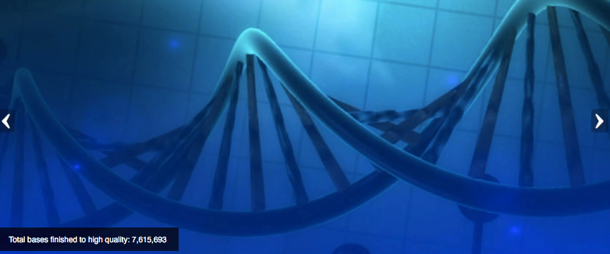
Integration of genomics into the undergraduate biology curriculum
Integration of research thinking into the academic year curriculum
Creation of dynamic student-scientist partnerships
Publication of research in genomics & in science education
Advantages of bioinformatics:
  Low laboratory costs (computers, internet connection)
  Web based tools (IT support, installation)
  No lab safety issues; open access 24/7
  Large pool of publically accessible raw data
  Lends itself to peer instruction
Currently >100 faculty from >100 colleges & universities; last year 70 schools claimed projects, >1000 students involved.
Goals:
Notes:
Started over 10 years ago, We realized from teaching a genoimcs researched based course some of the benefits of a research experience of this type
1. cost; 2. Safety; 3. data availabitly; 4. Acsessibilty (many web based tools)
Instructor: Professor Sarah CR Elgin
Slide: Faculty join by coming to a 1-week workshop at Wash U to learn software tools and approach.
Sources:
Talk specifically about each advantage and each goal –in particular the “no lab safety so lends peer instructio”
Notes:

Slide 4
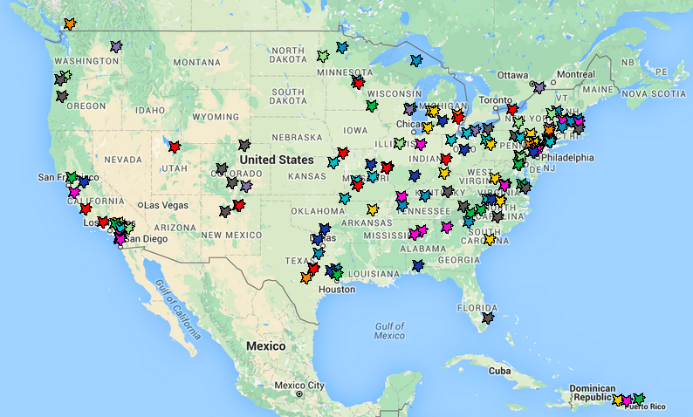

GEP Members 2016
2006
2007
2008
2009
2010
2011
Year joined:
2012
2013
2014
2015
2016

Slide 5
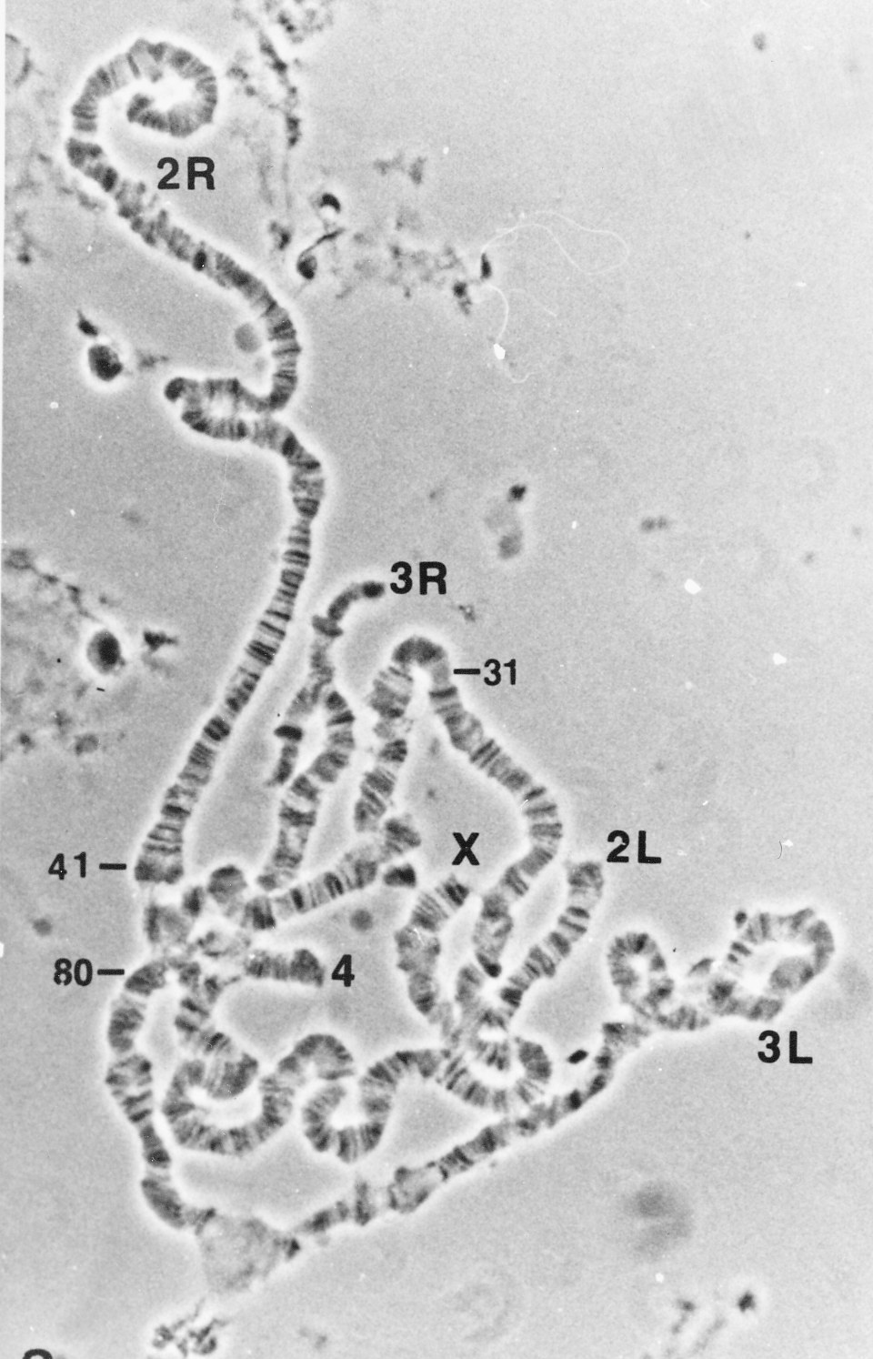
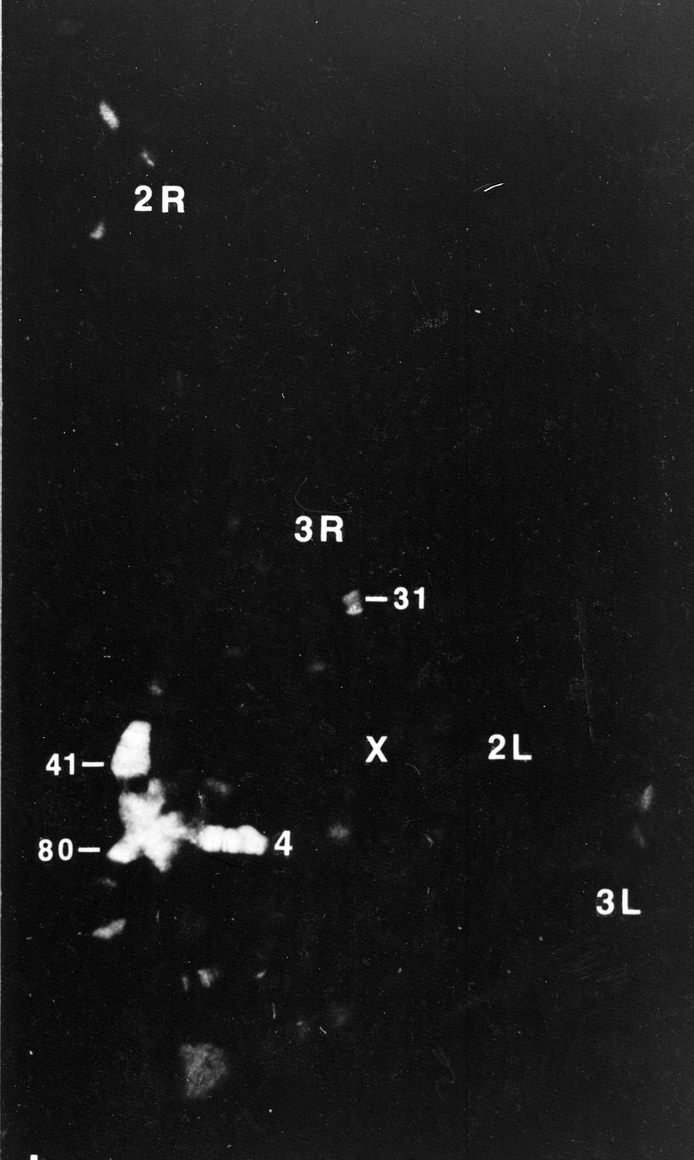
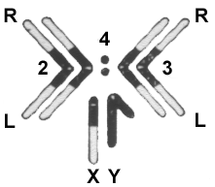
The Drosophila melanogaster fourth chromosome (F element) is largely heterochromatic (packaged with HP1a) but has ~80 genes
James et al, 1989, Europ J Cell Bio 50: 170
C
C
Phase
HP1
Notes:
To look for proteins preferentially associated with heterochromatin, we prepared monoclonal antibodies against proteins that bind tightly in the nucleus, and screened by using the antibodies for immunofluorescent staining of the polytene chromosomes. Heterochromatin Protein I (HP1) is preferentially associated with the chromocenter, small fourth chromosome, telomeres, and a few sites in the chromosome arms.

Slide 6
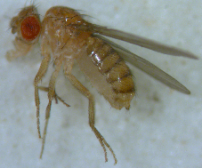
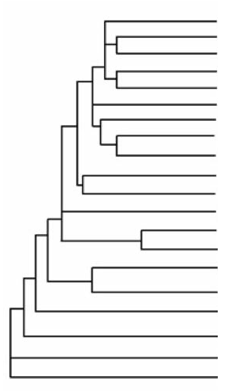
Drosophila comparative genomics: to understand the organization, evolution and gene function on the F element (dot chromosome)
D. melanogaster
D. simulans
D. sechellia
Reference
D. yakuba
D. erecta
D. ficusphila
Prior publication
D. eugracilis
D. biarmipes
Species in recent G3 publication
D. takahashii
D. elegans
D. rhopaloa
D. kikkawai
Ongoing annotation
D. bipectinata
D. ananassae
D. pseudoobscura
Manuscript in progress
D. persimilis
D. willistoni
New species sequenced by modENCODE
D. mojavensis
D. virilis
D. grimshawi
Phylogenetic tree produced by Thom Kaufman as part of the modENCODE project
Notes:
Anticipate that we will work on the remaining projects from the D. elegans F element and new projects from the D element this Fall.
Plan to have TSS only projects for D. biarmipes

Slide 7
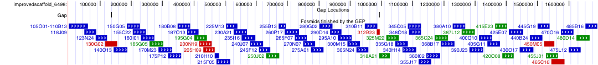
Strategy: divide and conquer!
The D. mojavensis dot chromosome
Students finished 68 projects
covered 1.7 Mb closing 26/28 gaps
added ~15,000 bp and improved ~5000 bp.
Fosmid sequence matches consensus sequence
Putative polymorphisms
Finished sequences are made publicly available;
annotations are linked to FlyBase.

Slide 8
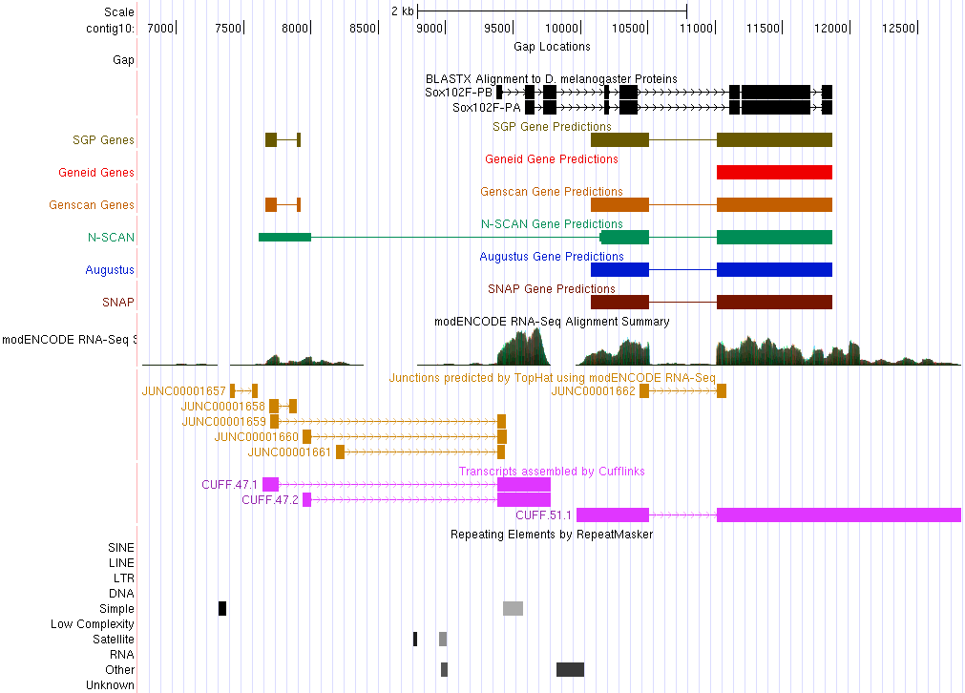
Annotation challenge: Create gene models from evidence: sequence similarity, computational predictions, RNA-Seq, etc.
(local UCSC Browser)
Improved Sequence
Sequence Homology
Gene Predictions
RNA-Seq, TopHat, Cufflinks
Repeats
Notes:
Browser allows us to map various evidence tracks against the improved genome sequence for a given species.

Slide 9
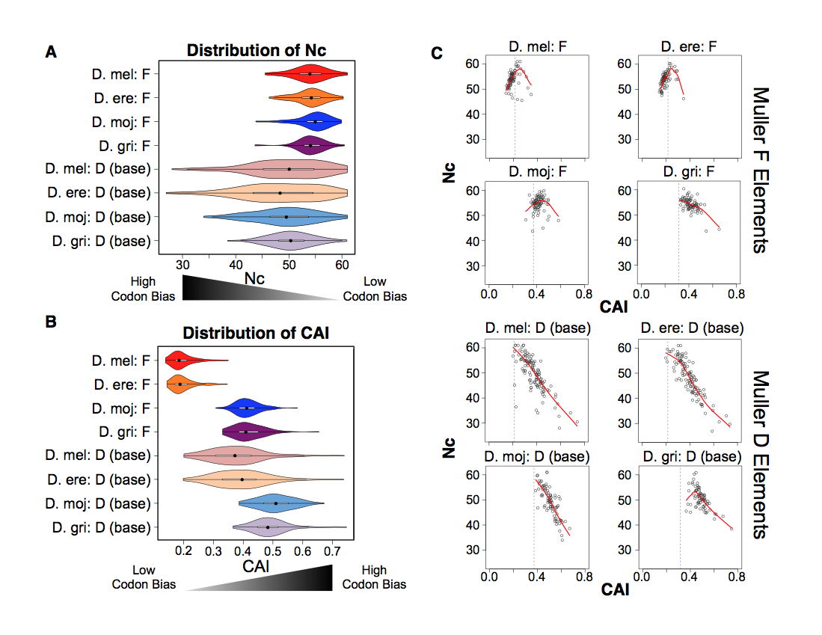
Pooling student data allows us to analyze patterns of evolution of different chromosome domains
Notes:
Simplify? Or figure two from paper? Or the hot spot

Slide 10
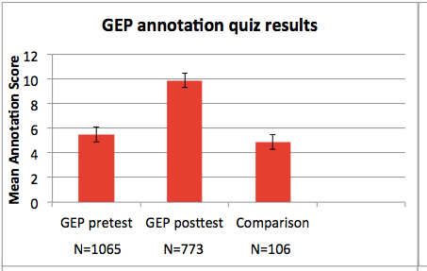
GEP annotation quiz results ’10 – ‘12
Notes:
Metric for measuring how much the students did learn through knowledge quizzes

Slide 11
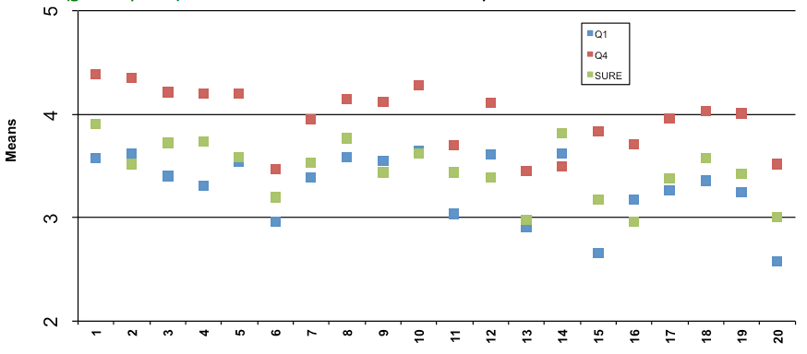
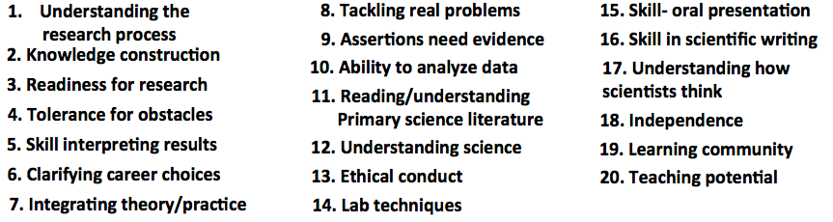
Survey results comparing ~10 hr course (blue) and
~45 hr course (red) with summer-in-the-lab (green)
.
GEP school
SURE 09 Bio
Notes:
Sample size: WU ~45, SURE 09 1200, soph lab 90, all GEP 350. Conclude that 1 semester is enough, 10 hr not enough. Instructors goal – use annotation to teach gene structure, any understanding of research is bonus!

Slide 12
Selected student quotes…..
The class was very intellectually challenging for me. It taught me to think in a way that I had never thought before.
The thing that sparked me the most was the fact that I was able to perform the BLAST searches on my own and was able to explain to my instructor what I had done.
It was a great team-building and learning experience. It was independent work, but you were going through the same things as the other students and built camaraderie.
I seriously think this should be the model for all biology courses.
Notes:
80% of the comments were positive, 20% were not
Initial frustration that were convinced by their own success

Slide 13
And…more comments from GEP students
I learned to fight through the frustration and eventually figure out the problem.
I guess we learned about genomics through doing the tasks…. it was sort of a self-teaching class….
Everything we gained from the class…was either found by desperately messing around on the various websites …or by talking with other students.
I know if I could survive this class then I could survive just about anything.

Slide 14
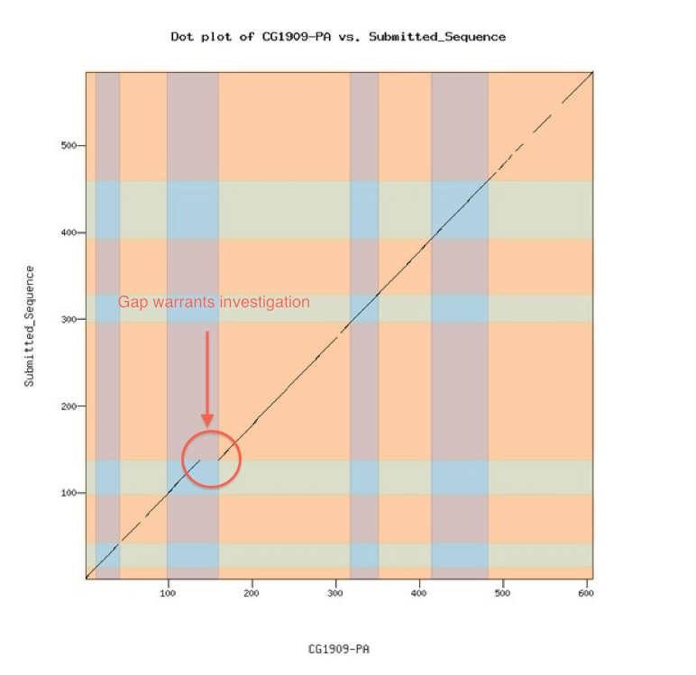
Can we reach more faculty and students?
Biggest need: generate a system making it easier to load a new genome into a browser, adding evidence tracks to facilitate annotation; now funded by NIH to work with Galaxy
Needs to include the ability to check work as you go
Designed to enable faculty to create their own projects, or work in their preferred model
organism
Will facilitate “satellite” groups, move to self-sustaining operation.
Gene Model Checker →

Slide 15
GEP / Galaxy Project: G-OnRamp
Partnership with Jeremy Goecks & Remi Marenco, George Washington University; WU, Wilson Leung & Yating Liu
Designed to work with eukaryotic genomes
Gene predictors: Augustus, GlimmerHMM, SNAP
Homology identification: tBlastN
Will display RNAseq data (HISAT/StringTie)
Galaxy tool: Hub Archive Creator, allows output to be viewed in UCSC Genome Browser.

Slide 16
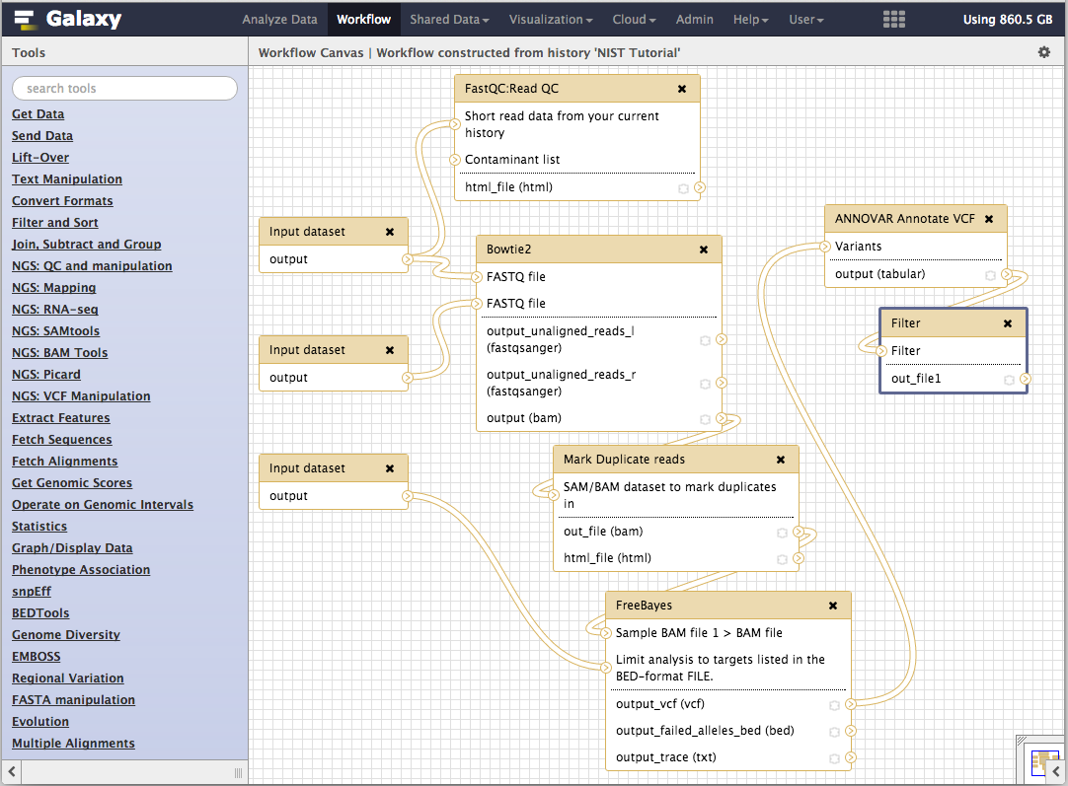
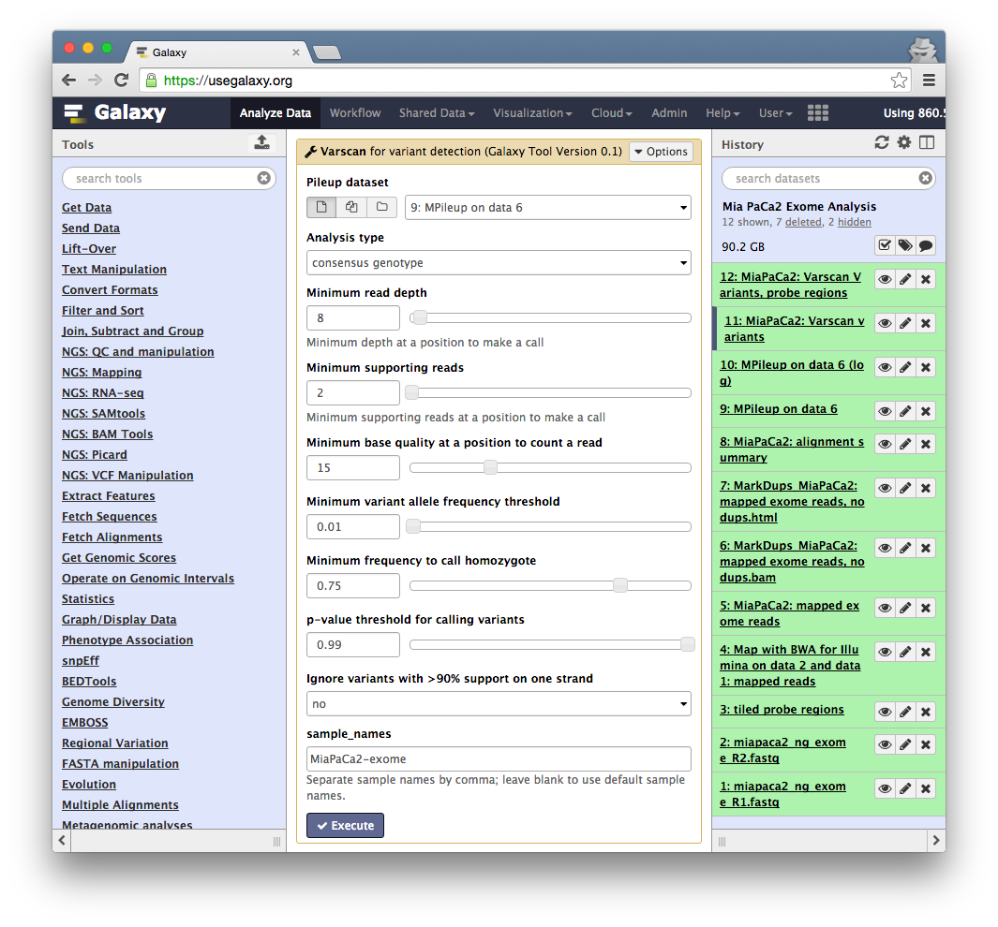
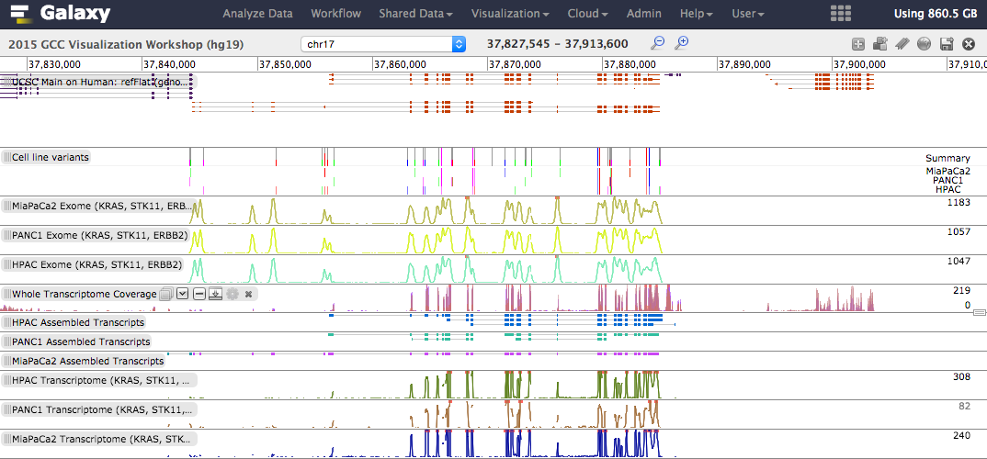
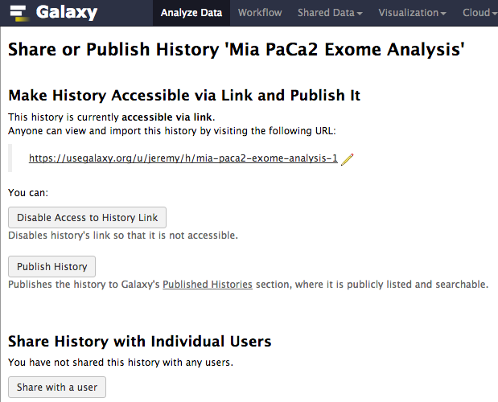
The Galaxy Project http://galaxyproject.org

Slide 17
Galaxy Project:
Fundamental Questions
When genomics (or any biomedical science) becomes dependent on computational methods, how to:
  make tools and workflows accessible to scientists?
  ensure that analyses are reproducible?
  enable transparent communication and reuse of analyses?

Slide 18
A free (for everyone) web service at
http://usegalaxy.org integrating a wealth of tools, compute resources, terabytes of reference data and permanent storage
Open source software that makes integrating your own tools and data and customizing for your own site simple
An open extensible platform for sharing tools, datatypes, workflows, ...

Slide 19
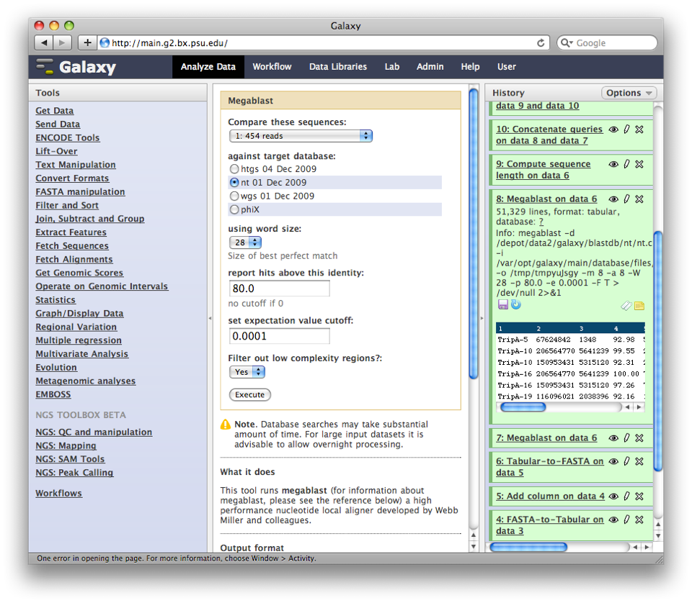
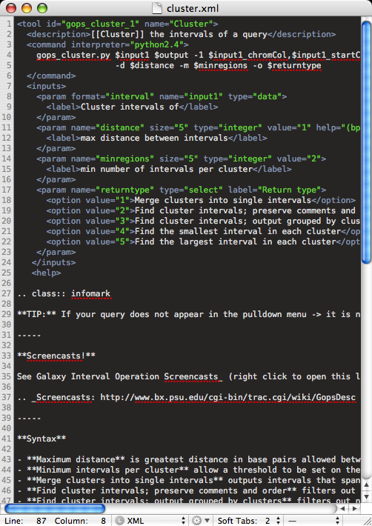
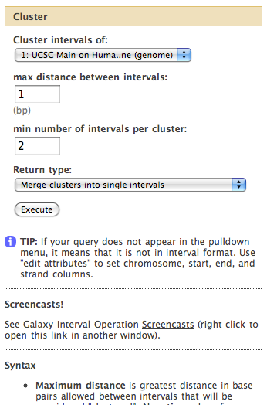
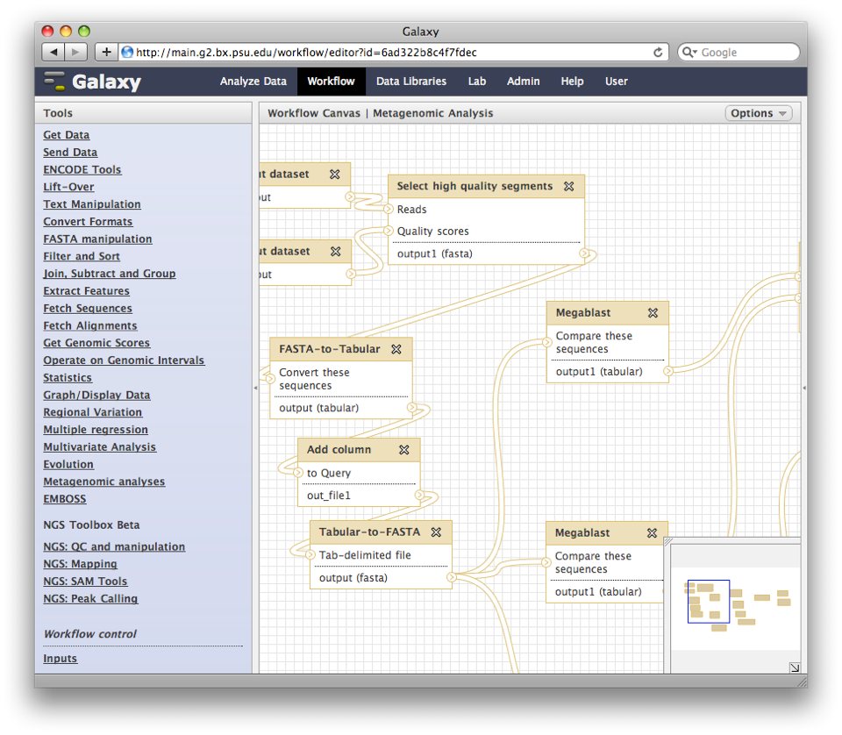
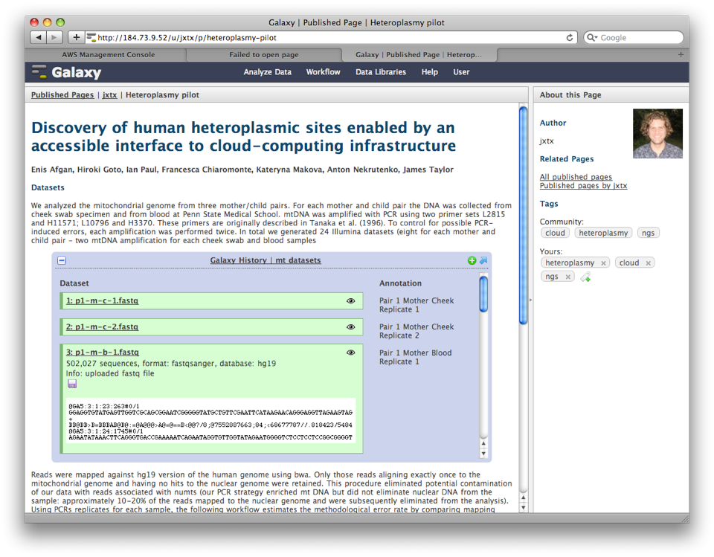
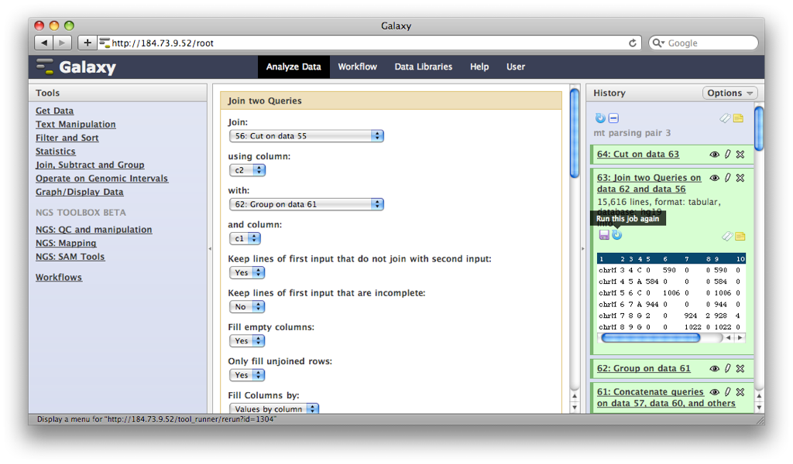
Describe analysis tool
behavior abstractly
Analysis environment automatically and transparently tracks details
Workflow system for complex analysis, constructed explicitly or automatically
Pervasive sharing, and publication
of documents with integrated analysis
Notes:
Bioinformatics research generates lots of useful little tools.
But, no incentive to make them robust, accessible to others, etc.
Can we make this easy enough that the incentive of tools being available in an integrated form outweighs and difficulty

Slide 20
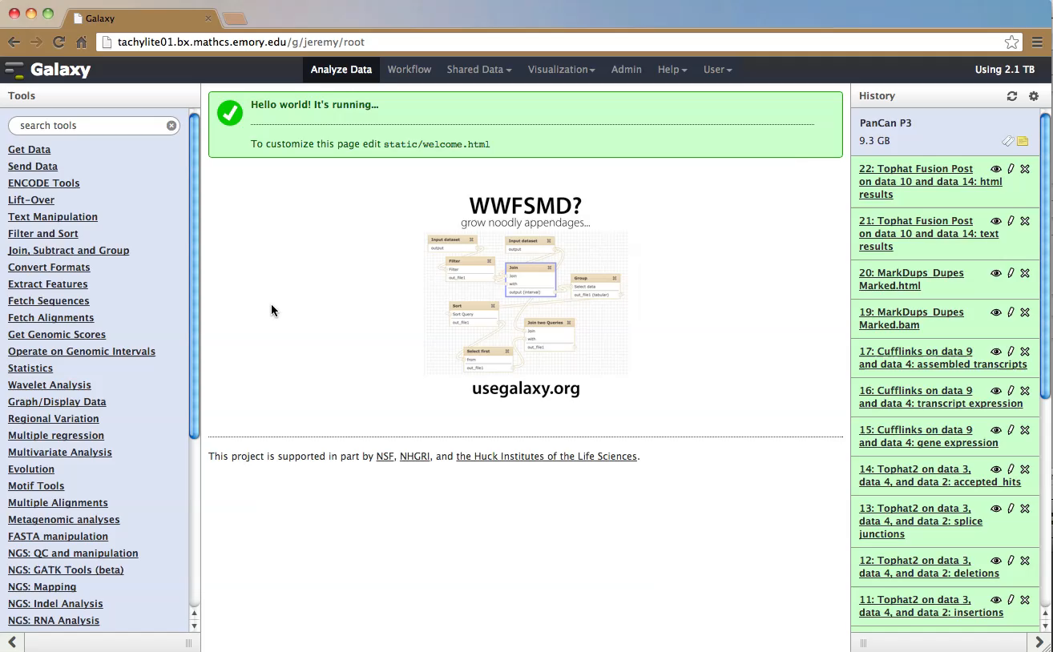
Galaxy Demo

Slide 21
Galaxy Usage
Cited in more than 3,000 publications
Main server at http://usegalaxy.org:
  ~500 new users per month, ~200 TB of user data, ~165,000 analysis jobs per month (http://bit.ly/gxystats)
80 public servers all over the world (http://bit.ly/gxyservers)
  15+ general servers, some supported by institutions
  Many domain-specific servers as well

Slide 22
Galaxy as a General Analysis Platform
For large-scale genome analysis, some type of platform is needed
Galaxy is for bioinformaticians too
  API for scripting and automation
  Devops (automated setup and administration) support
  Plug-in architecture: tools, visualizations, data sources, job engines, datatypes, and more…
Galaxy offers functionality and can connect Web users (e.g., biologists, clinical researchers), bioinformaticians, and system administrators

Slide 23
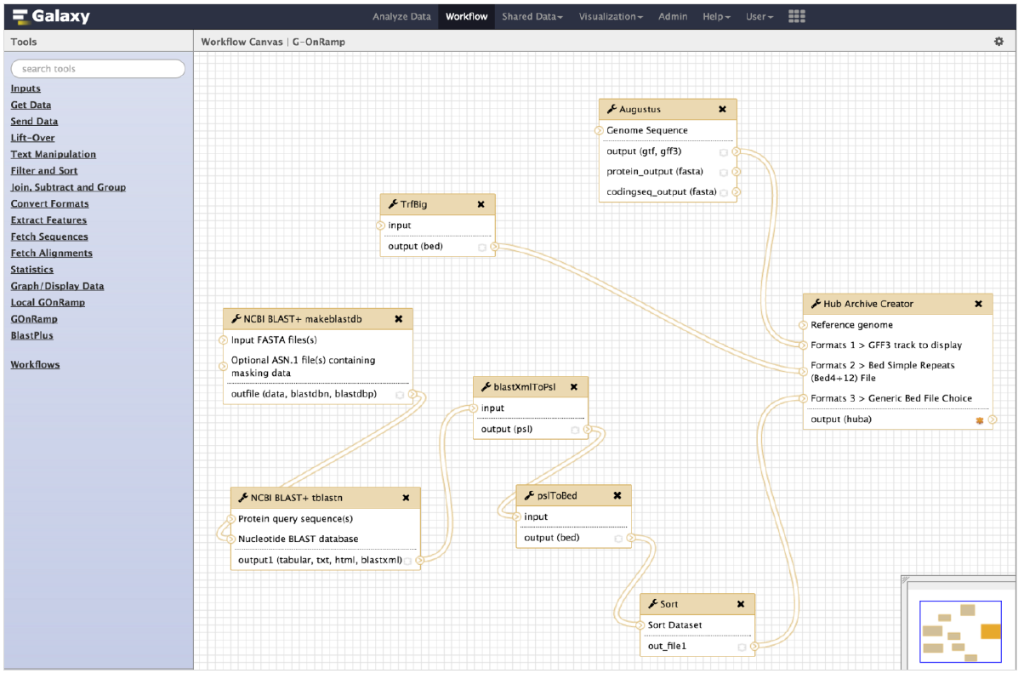
G-OnRamp Galaxy Workflow

Slide 24
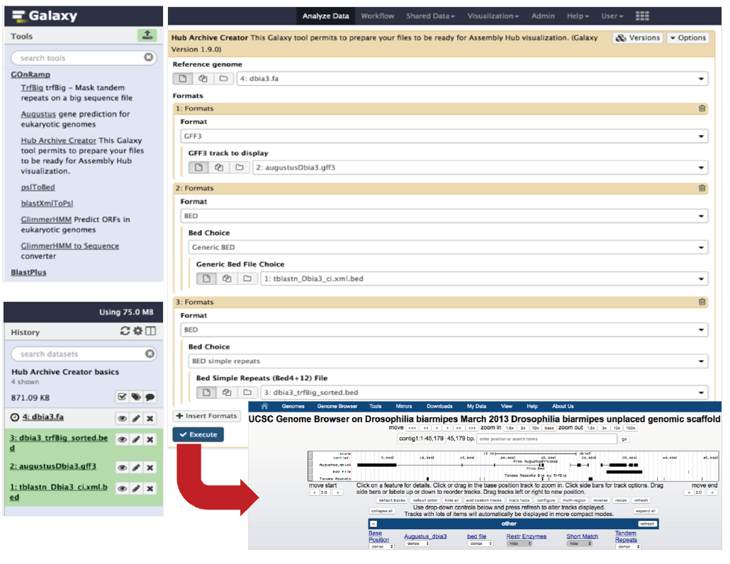
Executing the Workflow creates the browser

