Slide 1
Introduction to G-OnRamp
From Galaxy to Genome Annotation

Slide 2
Motivation for developing G-OnRamp
GEP has shown great success but there are some challenges:
  Limited to the analysis of different Drosophila species
  Limited flexibility to incorporate other analyses and data into the curriculum
  Collaboration is restricted to a central organization

Slide 3
GEP + Galaxy = G-OnRamp
G-OnRamp strengths:
  Any organisms
  Customizable workflows and analyses
  Automated installation and configuration of computational tools
  Web-based framework with built-in shared objects for collaboration

Slide 4
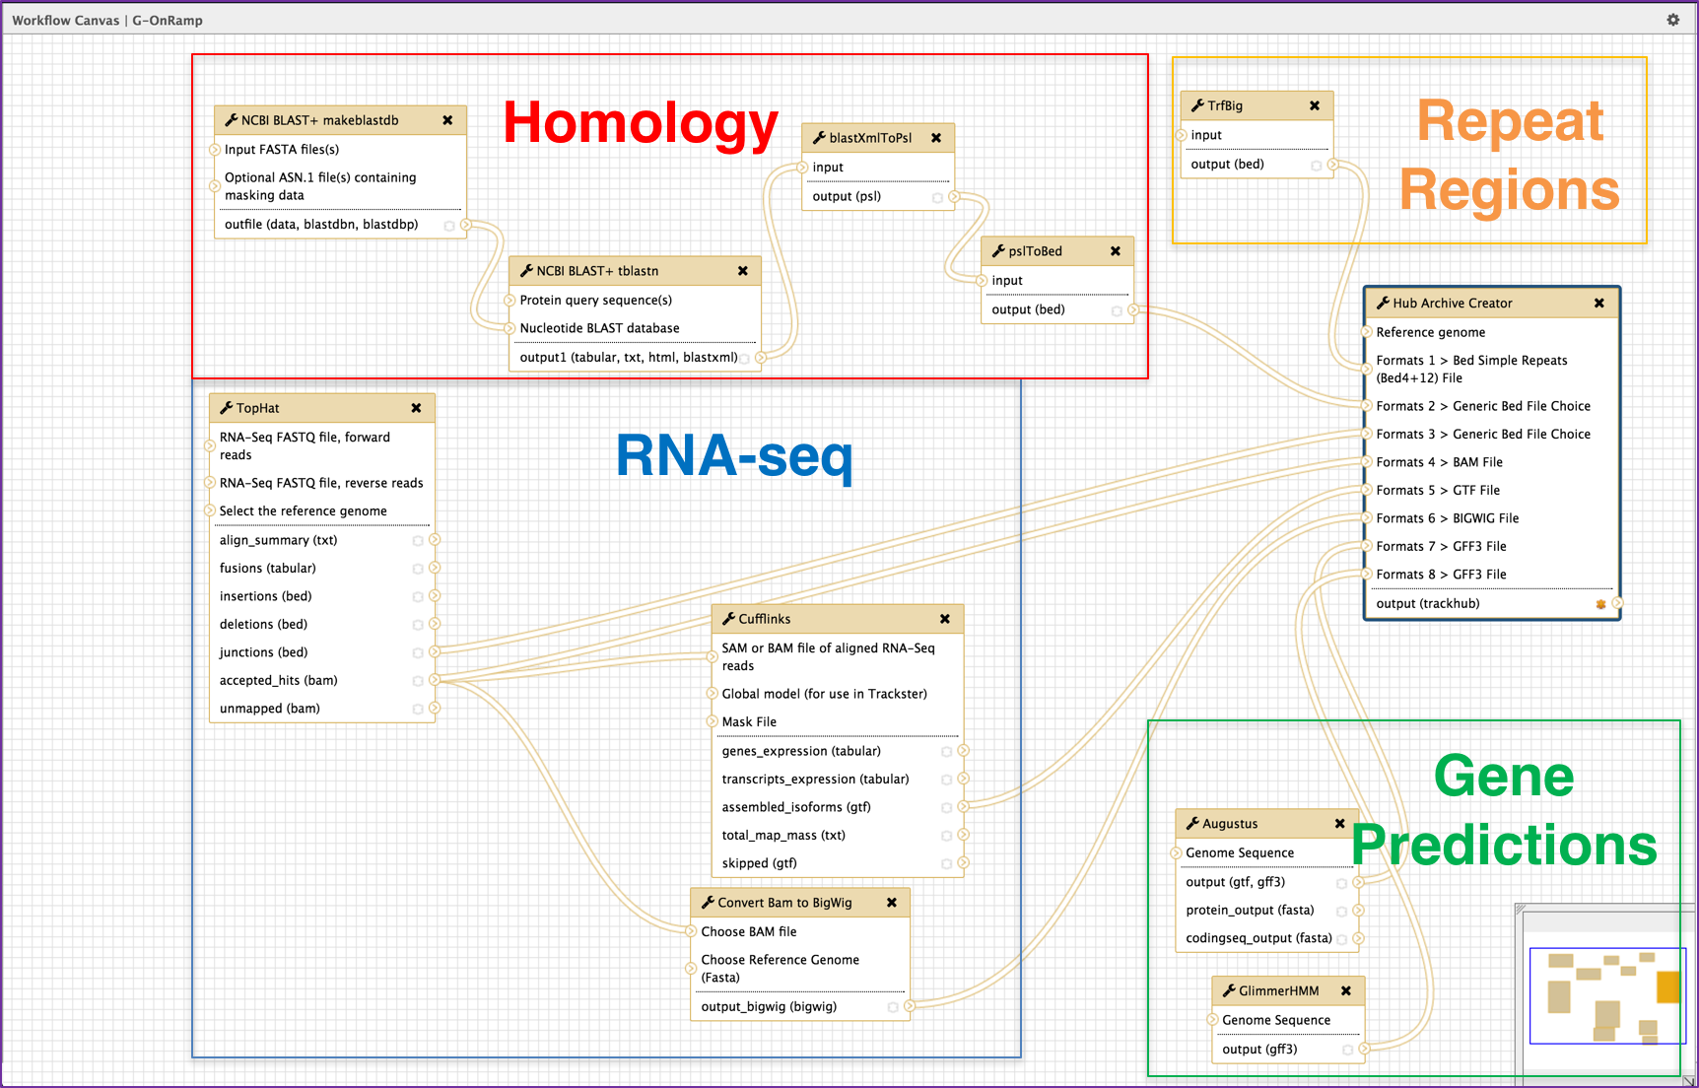
Fully customizable workflow

Slide 5
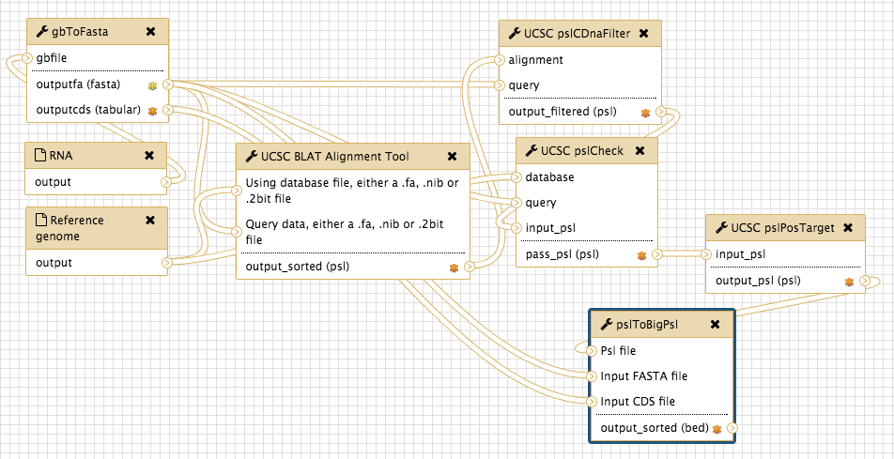
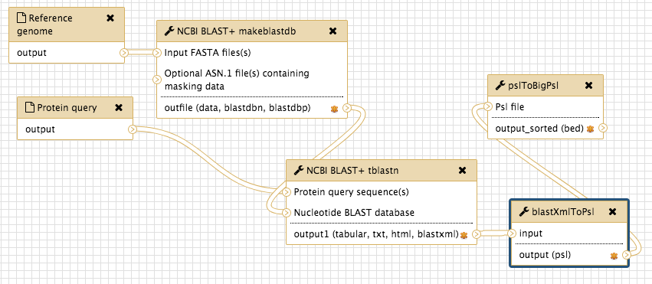
Sub-workflow: Homology

Slide 6
Sub-workflow: RNA-Seq

Slide 7
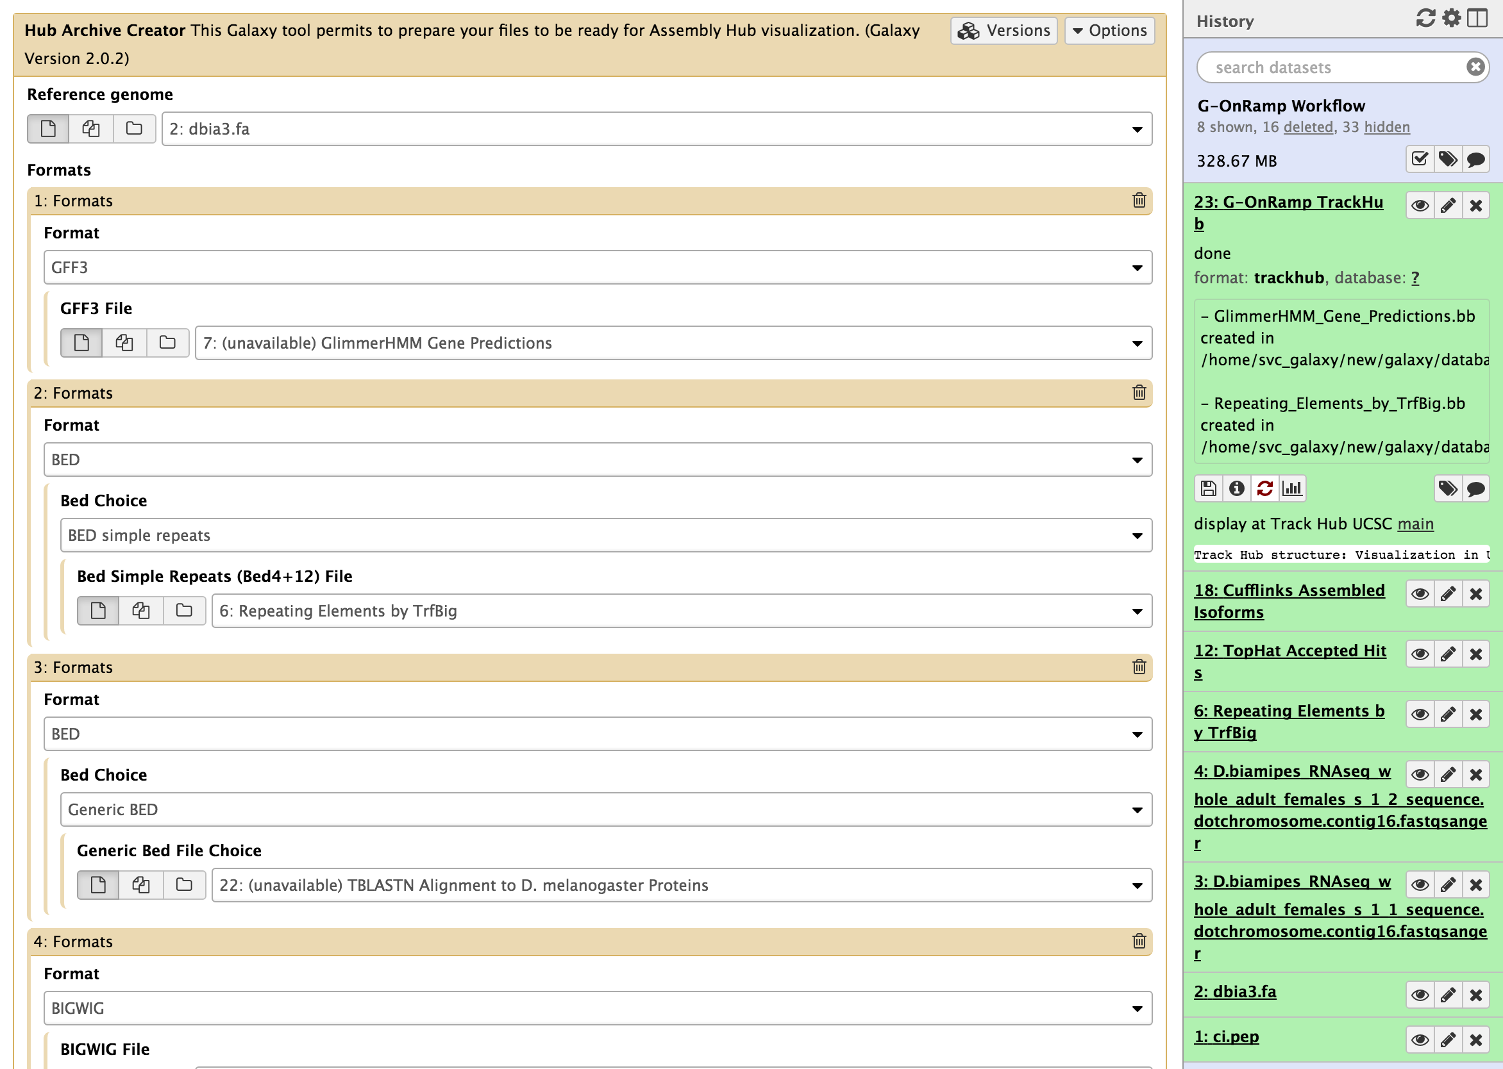
Tune parameters and Run!

Slide 8
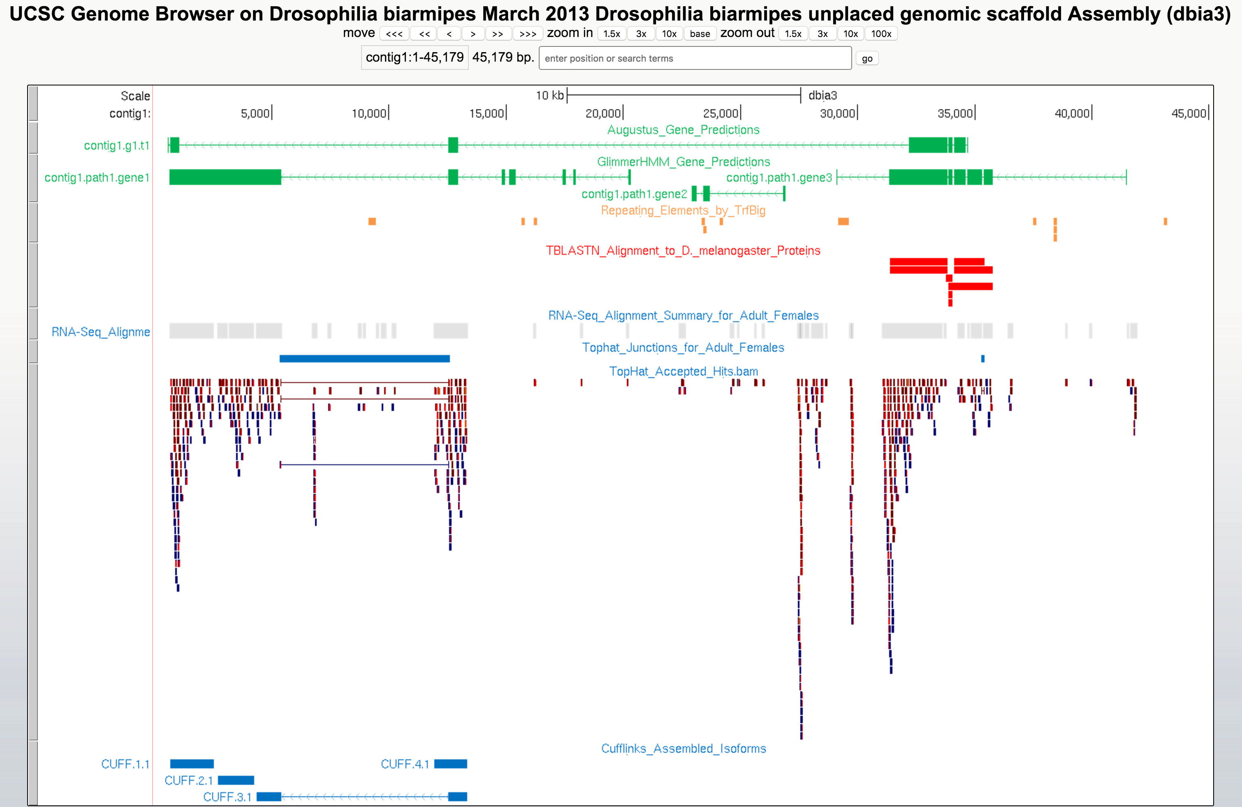
G-OnRamp to the UCSC Track Hub

Slide 9
G-OnRamp future
Extend workflow:
  ChIP-seq
  DNase-seq/ATAC-seq
  DNA methylation (bisulfite sequencing)
Incorporate integrated and interactive visualizations tools
Easy to install and use
Build for you, feedback welcome

Slide 10
Practice time!
Upload sample data
Import G-OnRamp workflow
Enjoy data at the UCSC Track Hub

Slide 11
Questions?

