Slide 1
Overview of Galaxy
G-OnRamp Workshop
Yating Liu, Rémi Marenco, Jeremy Goecks
07/2016

Slide 2
Outline
What is Galaxy?
Where can you run Galaxy?
The Galaxy team
Main Galaxy objects
Data analysis with Galaxy
Edit and reuse analysis workflows
Galaxy resources and community

Slide 3
What is Galaxy?
A Data integration and analysis platform that emphasizes accessibility, reproducibility, and transparency
http://galaxyproject.org
Notes:
Says everything!
Without the danger of specifically promising anything.

Slide 4
What is Galaxy?
Keith Bradnam's definition:
"A web-based platform that provides a simplified interface to many popular bioinformatics tools."
From
"13 Questions You May Have About Galaxy"
http://bit.ly/13questions
Notes:
A web-based platform that provides a simplified interface to many popular bioinformatics tools.

Slide 5
Where can you run Galaxy?
http://galaxyproject.org

Slide 6
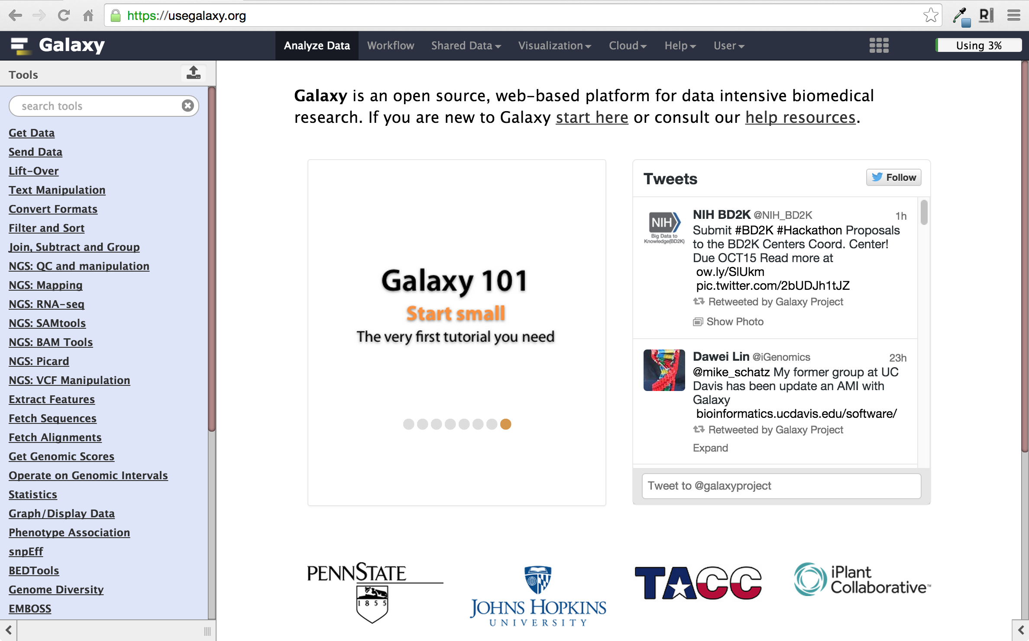
As a free for everyone service on the web: https://usegalaxy.org
Notes:
All of the screen shots we've seen are from usegalaxy.org, the galaxy project's public Galaxy server.

Slide 7


As a free for everyone service on the web: https://usegalaxy.org
A free (for everyone) web server integrating a wealth of tools, compute resources, petabytes of reference data and permanent storage
However, a centralized solution cannot support the different analysis needs of the entire world.

Slide 8

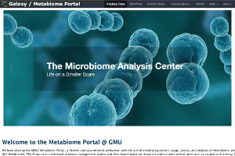

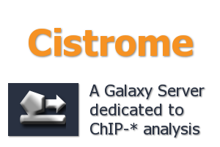





http://bit.ly/gxyServers
Notes:
UseGalaxy.org is not the only publicly accessible server.
There are over 80 of them.
RNA-Seq Portal was covered yesterday in this room
3 new ones were added last month

Slide 9
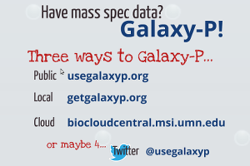
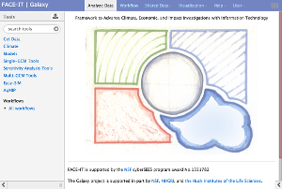
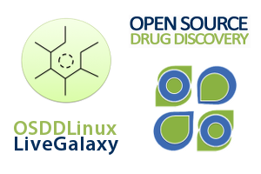
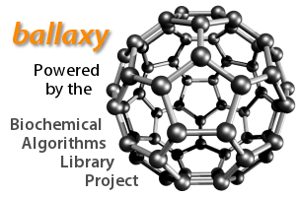
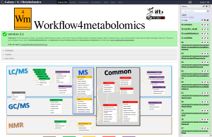

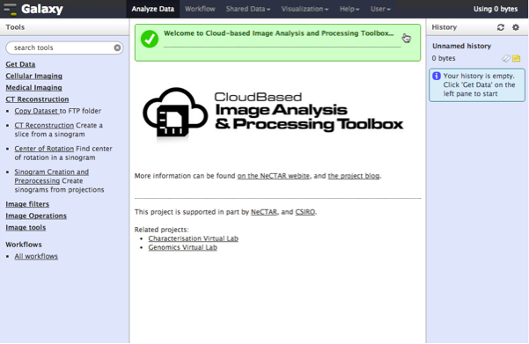

Proteomics
Metabolomics
Drug Discovery
Cosmology
Image Analysis
Climate Change Social Science
Natural Language
3000+ citations in scientific literature
Notes:
In fact Galaxy is used in all sorts of domains, some of them having nothing to do with life sciences.

Slide 10
Galaxy is available as Open Source Software
          Galaxy is installed in many locations around the world.
          http://getgalaxy.org

Slide 11




Galaxy is available on the Cloud
We are using this today
http://aws.amazon.com/education
http://globus.org/
http://wiki.galaxyproject.org/Cloud

Slide 12

Galaxy on the Cloud: Galaxy CloudMan
http://usegalaxy.org/cloud
Start with a fully configured and populated (tools and data) Galaxy instance.
Allows you to scale up and down your compute assets as needed.
Someone else manages the data center

Slide 13
Each Galaxy Instance/Server is Unique
Tools, datasets, histories, workflows, and user accounts exist on a particular instance/server
Can move many objects between servers, but not always easy (yet)
Not all G-OnRamp tools are available on main server or the cloud (yet)

Slide 14













The “Core” Galaxy Team
Engineering
Dannon Baker
Dan Blankenberg
Dave Bouvier
Nate Coraor
Enis Afgan
Martin Čech
Carl Eberhard
Sam Guerler
Nitesh Turaga
John Chilton
Support and outreach
Custodians
Dave Clements
Jennifer Jackson
James Taylor
Anton Nekrutenko
Jeremy Goecks
Supported by the NHGRI (HG005542, HG004909, HG005133, HG006620), NSF (DBI-0850103), Penn State University, Johns Hopkins University, The George Washington University, and the Pennsylvania Department of Public Health

Slide 15






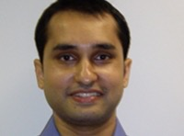

Extended team and other contributors…
Björn Grüning
Uni Freiburg
Peter Cock
TJHI
Kyle Ellrott
OHSU
Eric Rasche
CPT
Nicola Soranzo
TGAC
Brad Chapman
HSPH
Nuwan Goonasekera
VeRSI
Yousef Kowsar
VLSCI
And many others who have contributed to the main Galaxy code, tools to the ToolShed, participated in discussions, attended the Galaxy conferences, …

Slide 16
Primary Galaxy Objects
Datasets
  Obtained from web databases or produced by tools/workflows
Analysis Histories
  Record of tools used as well as inputs, intermediate, and output datasets
  Parameter settings used in each step
Workflows (Pipelines)
  Automated, multi-step analyses using several tools
  Tools and parameters selected for an analysis process but not the datasets
Pages
  Interactive research supplements that include text, figures, tables and embedded Galaxy objects
  Ideal for methods sections in publications and training materials

Slide 17
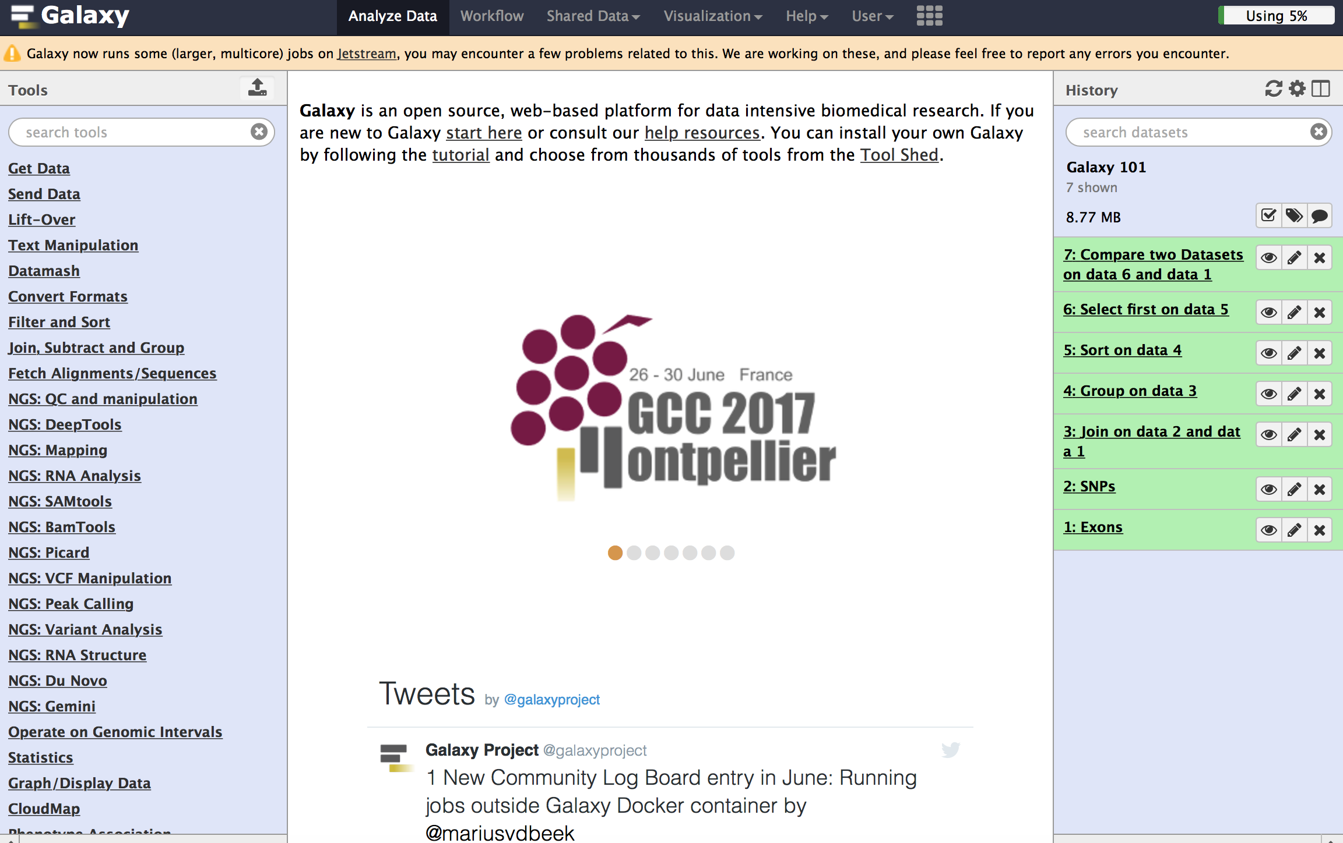
User Interface
Menu Bar
Tools
Workspace
History

Slide 18
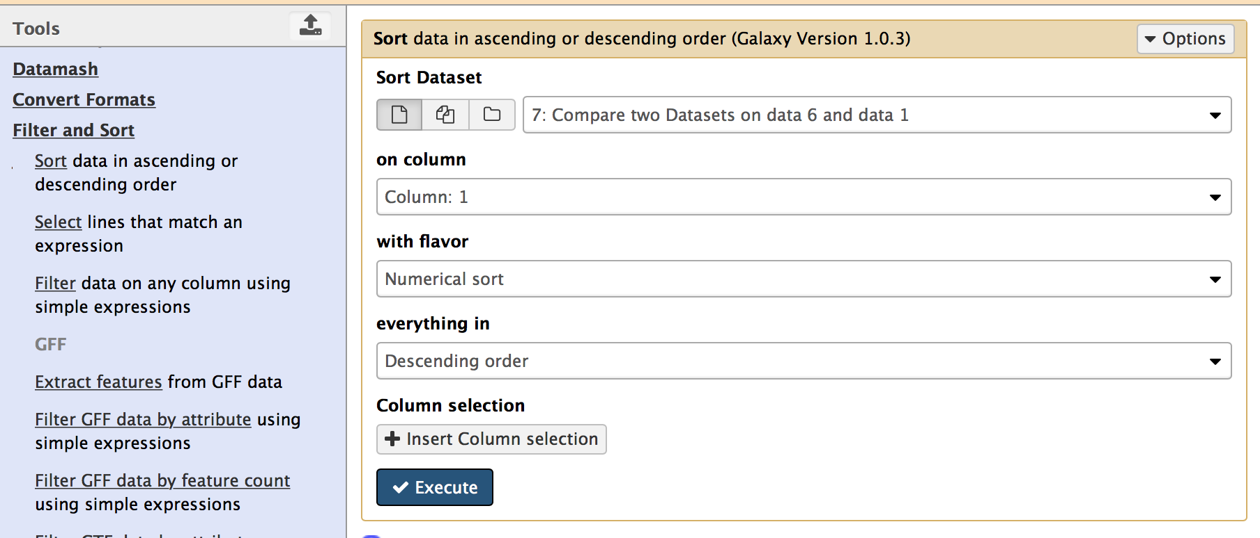
User Interface
Workspace for setting tools input datasets and parameters
Use a tool

Slide 19
Register and Login
Create an account with your email address
Login with your account
  Data quotas increased from 5 GB to 250 GB
  Access the full functionality of Galaxy
    create and edit workflows
    share and publish Galaxy objects

Slide 20
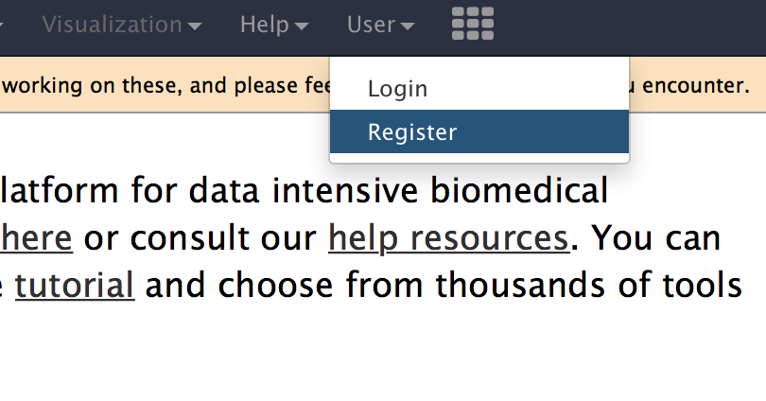
Create an Account
Click on the register link to create an account

Slide 21
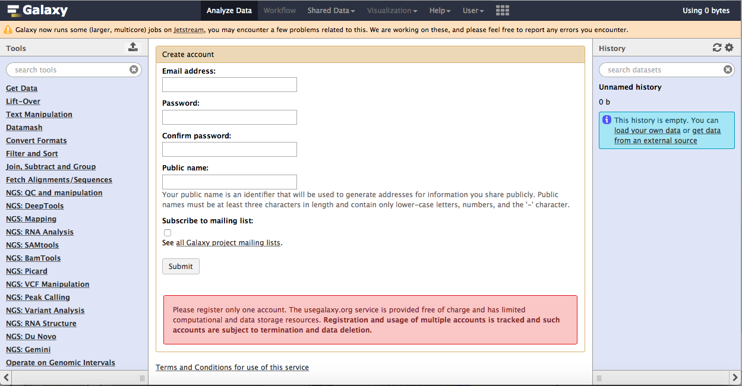
Create an Account
Enter your email address and password
Create your public name
Submit

Slide 22
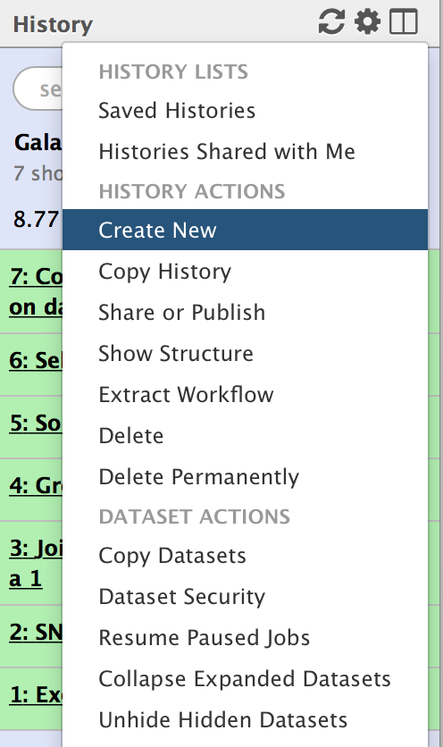
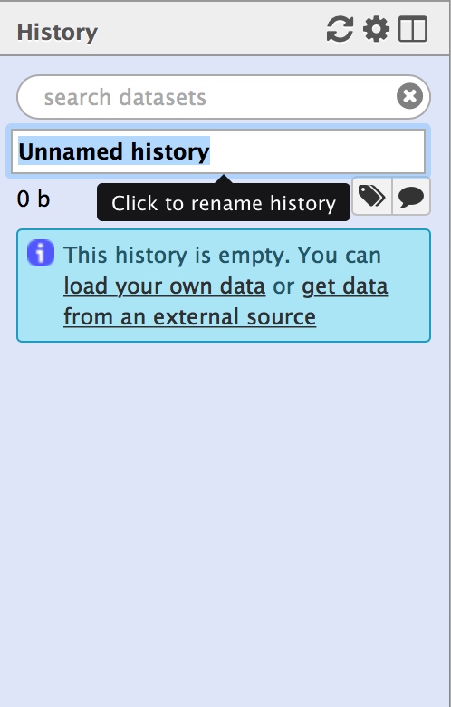
Create a new History
Click on the settings icon at the history panel
Create a new History

Slide 23
Get Data
Galaxy can import data from many data sources:
  UCSC Table Browser
  BioMart
  EBI SRA
    High-throughput sequencing data (fastq files)
  InterMine
    modMine, FlyMine, MouseMine
Upload file
  Choose local file (small size)
  Choose FTP file (large size)
  Paste/Fetch Data

Slide 24
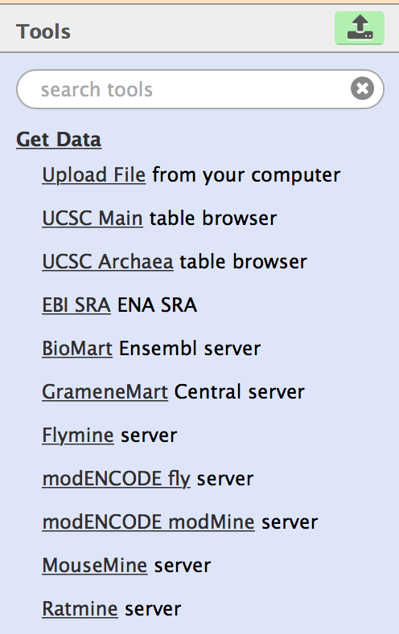
  Paste/Fetch Data

Slide 25
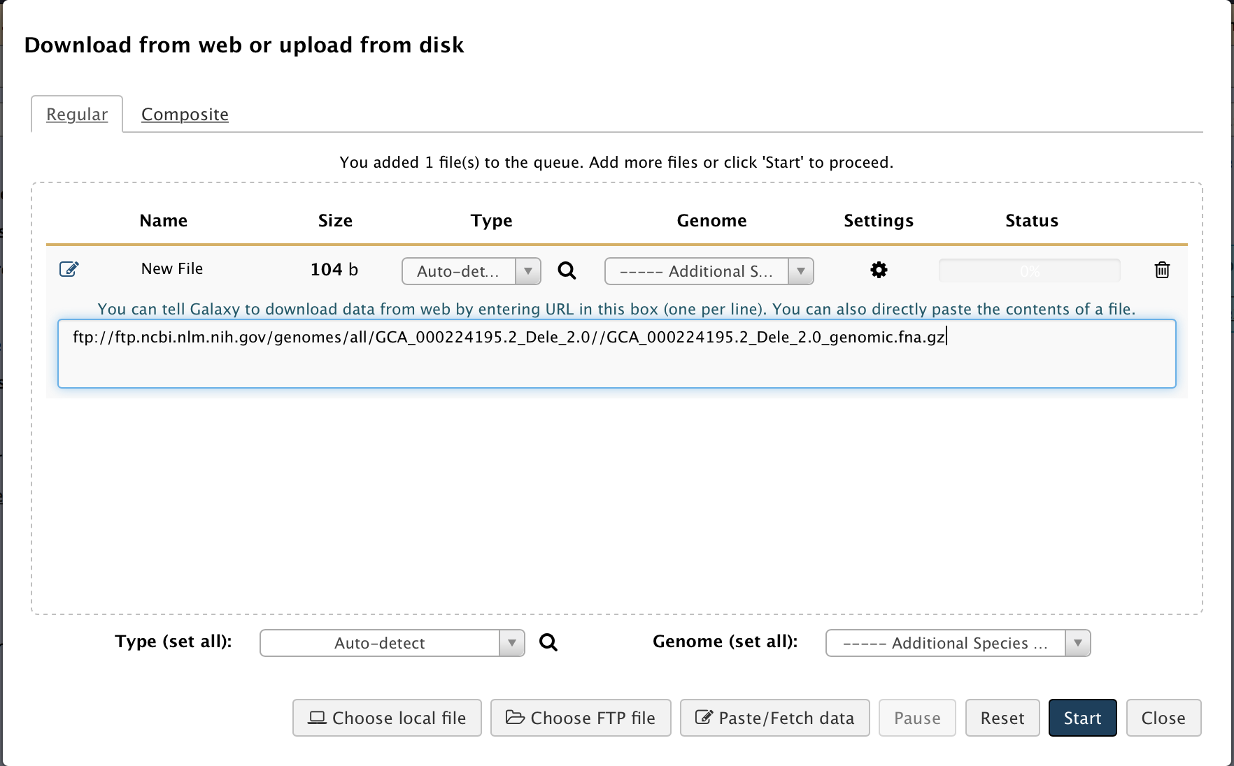
  Paste/Fetch Data
Copy and paste the content of a file
Or enter an URL into the textbox

Slide 26
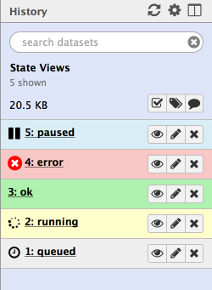
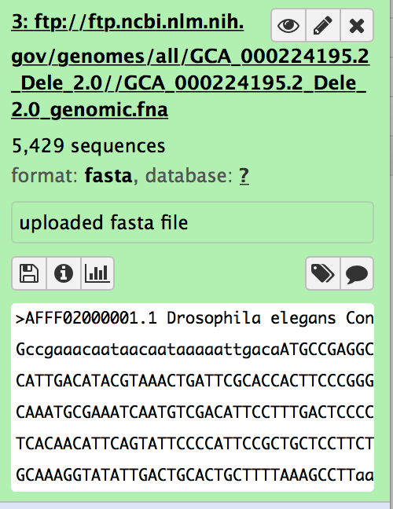
Key Features of the History Panel
Step number
Dataset name
Color denotes status of the workflow item
View
Edit
Delete
Save
Tag
Annotate
Visualize

Slide 27
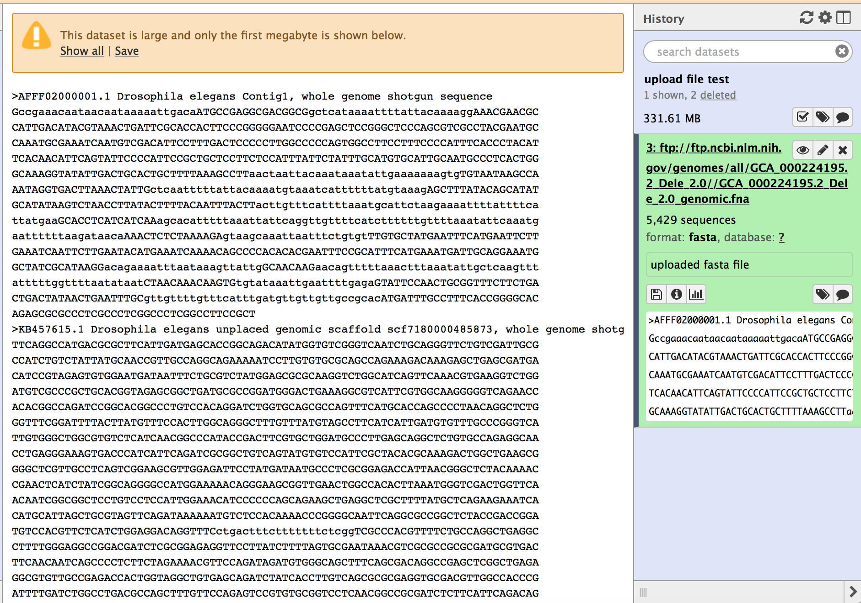
View the Dataset
Click on the header to see details
View the dataset in the workspace
Preview

Slide 28
Edit the Dataset Attributes
Click on the pencil icon to edit the dataset attributes

Slide 29
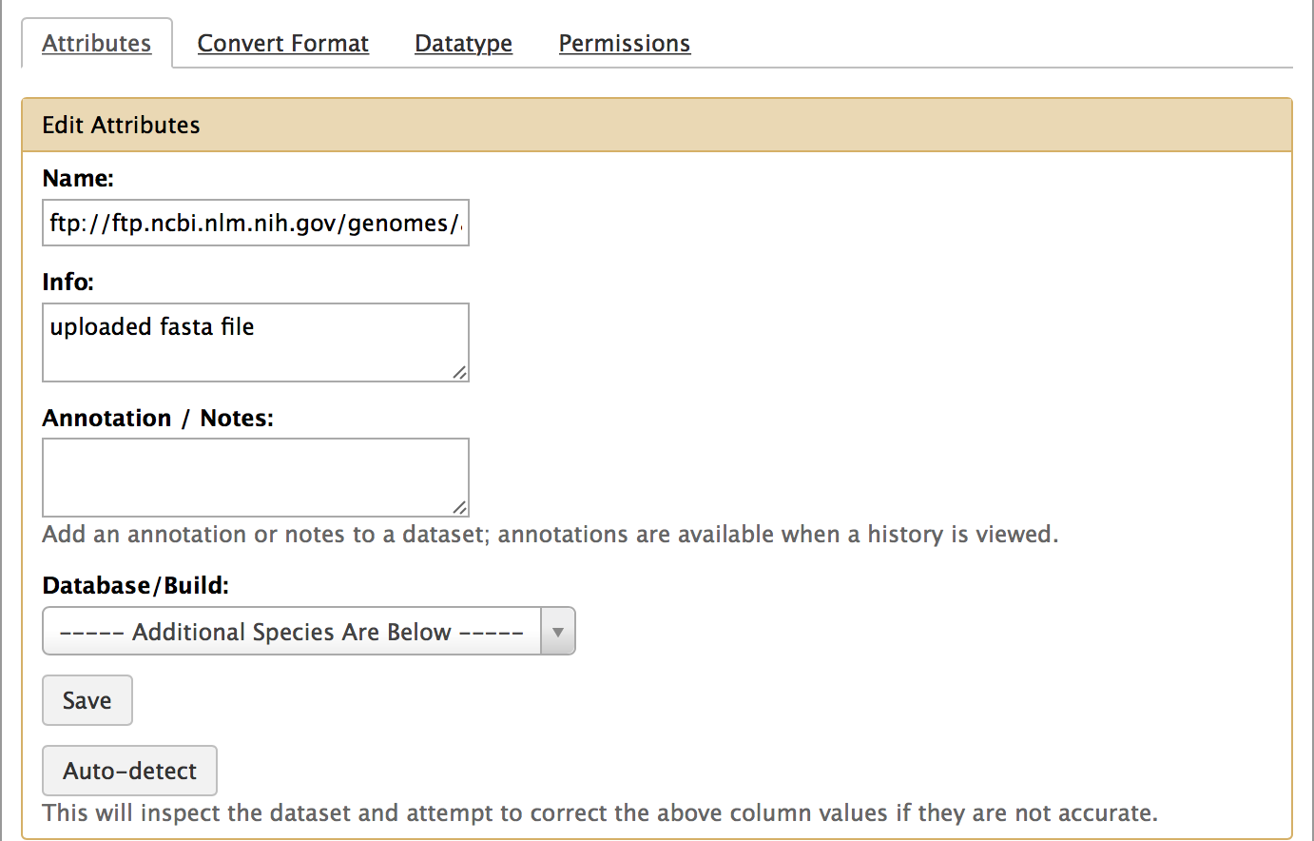
Edit Data Attributes
Change dataset name
Dataset description
Specify genome database and build
Remember to save before switching to a different tab

Slide 30
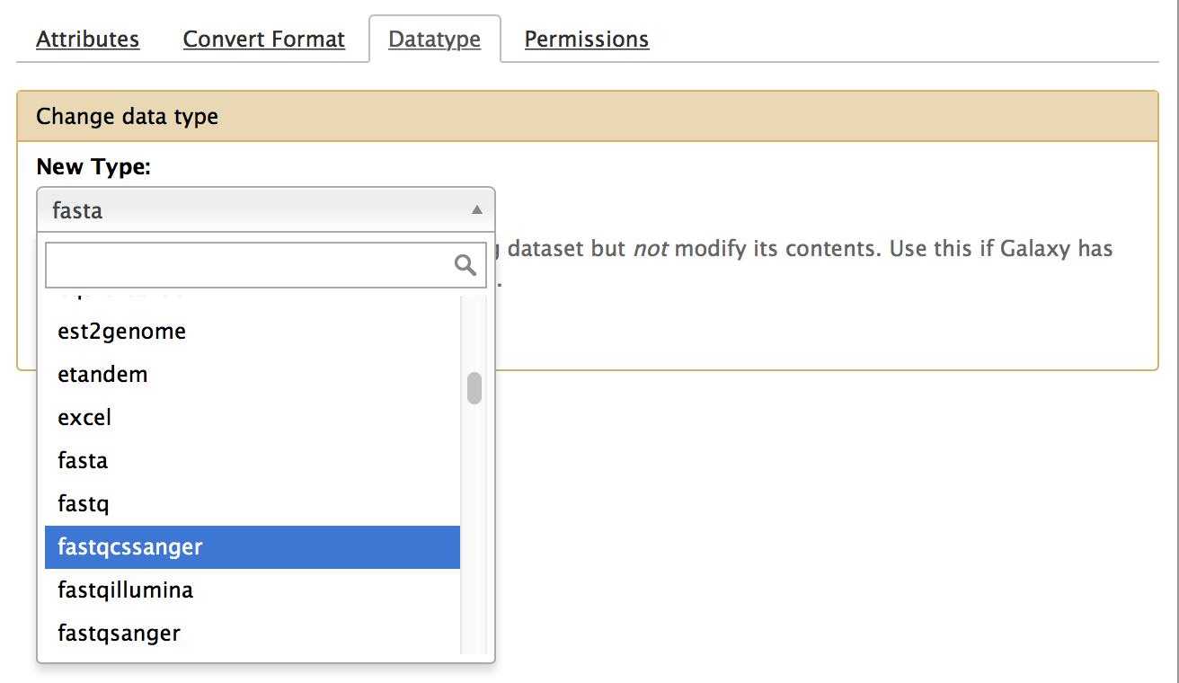
Edit Data Types
Switch to the datatype tab
Choose a datatype from the drop-down menu
Some tools will require a certain datatype
  e.g. change from “fastq” to “fastqsanger”
Editing the datatype does not convert the dataset to the new datatype

Slide 31
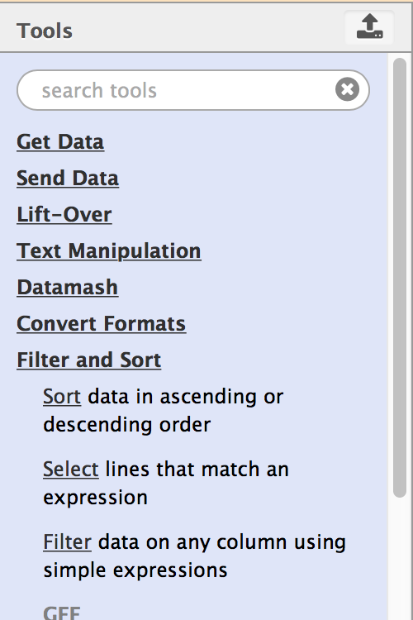
Search Tools
Enter the name of a tool or a search term
Click on the group header to expand each section

Slide 32
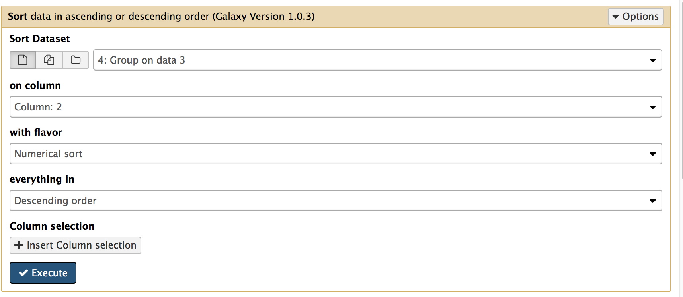
Tool Configuration and Execute
Select dataset
Set parameters
Run the tool
Each tool has a different set of parameters

Slide 33
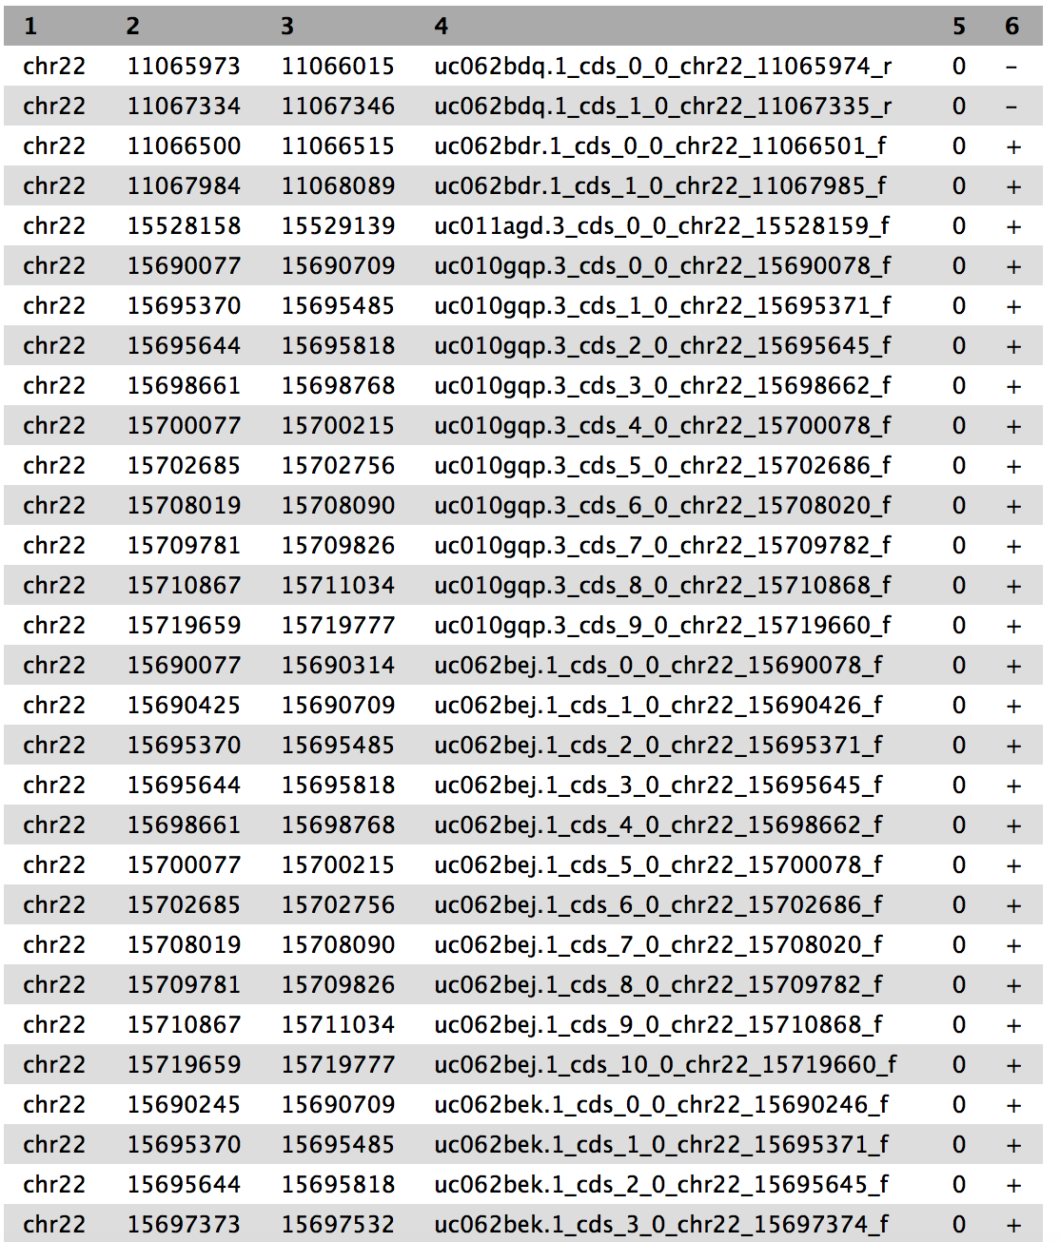
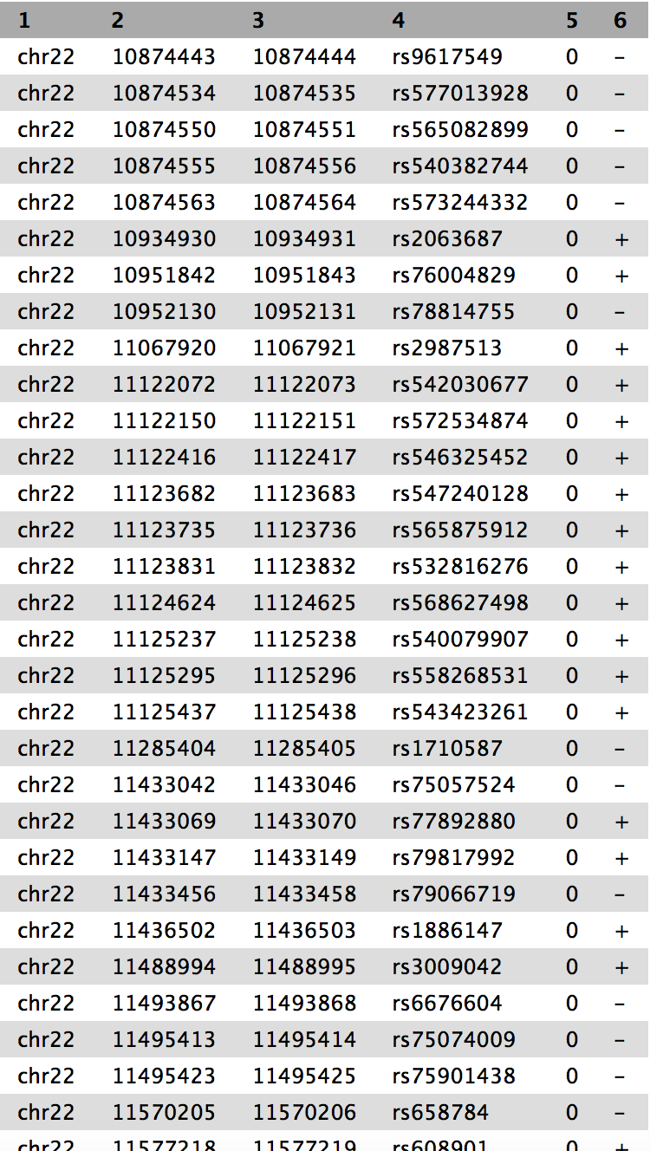
Galaxy 101: Find the top 5 exons with the highest number of SNPs
Exons: 14,859 regions
SNPs: ~200,000 regions
https://github.com/nekrut/galaxy/wiki/Galaxy101-1

Slide 34
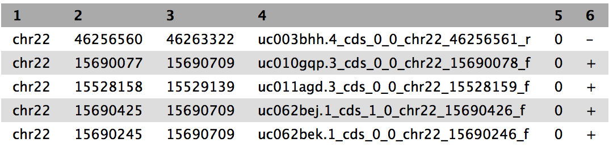
Solution from Galaxy
Exons
Join exons with SNPs
Group by exons
Sort exons by SNP count
Select top five exons
Recover exon info
SNPs

Slide 35
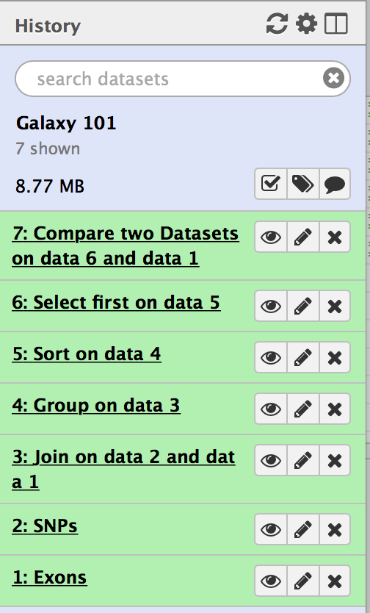
History of Galaxy 101
Input datasets: exons and SNPs
Intermediate datasets
Output dataset
Tools and parameter settings for each step

Slide 36
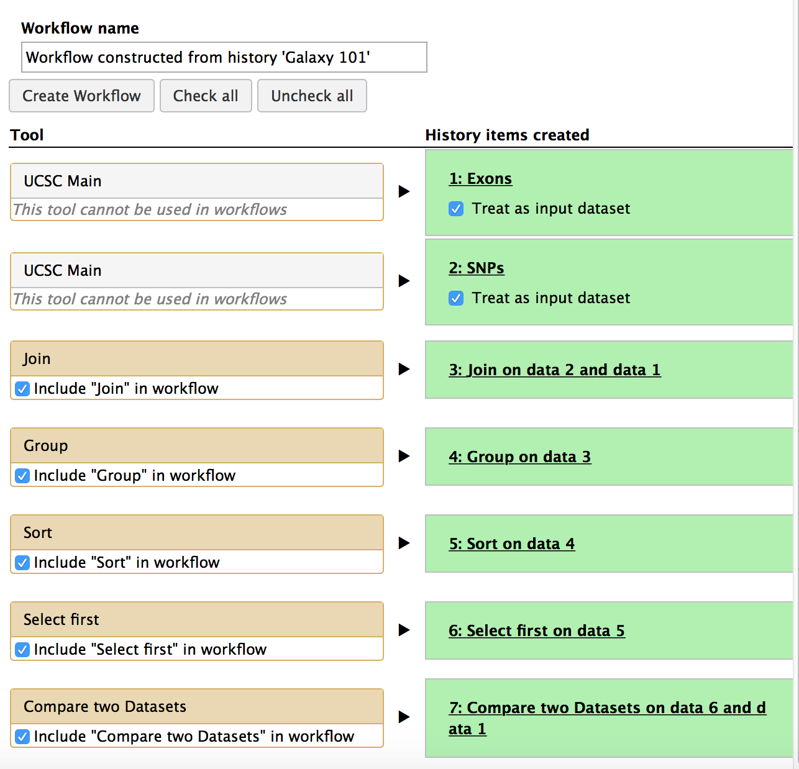
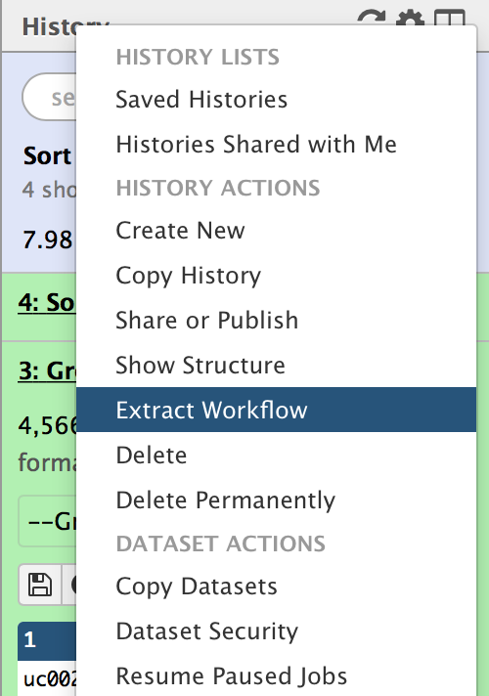
Extract Workflow
Edit workflow name
Create the workflow
Uncheck the tools you do not need
Record all steps of the analysis
Parameter settings used in each step
Extract to the workflow for running again with different datasets

Slide 37
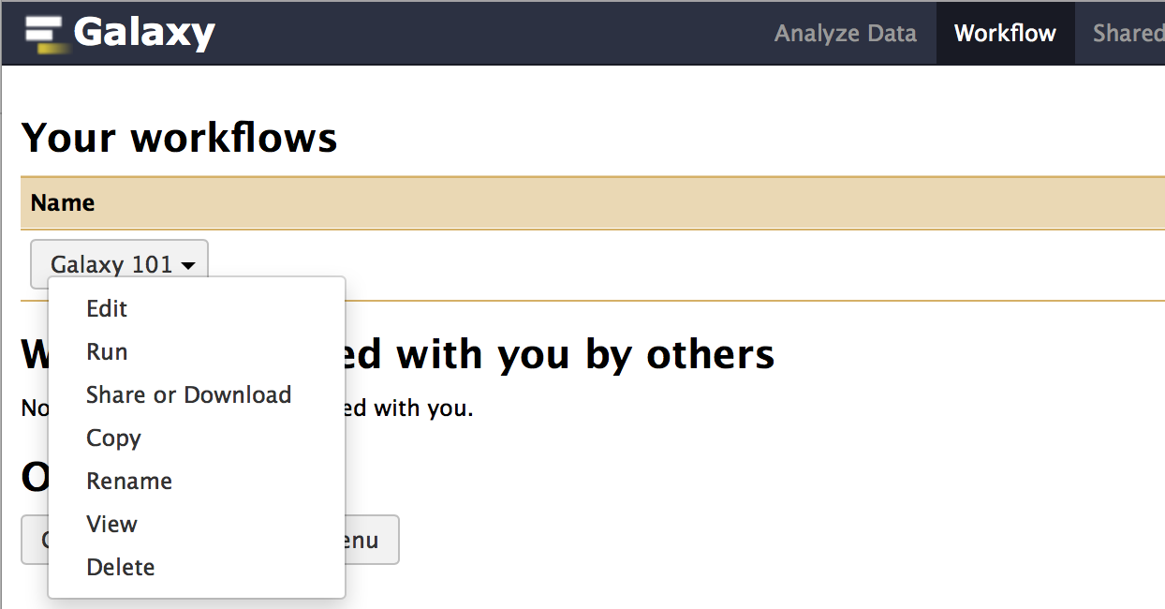
Edit Workflow
Access to workflows from menu bar
Edit the workflow using the workflow canvas
Run the workflow
Rename the workflow

Slide 38
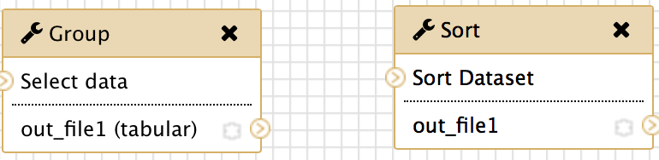
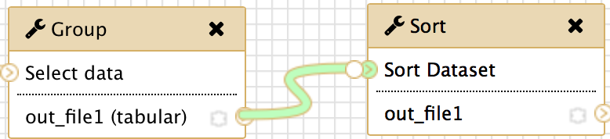
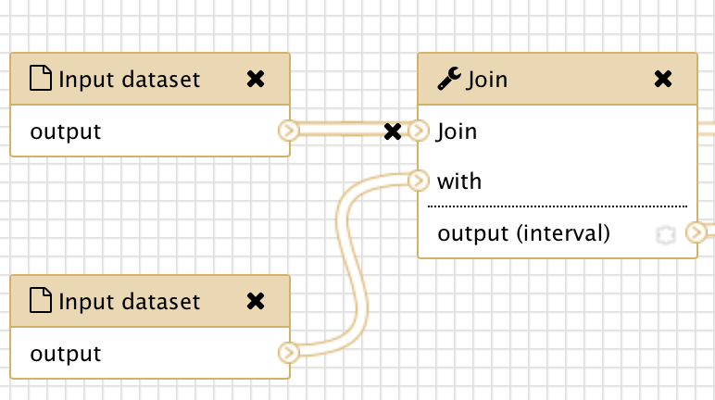
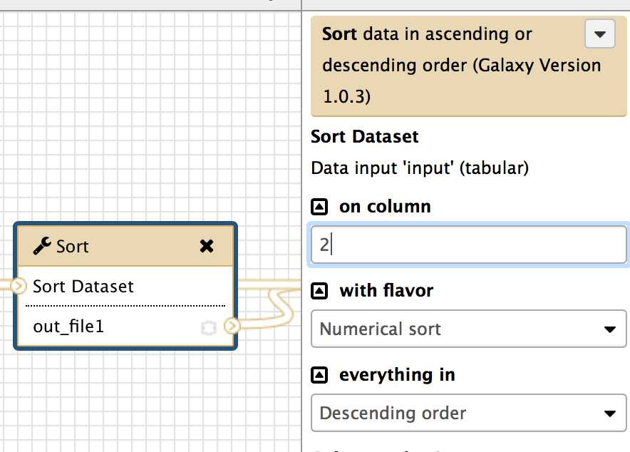
Edit the Workflow using the Workflow Canvas
Create a new connection by dragging from the output connection of one tool to the input connection of another tool
Delete a connection by clicking on the ‘x’ icon
Click on the tool to edit parameters

Slide 39
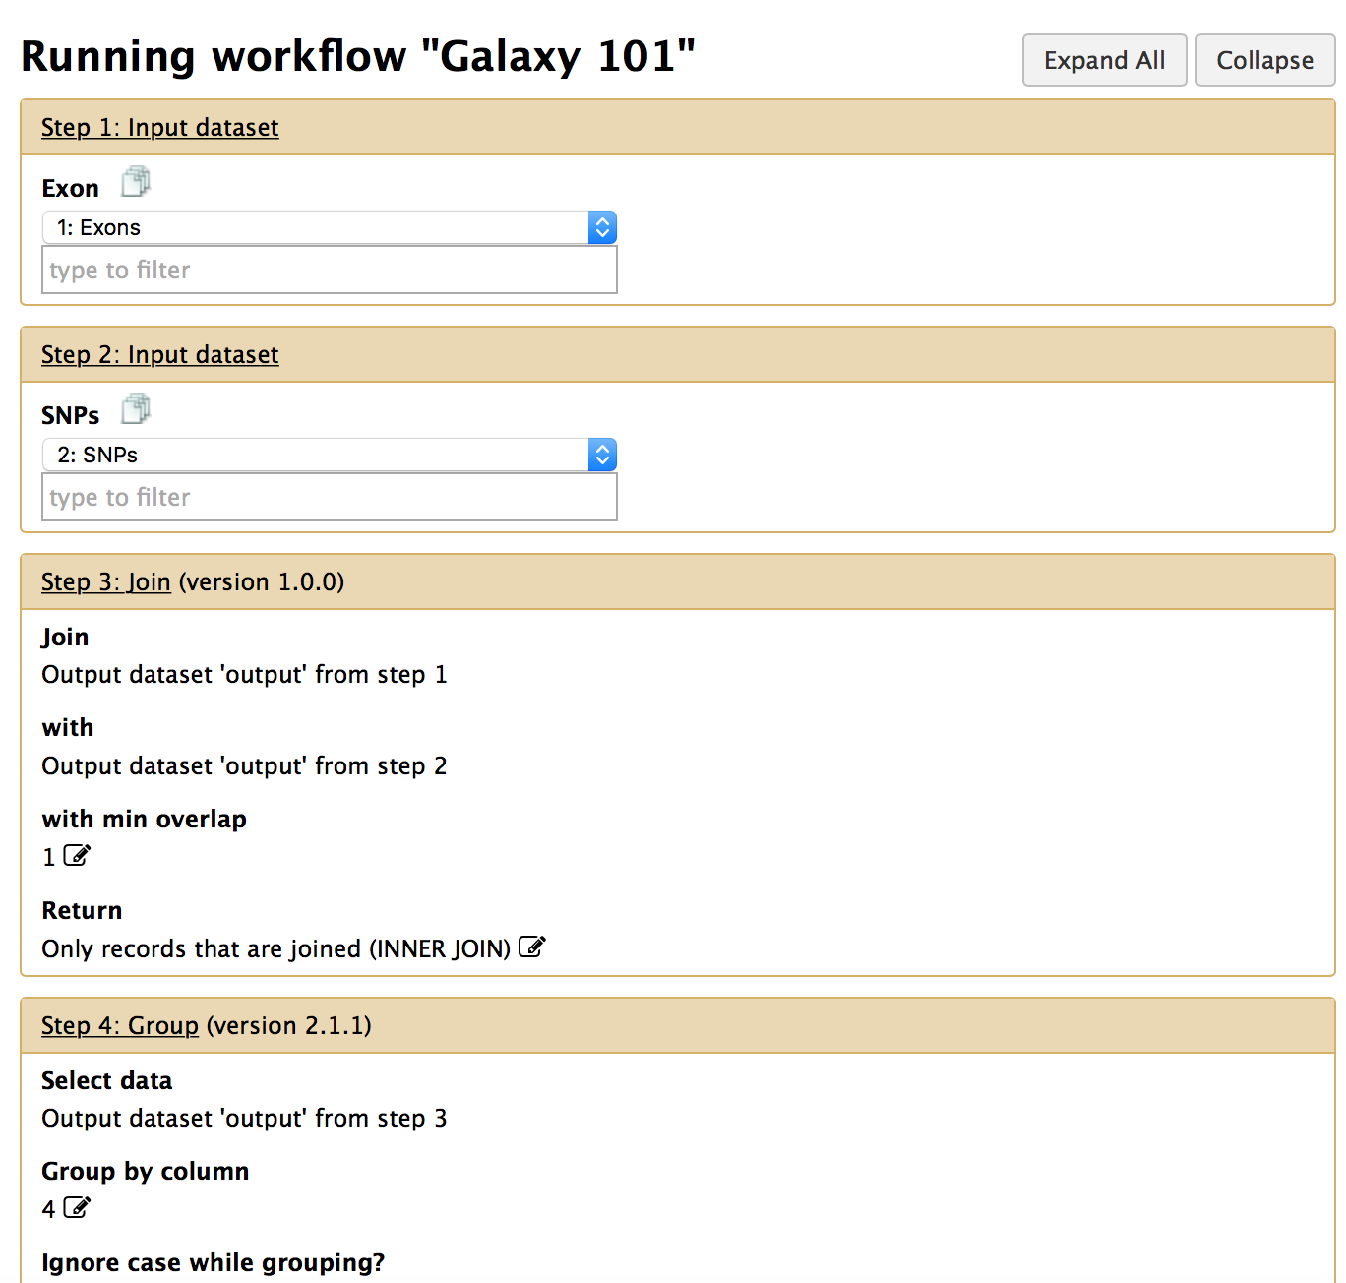
Run an existing workflow
Specify input datasets
Click on the header to expand each step
Click on the pencil icon to modify the parameters

Slide 40
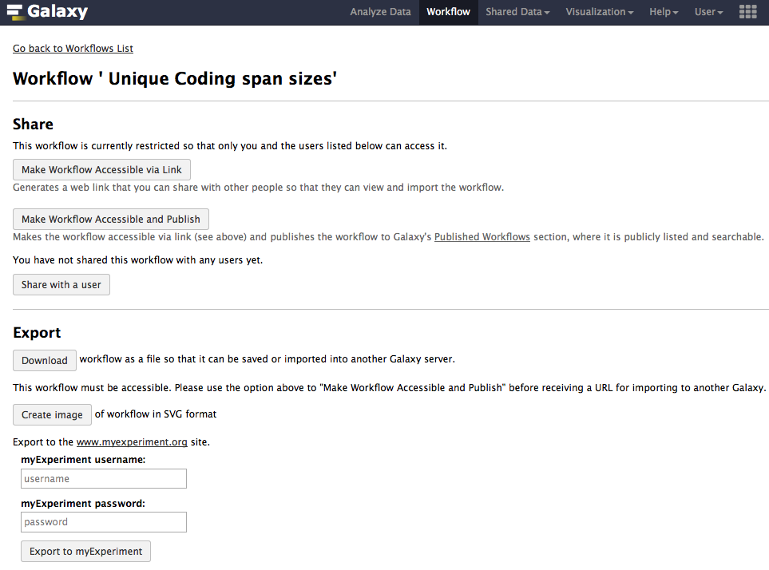
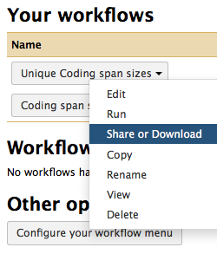
Share a workflow with others
Share workflow publicly or with another user
Publish a workflow
Export to another Galaxy server or to myExperiment

Slide 41
Workflows: Sweet spots
Short, well-defined tasks, with well-defined inputs and outputs
Analysis pipelines for large experiments with many samples where sample and data preparation protocols are the same throughout

Slide 42
Galaxy Resources and Community
Mailing Lists (very active)
Unified Search
Issues Board
Events Calendar, News Feed
Community Wiki
GalaxyAdmins
Screencasts
Tool Shed
Public Installs
CiteULike group, Mendeley mirror
Annual Community Meting
http://wiki.galaxyproject.org

Slide 43

Galaxy Community Resources: Galaxy Biostar
Tens of thousands of users leads to a lot of questions
Absolutely have to encourage community support
Project traditionally used mailing list
Moved the user support list to Galaxy Biostar, an online forum, that uses the Biostar platform
https://biostar.usegalaxy.org/

Slide 44
Galaxy Community Resources: Mailing Lists
Galaxy-Dev
  Questions about developing for and deploying Galaxy
  High volume (2336 posts in 2015, 1000+ members)
Galaxy-Announce
  Project announcements, low volume, moderated
  Low volume (36 posts in 2015, 6500+ members)
Also Galaxy-UK, -France, -Proteomics, -Training, ...
http://wiki.galaxyproject.org/MailingLists

Slide 45
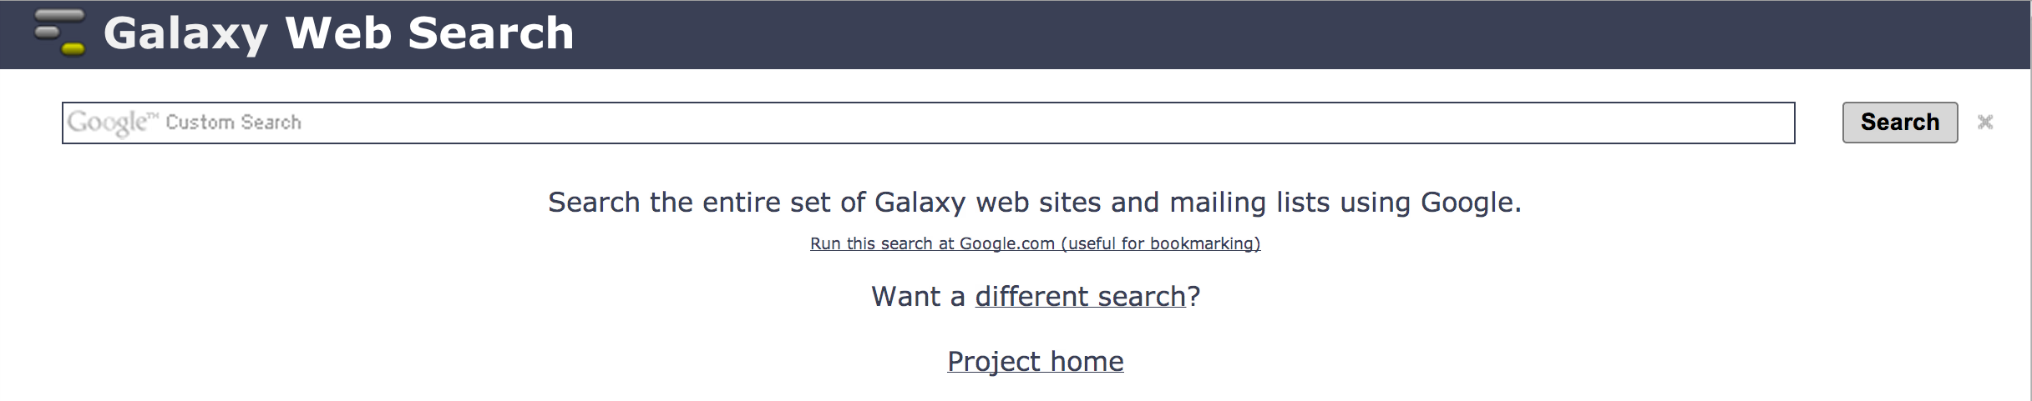
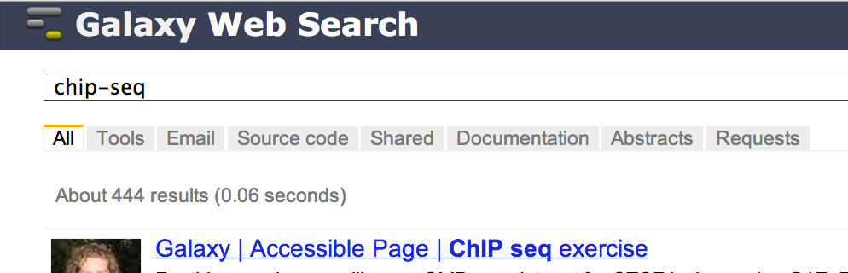
Unified Search: http://galaxyproject.org/search
Find
Everything on …
Tools for …
Email about …
Source code for …
Published Histories, Pages, Workflows, about …
Related feature requests
Papers using Galaxy for …
Documentation on …

Slide 46
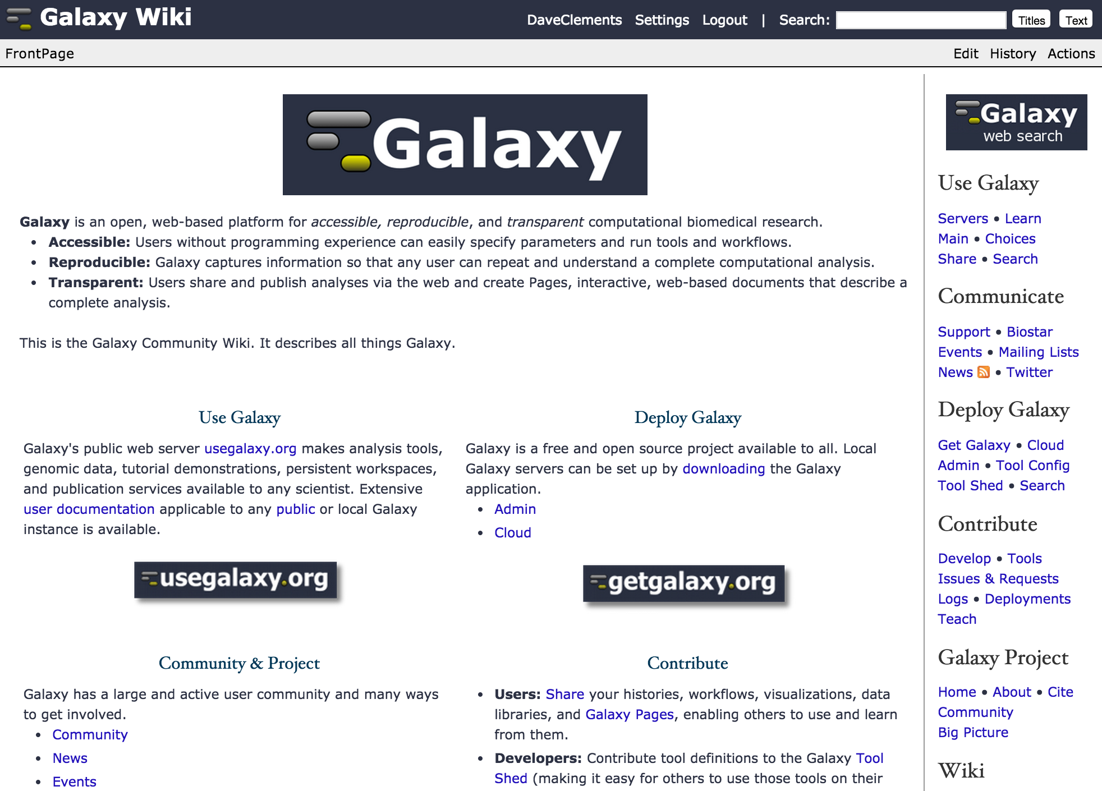
http://wiki.galaxyproject.org

Slide 47
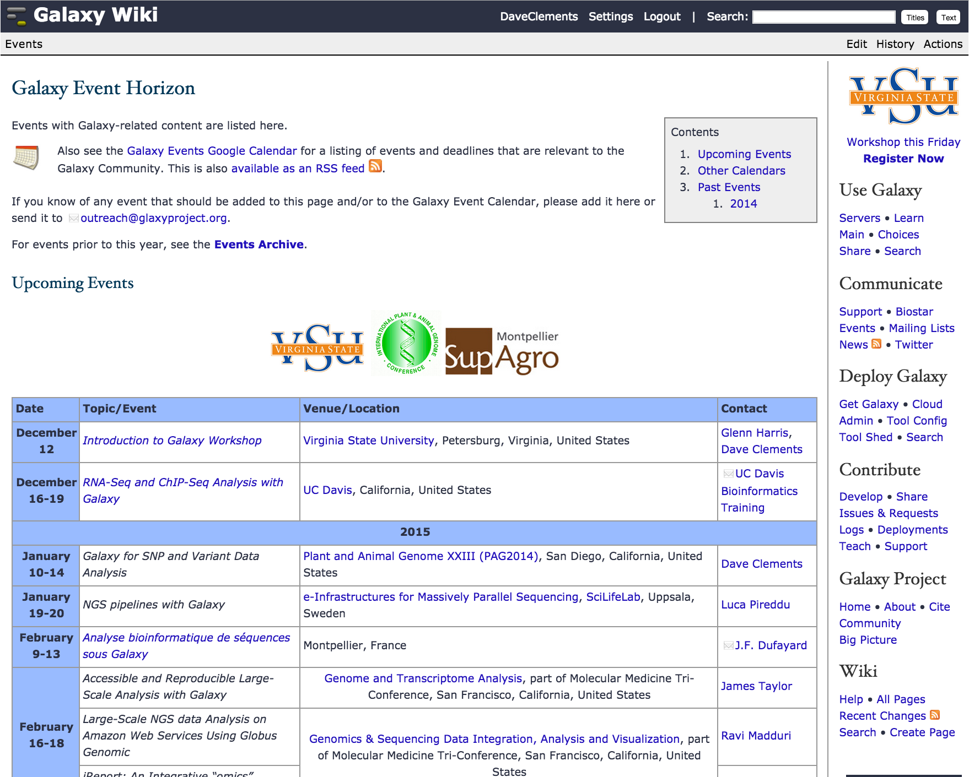
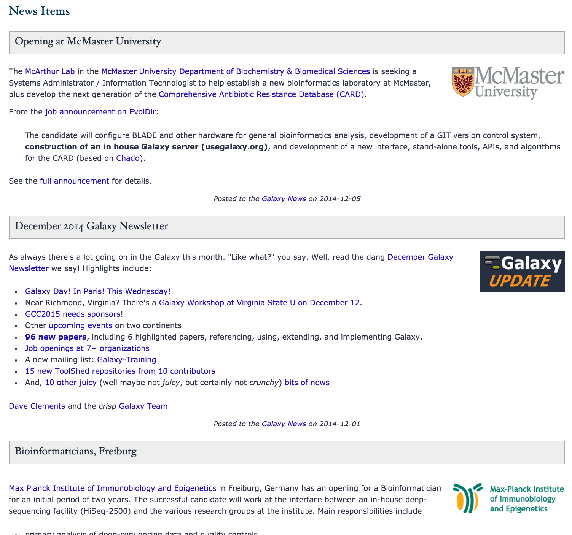
Events
News

Slide 48
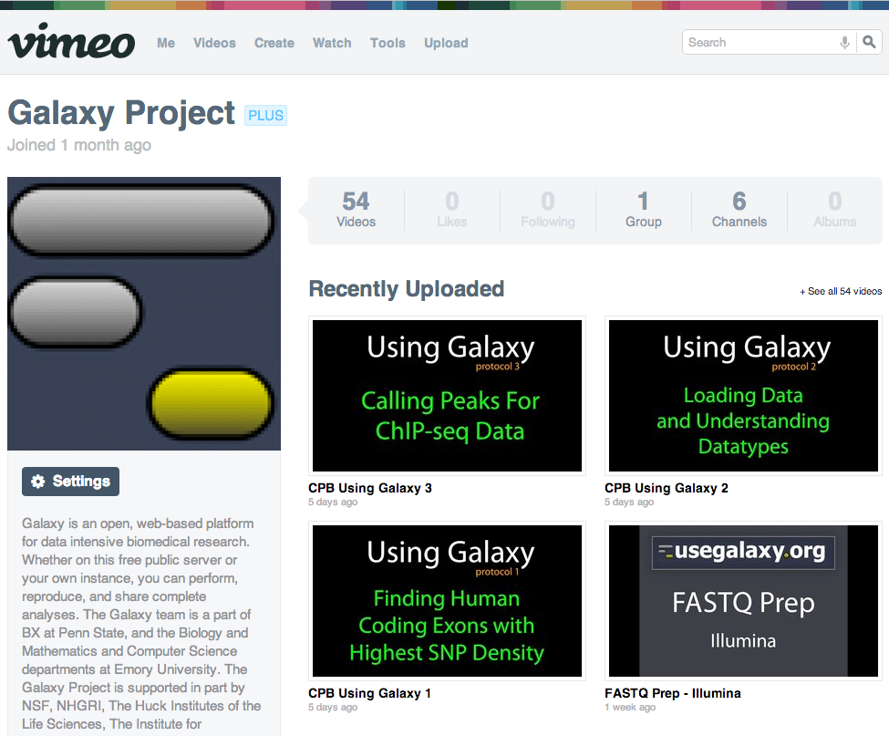
Galaxy Resources & Community: Videos
“How to” screencasts on using and deploying Galaxy
Talks from previous meetings.
http://vimeo.com/galaxyproject

Slide 49
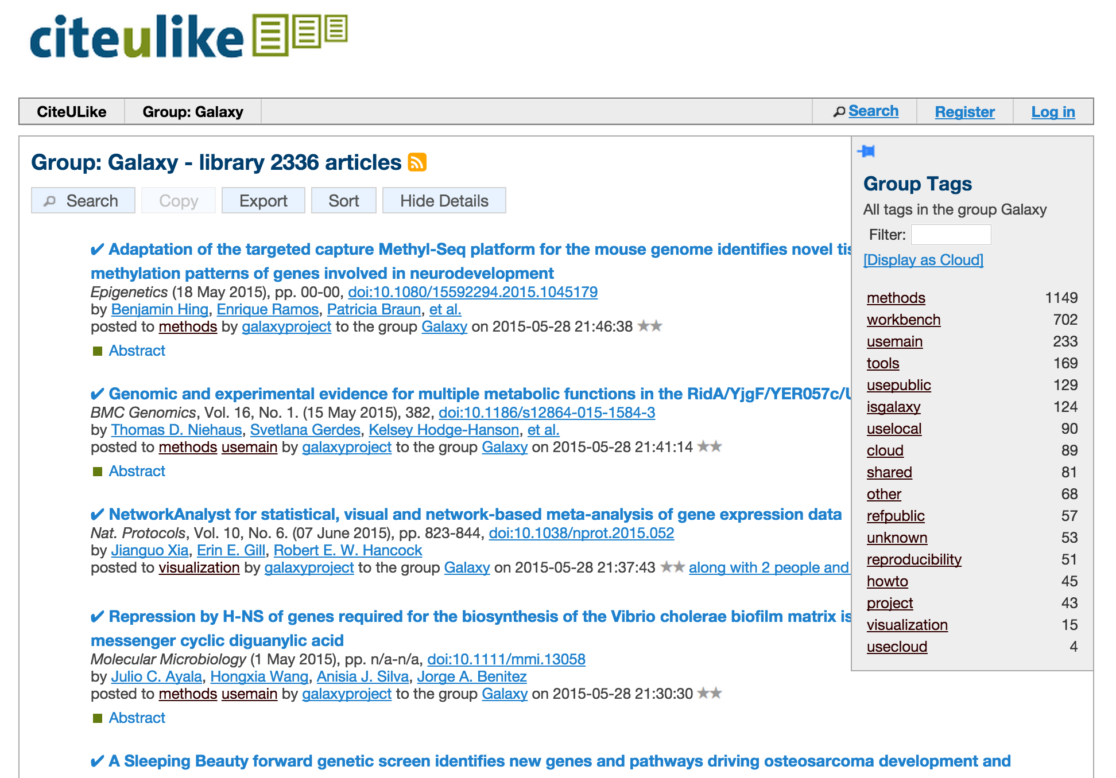
Galaxy Resources & Community: CiteULike Group
Now almost 3000 papers
http://bit.ly/gxycul

Slide 50
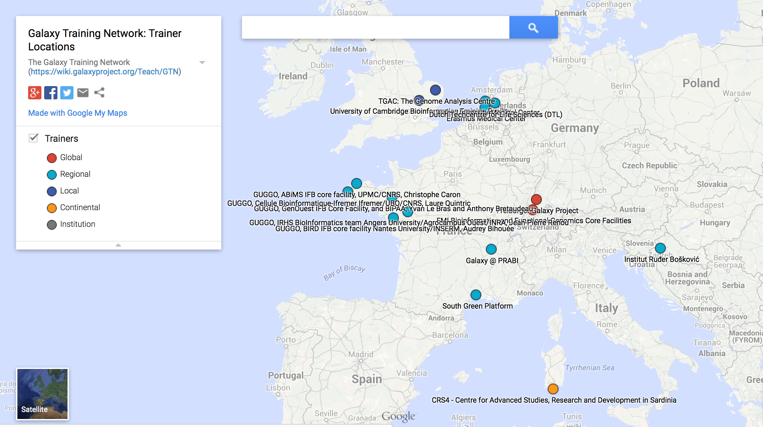
Scaling Training
Galaxy Training Network launched In October 2014.
bit.ly/gxygtn
Notes:
TODO

Slide 51
Galaxy Project: Further Reading & Resources
http://galaxyproject.org
http://usegalaxy.org
http://getgalaxy.org
http://wiki.galaxyproject.org/Cloud
http://bit.ly/gxychoices

