Slide 1
Outline
Overview of RNA-Seq
Quality control and read trimming
Mapping RNA-Seq reads
Transcriptome assembly
Additional training resources on RNA-Seq

Slide 2
This presentation is based on the following resources
Griffith M., et al. Informatics for RNA Sequencing: A Web Resource for Analysis on the Cloud. PLoS Comput Biol. 2015 Aug 6;11(8):e1004393.
  https://github.com/griffithlab/rnaseq_tutorial/wiki
Reference based RNA seq (Anton Nekrutenko)
  https://github.com/nekrut/galaxy/wiki/Reference-based-RNA-seq
RNA-Seq course at the Weill Cornell Medical College
  Curriculum developed by Friederike Dündar, Luce Skrabanek, Paul Zumbo, Björn Grüning, and Dave Clements
  http://chagall.med.cornell.edu/RNASEQcourse/

Slide 3
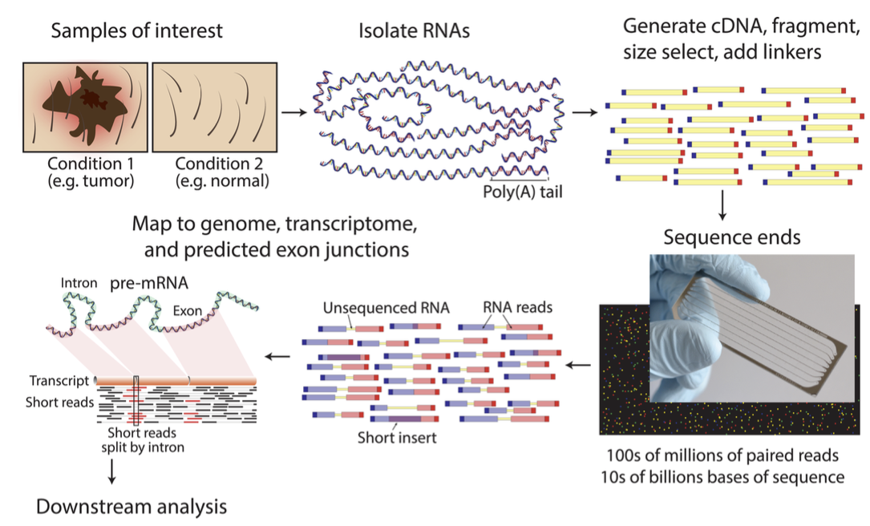
RNA-Seq overview
Griffith M., et al. PLoS Comput Biol. 2015 Aug 6;11(8):e1004393.

Slide 4
Common applications of RNA-Seq
Transcriptome profiling
  Identify novel transcripts (e.g., gene annotations) and structural variation
  Quantify expression levels
Differential quantification—expression, splicing, …
  Different developmental stages; treatment versus control
  Alternative splicing
Visualization and integration with other datasets
  Correlate with epigenomic landscape
    Genomic variants, histone modifications, DNA methylation, etc.
Conesa A., et al. A survey of best practices for RNA-seq data analysis. Genome Biol. 2016 Jan 26;17:13.

Slide 5
The optimal RNA-Seq sequencing and analysis protocols depend on the goals of the study

Slide 6
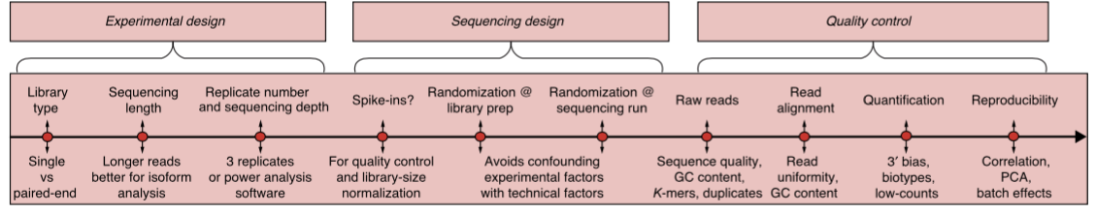
Design considerations for RNA-Seq
Experimental design
  Number of samples, number of biological and technical replicates
Sequencing design
  Spike-in controls, randomization of library prep and sequencing
Quality control
  Sequencing quality, mapping bias
Conesa A., et al. A survey of best practices for RNA-seq data analysis. Genome Biol. 2016 Jan 26;17:13.

Slide 7
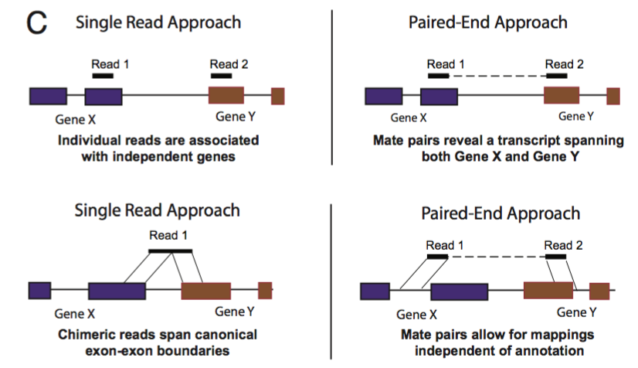
Using RNA-Seq to identify chimeric transcripts
Maher C.A., et al. Chimeric transcript discovery by paired-end transcriptome sequencing. Proc Natl Acad Sci U S A. 2009 Jul 28;106(30):12353-8.
Notes:
Often found in cell lines and cancer genomes

Slide 8
Using Galaxy to perform
RNA-Seq analysis
Quality control with FastQC
Read mapping with HISAT
Transcriptome assembly with StringTie
  Tutorial and sample datasets from Griffith M., et al., 2015 https://github.com/griffithlab/rnaseq_tutorial/wiki

Slide 9
Overview of sample datasets
chr22 from Human genome (hg19)
Two RNA-Seq samples (3 replicates each)
  Universal Human Reference (UHR)
    RNA from 10 cancer cell lines
  Human Brain Reference (HBR)
    RNA from brains of 23 Caucasian males and females
ERCC spike-in controls
  92 transcripts with known range of concentrations
    Ensure analysis reflects actual abundance within a sample
  Added Mix1 to UHR and Mix2 to HBR samples
    Controls for comparisons between samples
Notes:
ERCC ExFold RNA Spike-in control mix
Quantified with KAPA Library Quantification qPCR, concentration adjusted for sequencing
Sequenced on 2 lanes of HiSeq2000 with 100bp read lengths

Slide 10
Biological and technical replicates
Biological replicates
  RNA from independent growth of cells and tissues
  Account for random biological variations
Technical replicates
  Different library preparations of the same RNA-Seq sample
  Account for batch effects from library preparations
    Sample loading, cluster amplifications, etc.
ENCODE long RNA-Seq standards:
  https://www.encodeproject.org/data-standards/rna-seq/long-rnas/
Blainey P, Krzywinski M, Altman N. Points of significance: replication.
Nat Methods. 2014 Sep;11(9):879-80.

Slide 11
How many biological replicates?
As many as possible…
Analysis of 48 biological replicates in two conditions
  Requires 20 biological replicates to detect > 85% of all differentially expressed genes
Recommend at least six biological replicates per condition
  Twelve biological replicates needed to detect smaller fold changes (≥ 0.3-fold difference in expression)
Three biological replicates per condition can usually detect genes with ≥ 2-fold difference in expression
Schurch NJ., et al. How many biological replicates are needed in an RNA-seq experiment and which differential expression tool should you use? RNA. 2016 Jun;22(6):839-51.
Notes:
Three replicates detect only 20-40% of differentially expressed genes
Use edgeR (exact) if there are less than 12 replicates
Use DESeq if there are more than 12 replicates

Slide 12
Outline
Overview of RNA-Seq
Quality control and read trimming
Mapping RNA-Seq reads
Transcriptome assembly
Additional training resources on RNA-Seq

Slide 13
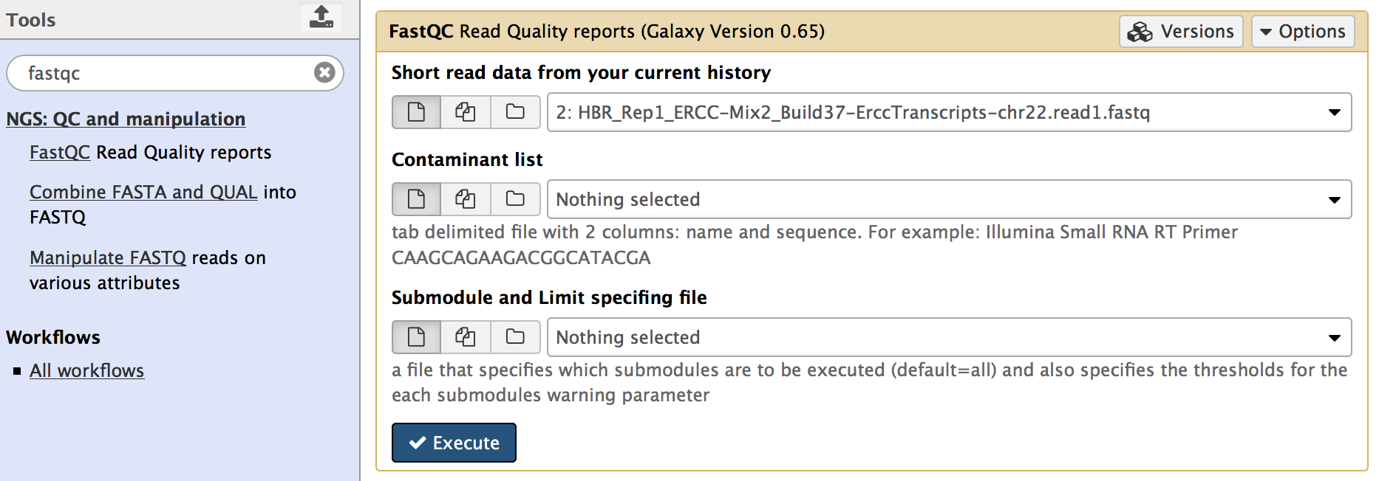
Quality control with FastQC
Determine quality encoding of fastq files
Identify over-represented sequences
  Adapters, potential contamination, etc.
Assess quality of sample and sequencing

Slide 14
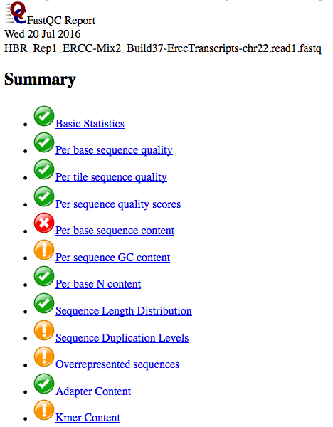
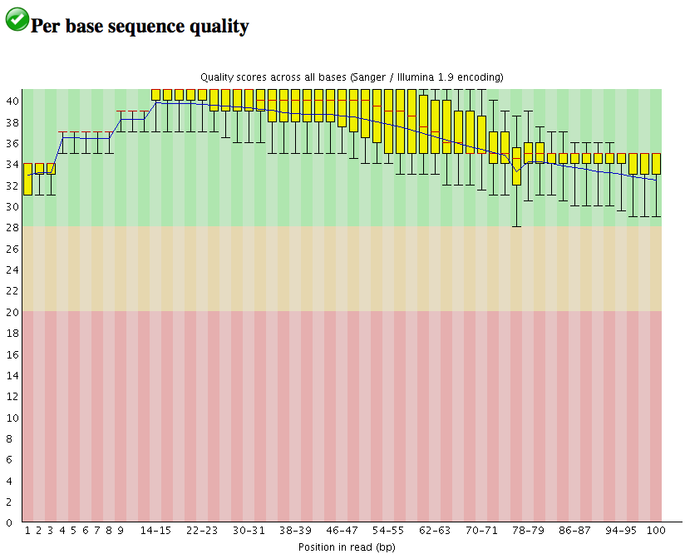
DEMO: Quality assessment of fastq files with Galaxy

Slide 15
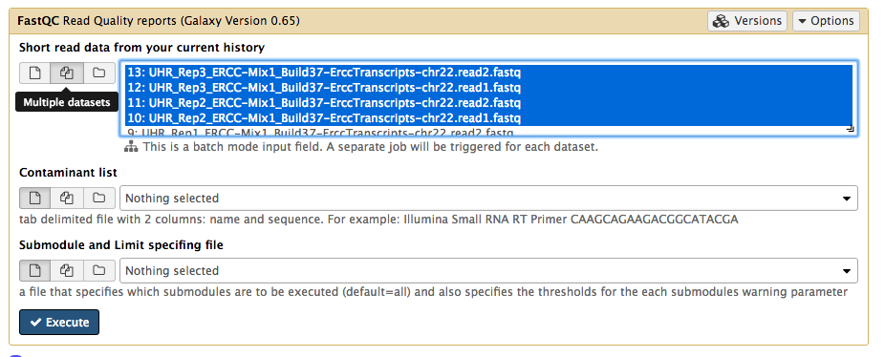
Processing multiple datasets
A separate job will be launched for each dataset

Slide 16
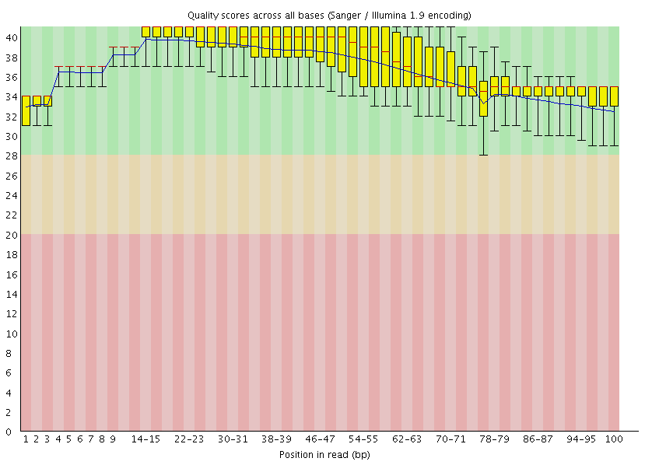
FastQC: Per base sequence quality

Slide 17
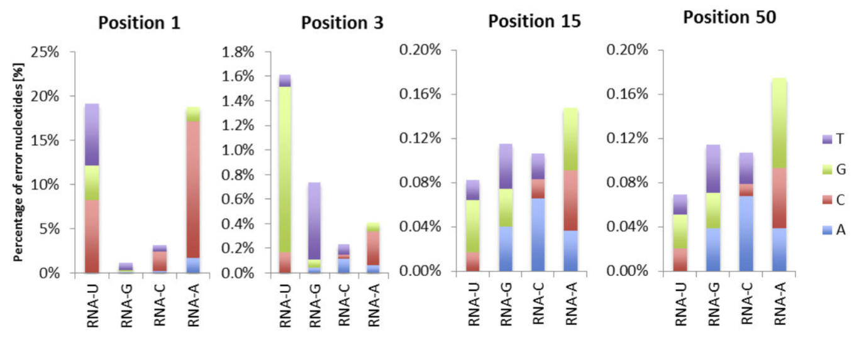
FastQC: Per base sequence quality
van Gurp TP, McIntyre LM, Verhoeven KJ. Consistent errors in first strand cDNA due to random hexamer mispriming. PLoS One. 2013 Dec 30;8(12):e85583.

Slide 18
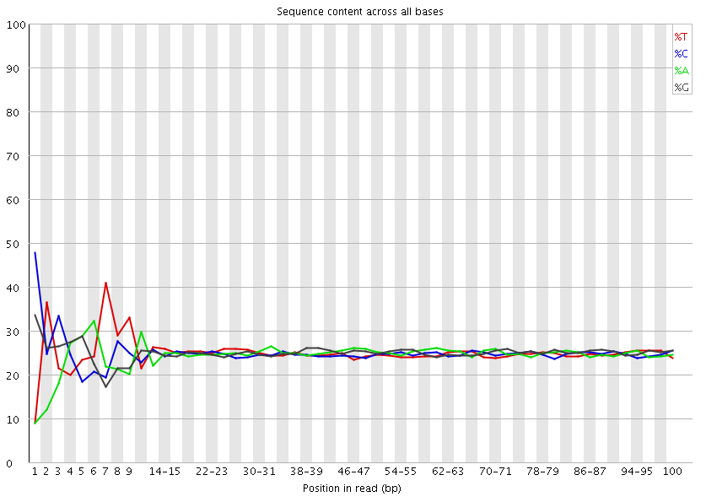
FastQC: Per base sequence content

Slide 19
Sequence bias at 5’ end caused by random hexamer priming
Hansen KD, Brenner SE, Dudoit S. Biases in Illumina transcriptome sequencing caused by random hexamer priming. Nucleic Acids Res. 2010 Jul;38(12):e131.

Slide 20
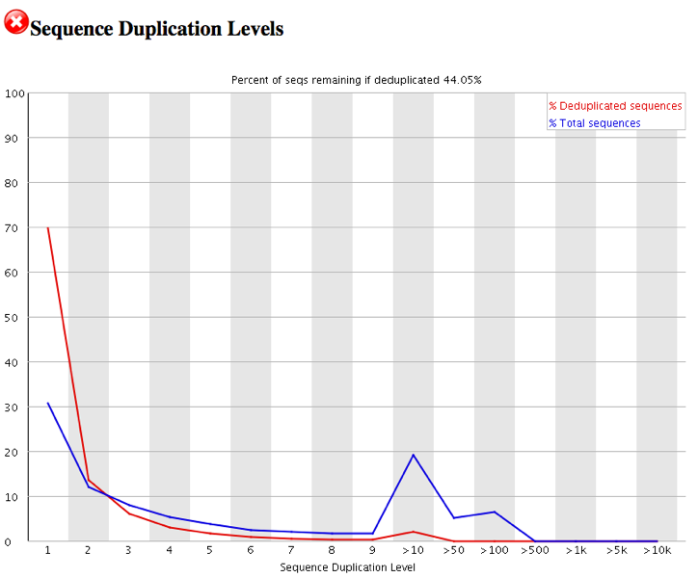
FastQC: Sequence Duplication Levels

Slide 21
FastQC: Sequence Duplication Levels
Sequencing highly-expressed transcripts leads to sequence duplication

Slide 22
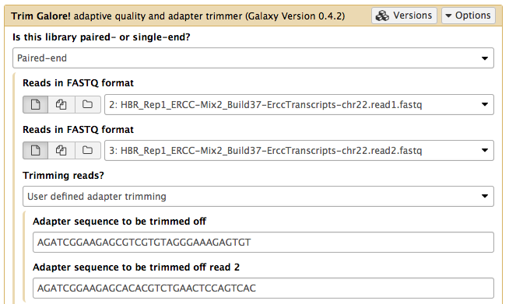
Use Trim Galore! to remove adapters and low quality regions
List of common Illumina adapters:
  http://support.illumina.com/downloads/illumina-customer-sequence-letter.html

Slide 23
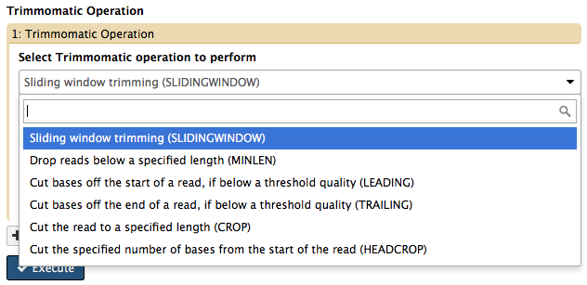
Quality trimming strategies
Trimmers available under NGS: QC and manipulation
Need to decide whether to include unpaired reads in the analysis
Notes:
Other read trimming tools available in Galaxy main

Slide 24
Outline
Overview of RNA-Seq
Quality control and read trimming
Mapping RNA-Seq reads
Transcriptome assembly
Additional training resources on RNA-Seq

Slide 25
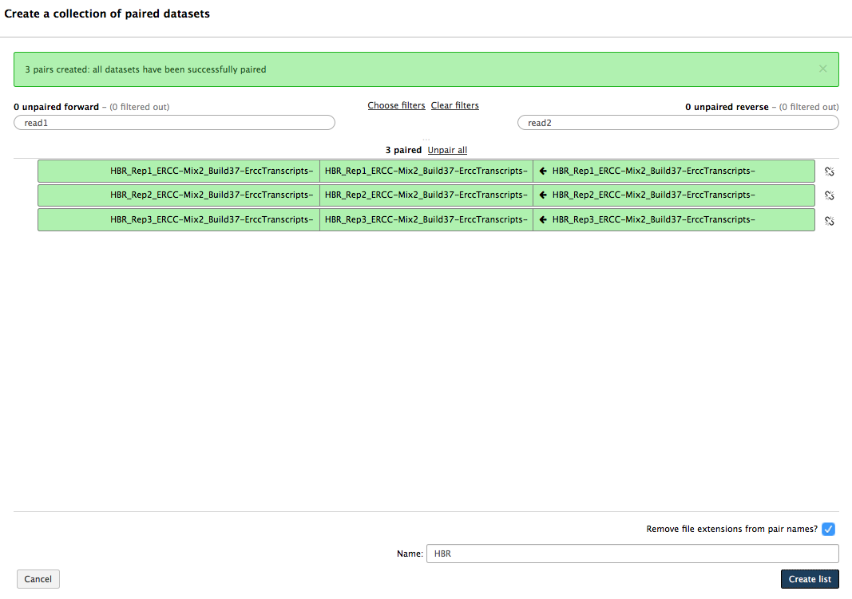
DEMO: Group paired-end reads from multiple replicates into a single collection

Slide 26
Use dataset collection to work with multiple related datasets
Treat multiple datasets as a single group
  Paired-end reads
  Multiple replicates from the same treatment
Cleaner History and less error prone
Compatible with a subset of Galaxy tools
  Examples: Trim Galore!, Trimmomatic, TopHAT2, HISAT
  Results for individual datasets are hidden in the History

Slide 27
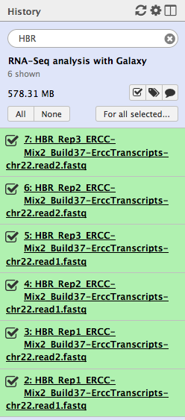
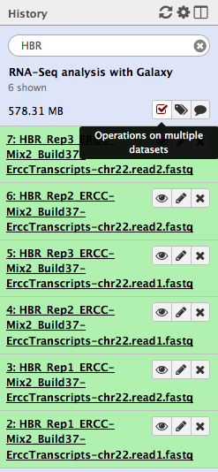
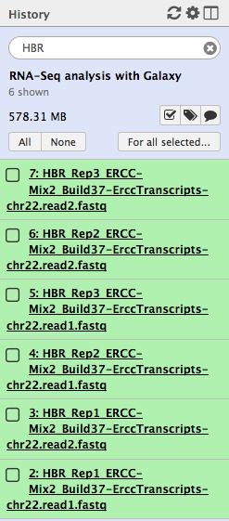
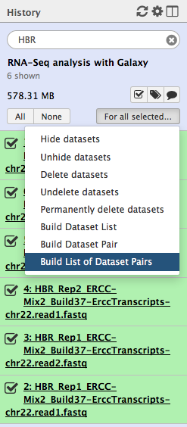
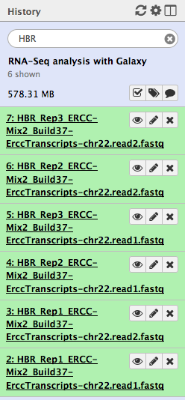
Select datasets in a dataset collection

Slide 28
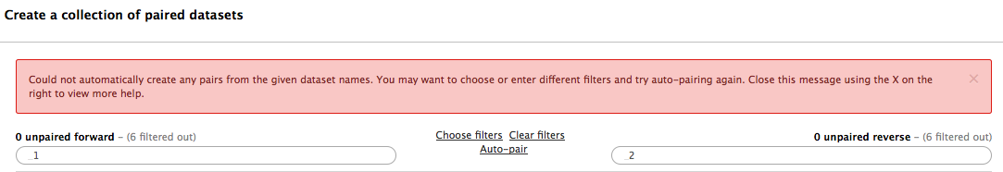

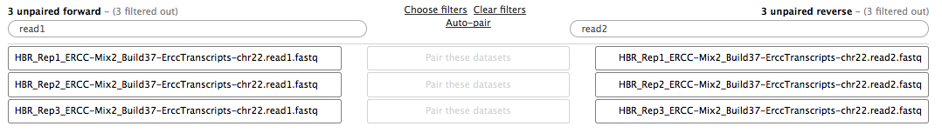
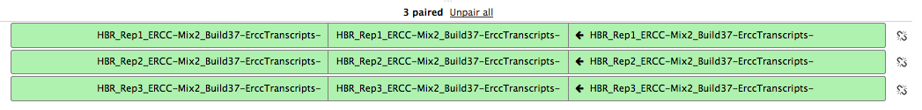
Define collection of paired datasets
read1
read2
Click on Auto-pair

Slide 29
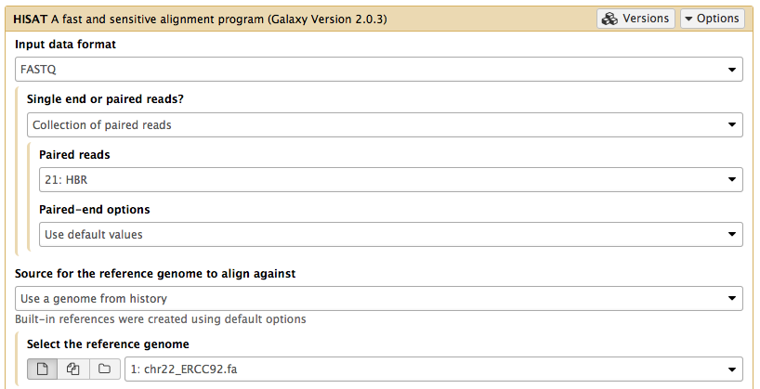
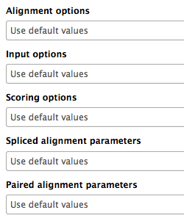
RNA-Seq mapping with HISAT
Many different alignment parameters available…
  Which parameters should be changed?

Slide 30
Strand-specific RNA-Seq libraries
Standard libraries do not preserve strand information
Prefer strand-specific RNA-Seq
  Transcript reconstruction and quantification
  Detect antisense transcripts
Library prep kits available from Illumina:
  TruSeq Stranded Total RNA Sample Prep Kit
  TruSeq Stranded mRNA Sample Prep Kit
  Zhao S., et al. Comparison of stranded and non-stranded RNA-seq transcriptome profiling and investigation of gene overlap. BMC Genomics. 2015 Sep 3;16:675.

Slide 31
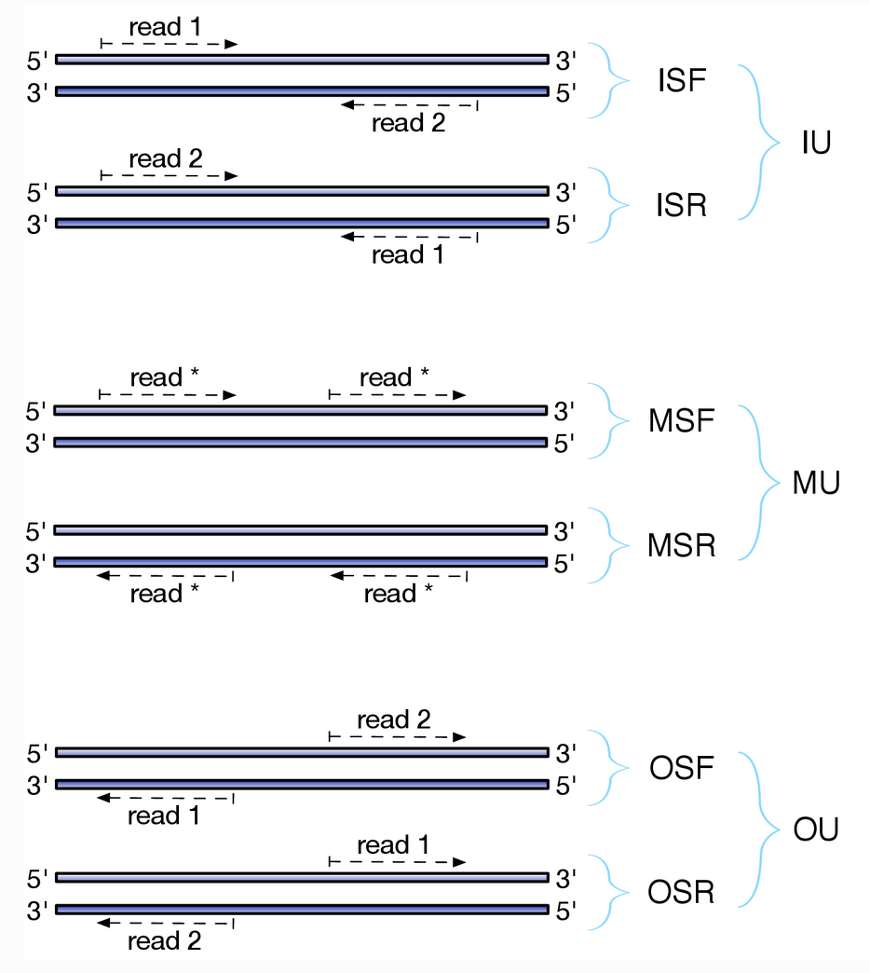
Orientations of RNA-Seq reads depend on the paired-end protocol
http://sailfish.readthedocs.io/en/master/library_type.html
TruSeq Strand-Specific Total RNA:
  First Strand (R/RF)
  fr-firststrand (F2R1)
NuGEN Encore:
  Second Strand (F/FR)
  fr-secondstrand (F1R2)
NuGEN Ovation V2:
  FR Unstranded
  fr-unstranded
https://github.com/genome/gms/wiki/RnaSeq
Notes:
I = Inward, O= outward, M = matching; S = stranded, U = unstranded; F = forward, R = reverse
F2R1 = second read in forward strand, first read in reverse strand (ISR), RF

Slide 32
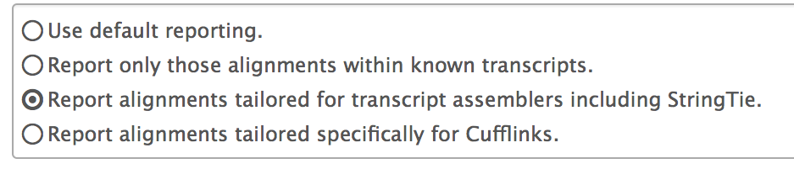
Common changes to HISAT spliced alignment parameters
Minimum and maximum intron lengths
Specify strand-specific information
GTF file with known splice sites
    Use known gene annotations to guide read mapping if available
Transcriptome assembly reporting

Slide 33
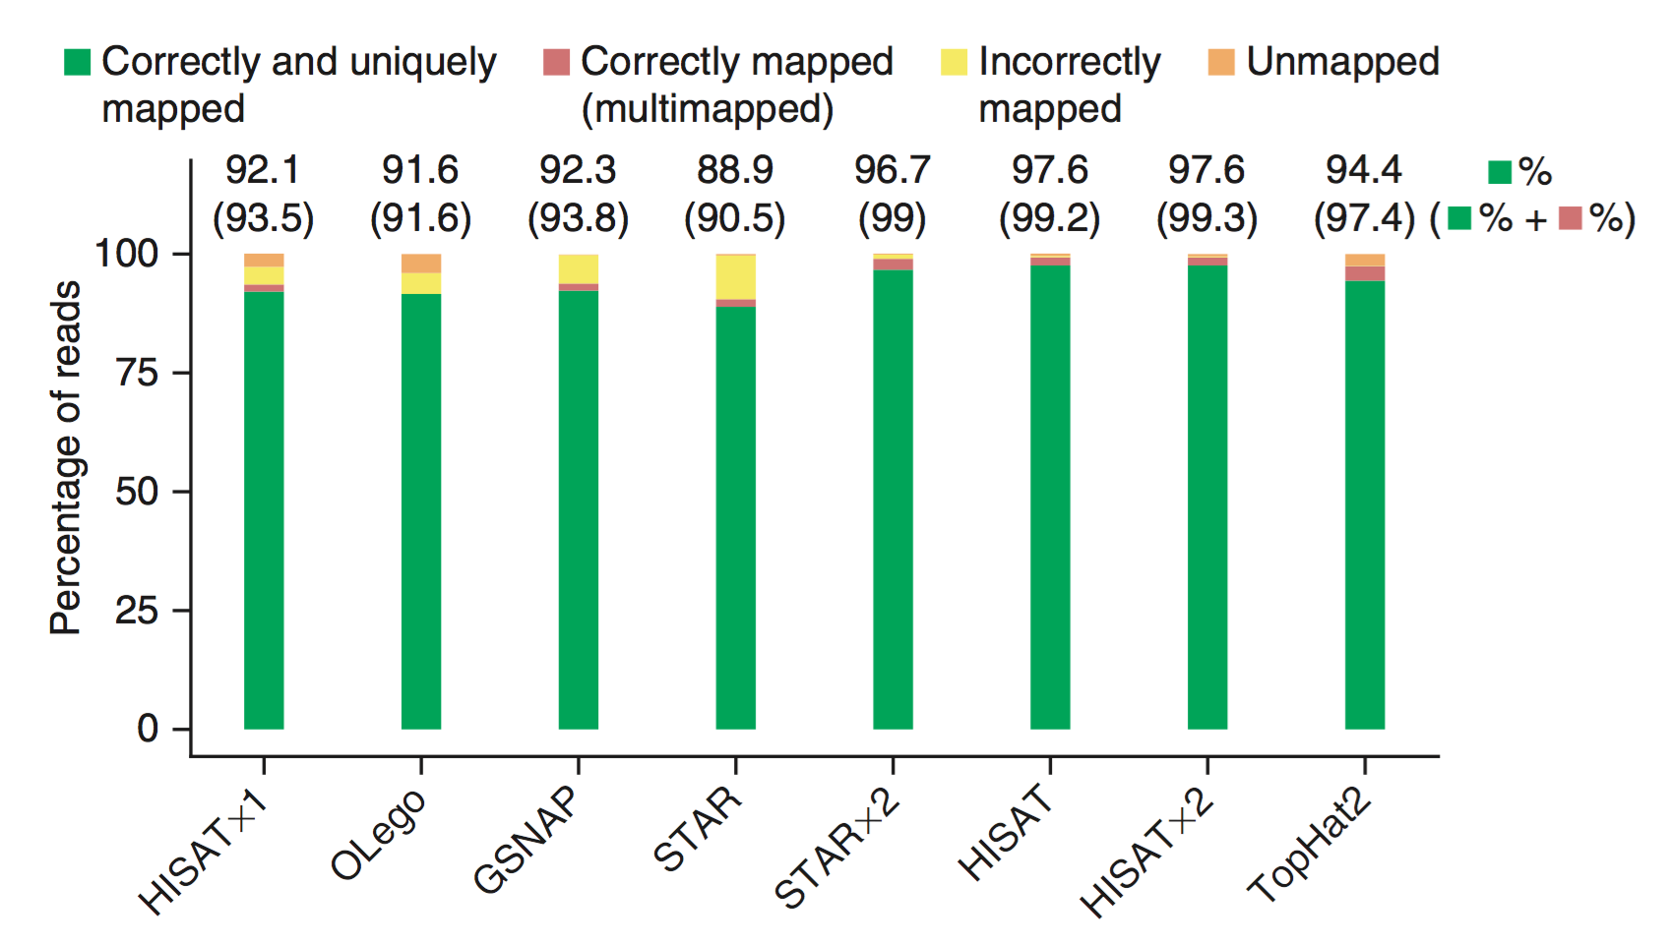
Use splice site information during read mapping to improve alignment accuracy
  Kim D, Langmead B, Salzberg SL. HISAT: a fast spliced aligner with low memory requirements. Nat Methods. 2015 Apr;12(4):357-60.
Notes:
Recommend run STAR and TopHat2 twice:
Round 1 to discover junctions; round 2 use these junctions in read mapping
HISAT by default make use of splice sites found during the alignment process so that it does not have to run twice
(Compare HISATx1, HISAT, and HISATx2)

Slide 34
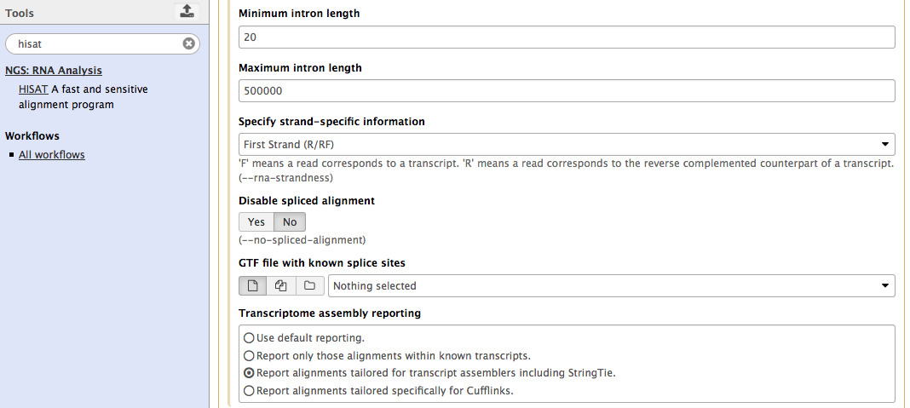
DEMO: Use Galaxy to map RNA-Seq reads against human chr22 with HISAT
Notes:
First Strand (R/RF), Report alignments tailored for transcript assemblers including StringTie

Slide 35
Galaxy HISAT output
The Galaxy HISAT wrapper sorts the RNA-Seq read alignments by position and then convert the results into a BAM file
Assess RNA-Seq read alignments
  CollectRnaSeqMetrics in the “NGS: Picard” section
  Require gene annotations from the UCSC Table Browser
    https://broadinstitute.github.io/picard/command-line-overview.html#CollectRnaSeqMetrics
Visual inspection on the UCSC Genome Browser
Notes:
CollectRNASeqMetrics – median coverage, 5’/3’ biases, number of reads assigned to correct strand, etc.

Slide 36
Galaxy tools for analyzing BAM files
Merge BAM alignments from multiple replicates
  MergeBamAlignment (NGS: Picard)
Calculate RNA-Seq coverage
  Genome Coverage: (BEDTools)
Number of reads that overlap with features in a GFF file
  htseq-count (NGS: RNA Analysis)

Slide 37
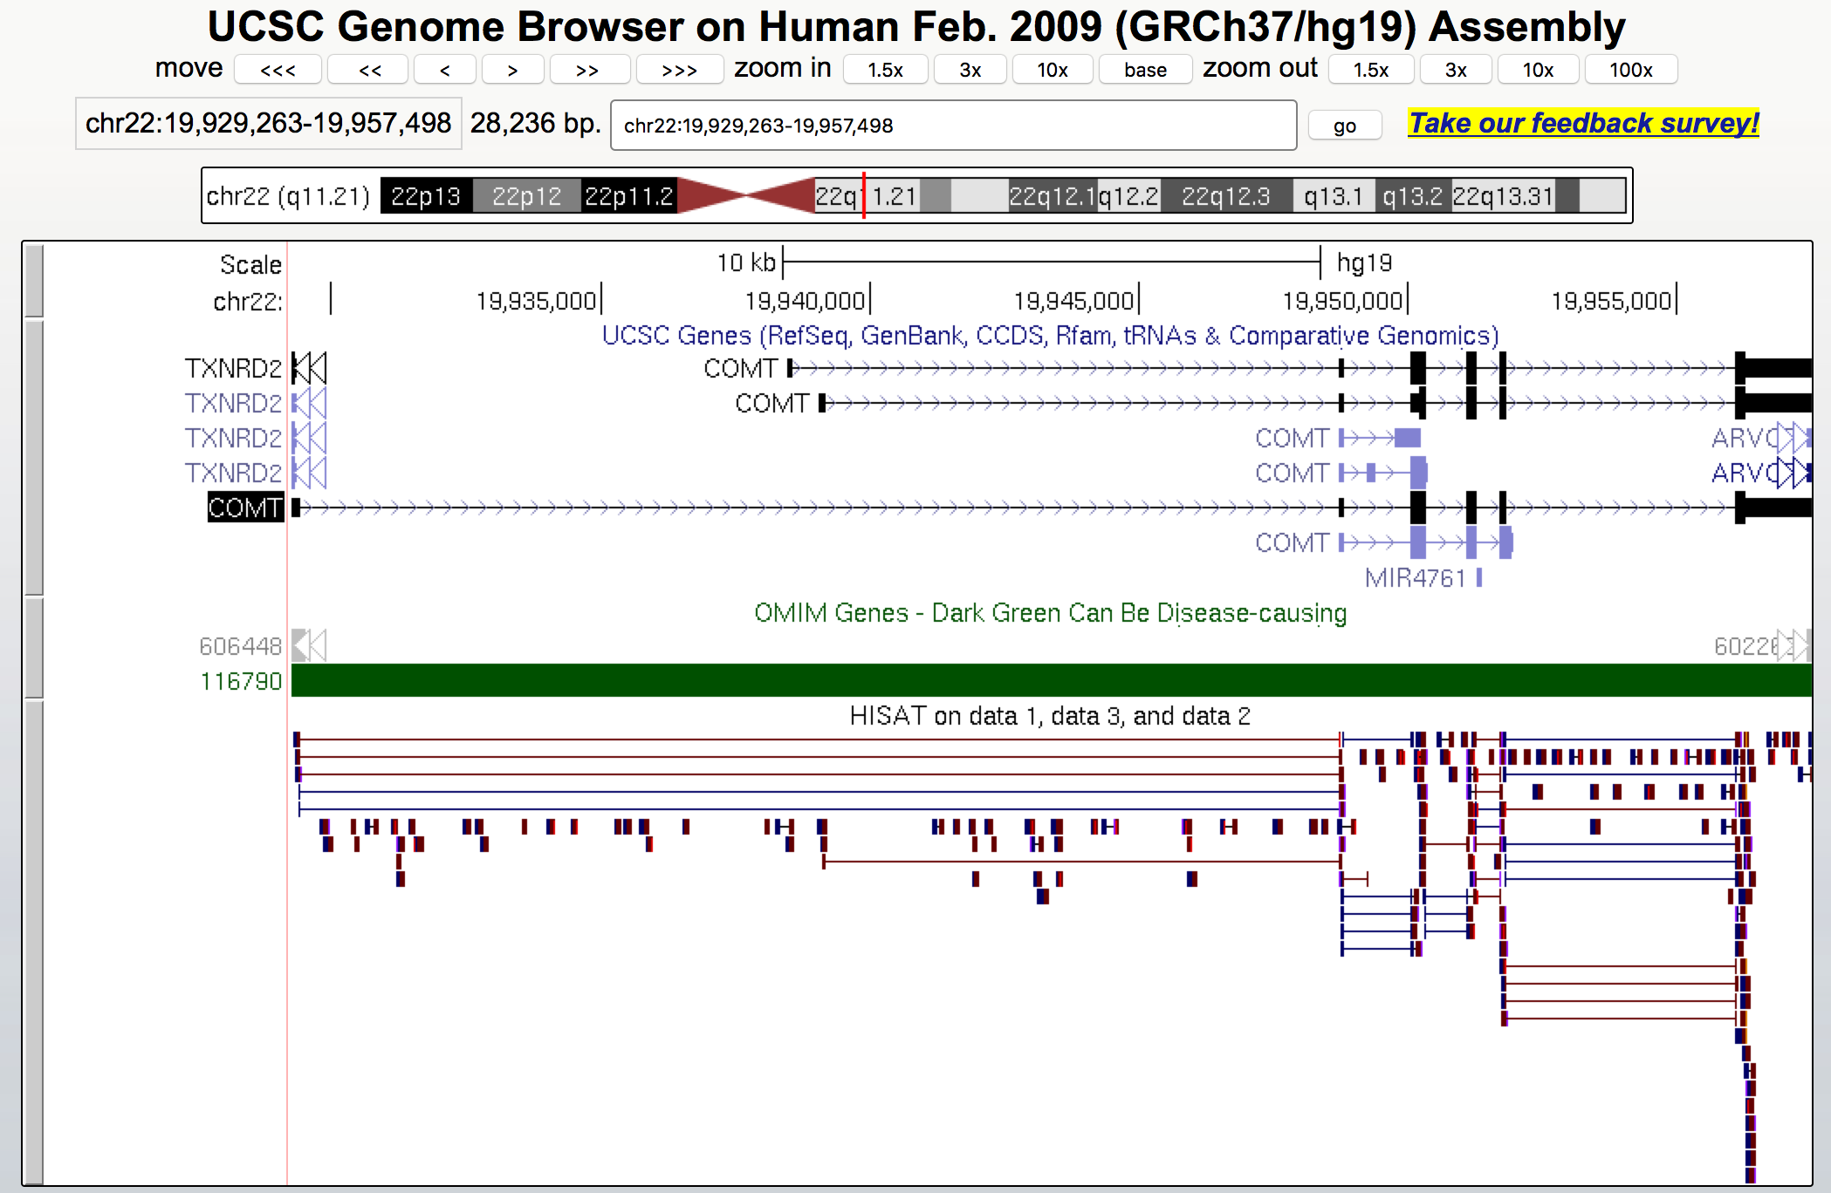
DEMO: Visualize RNA-Seq alignments on the UCSC Genome Browser
Notes:
chr22:19,929,263-19,957,498
COMT – Catechol-O-methyltransferase: associated with panic disorder and schizophrenia

Slide 38
Outline
Overview of RNA-Seq
Quality control and read trimming
Mapping RNA-Seq reads
Transcriptome assembly
Additional training resources on RNA-Seq

Slide 39
Two common approaches to
RNA-Seq assembly
Reference-based assembly
  Map RNA-Seq reads against a reference genome
    Examples: TopHat2, HISAT
  Assemble transcripts from mapped RNA-Seq reads
    Examples: Cufflinks, StringTie
De novo transcriptome assembly
  Assemble transcripts from RNA-Seq reads
    Examples: Oases, Trinity
  More computationally expensive
  Merge assemblies produced by different parameters
Notes:
Advantage of de novo assembly is that it does not require a reference genome

Slide 40
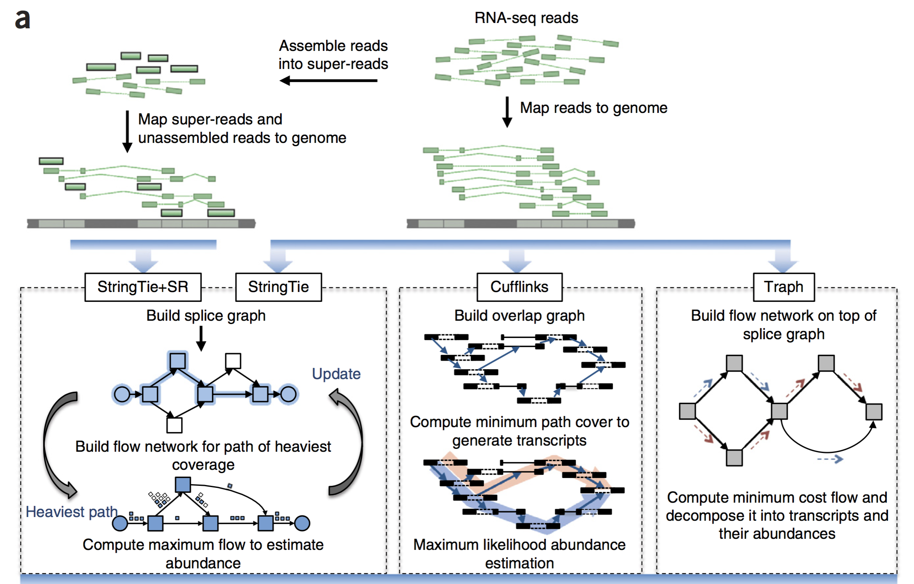
Augment mapped RNA-Seq reads with pre-assembled super-reads (SR)
Pertea M., et al. StringTie enables improved reconstruction of a transcriptome from RNA-seq reads. Nat Biotechnol. 2015 Mar;33(3):290-5.

Slide 41
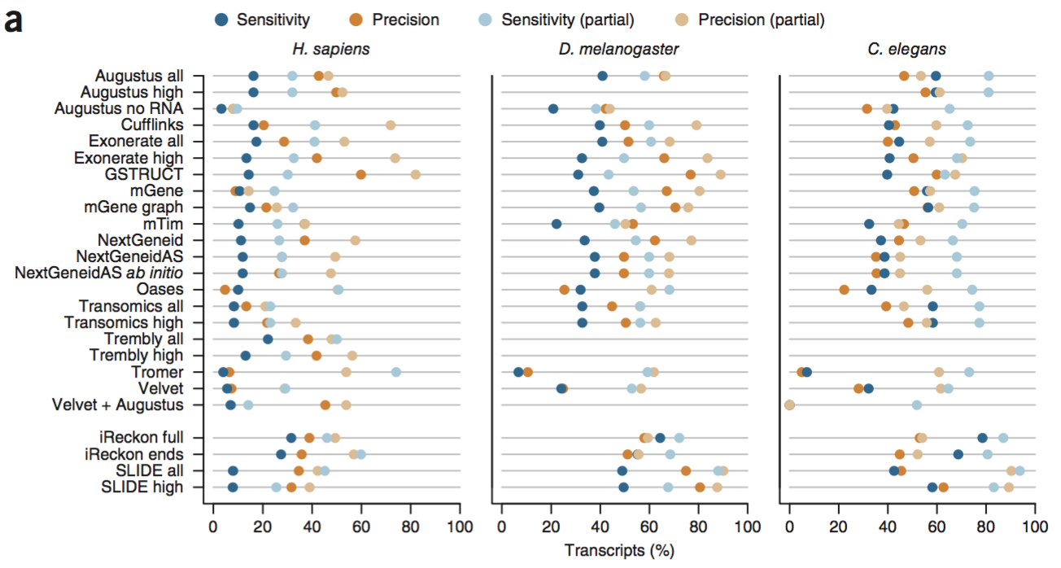
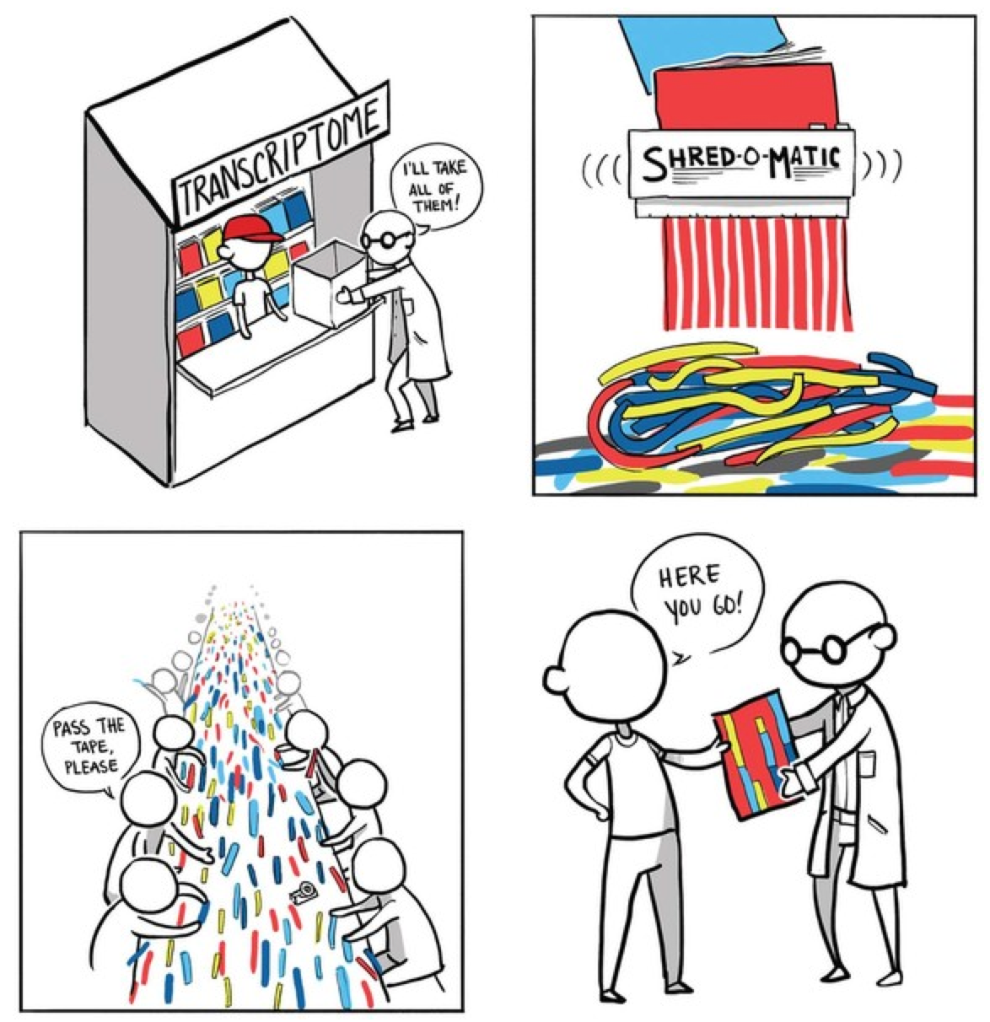
Transcriptome assembly remains an active area of research
Korf I. Genomics: the state of the art in RNA-seq analysis. Nat Methods. 2013 Dec;10(12):1165-6.
Steijger T., et al. Assessment of transcript reconstruction methods for RNA-seq. Nat Methods. 2013 Dec;10(12):1177-84.

Slide 42
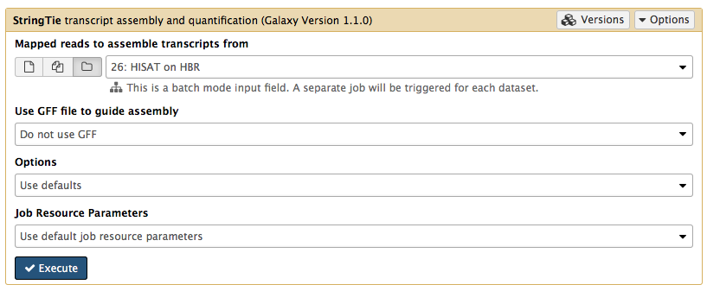
DEMO: Assemble transcripts from mapped RNA-Seq reads with StringTie

Slide 43
Quantifying gene expression levels
RPKM
  Reads Per Kilobase per Million mapped reads
  Normalize relative to sequencing depth and gene length
FPKM
  Similar to RPKM but count DNA fragments instead of reads
  Used in paired end RNA-Seq experiments to avoid bias
TPM
  Transcripts Per Million
  Better suited for comparisons across samples and species
Wagner GP, Kin K, Lynch VJ. Measurement of mRNA abundance using RNA-seq data: RPKM measure is inconsistent among samples. Theory Biosci. 2012 Dec;131(4):281-5.

Slide 44
Next steps
Optimize read mapping and assembly parameters:
  Goecks J., et al. NGS analyses by visualization with Trackster. Nat Biotechnol. 2012 Nov;30(11):1036-9.
Differential expression analysis:
  Cuffdiff + cummeRbund
  htseq-count + DEseq2
Comparison of differential expression analysis tools:
  Soneson C, Delorenzi M. A comparison of methods for differential expression analysis of RNA-seq data. BMC Bioinformatics. 2013 Mar 9;14:91.

Slide 45
Additional resources
Galaxy NGS 101
  https://wiki.galaxyproject.org/Learn/GalaxyNGS101
UC Davis Bioinformatics Core training course
  http://bioinformatics.ucdavis.edu/training/documentation/
  So you want to do a: RNAseq experiment, Differential Gene Expression Analysis
    https://github.com/msettles/Workshop_RNAseq
Transcriptome Assembly Computational Challenges of Next Generation Sequence Data (Steven Salzberg)
  https://www.youtube.com/watch?v=2qGiw4MRK3c
Notes:
Specific course from UC Davis on RNA-Seq and differential gene expression analysis

Slide 46

Questions?
https://flic.kr/p/bhyT8B

Slide 47
RNA-Seq analysis with Galaxy
G-OnRamp Beta Users Workshop
Wilson Leung
07/2016

