Slide 1
Welcome to the G-OnRamp Beta Testers Workshop
July 25 - 27, 2017 SCR Elgin, J Goecks
Funded by the NIH BD2K Program
With continuing GEP support from NSF.
Washington University in St Louis and Oregon Health and Science University
Copyright 2017 Washington University

Slide 2
Workshop Participants
Doug Chalker Washington University in St. Louis, MO
Juan Carlos Martinez-Cruzado University of Puerto Rico at Mayaguez, PR
Mike Foulk Mercyhurst University, PA
Tariq Islam Donald Danforth Plant Science Center, MO
Chris Jones Moravian College, PA
Jenni Kennell Vassar College, NY
David Kovalic Webster University, MO
Mollie Manier George Washington University, DC
Laura Reed University of Alabama – Tuscaloosa, AL
Chong Teng Donald Danforth Plant Science Center, MO
Bob Thacker Stony Brook University, NY
Sally Elgin, Wilson Leung,
Chris Shaffer, Yating Liu Washington University in St Louis, MO
Jeremy Goecks, Luke Sargent Oregon Health Sciences University
Fusion of Galaxy and the Genomics Education Partnership
Notes:
Instructor: Professor Sarah CR Elgin
Slide:
Sources:
Notes:

Slide 3

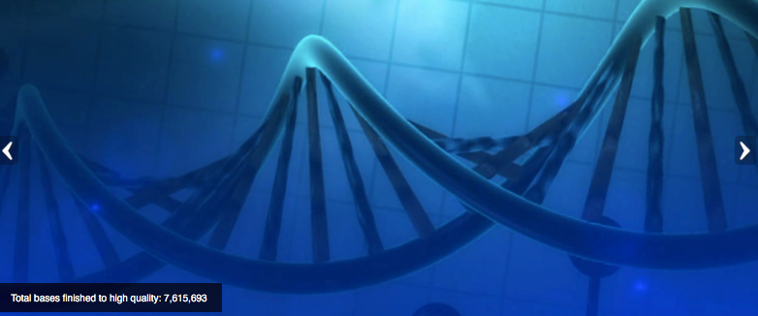
Integration of genomics into the undergraduate biology curriculum
Integration of research thinking into the academic year curriculum
Creation of dynamic student-scientist partnerships
Publication of research in genomics & in science education
Advantages of bioinformatics:
  Low laboratory costs (computers, internet connection)
  Web based tools (IT support, installation)
  No lab safety issues; open access 24/7
  Lends itself to peer instruction
  Large pool of publically accessible raw data
Currently >100 faculty from >100 colleges & universities; last year 74 schools claimed projects, >1300 students involved.
Goals:
Notes:
Started over 10 years ago, We realized from teaching a genoimcs researched based course some of the benefits of a research experience of this type
1. cost; 2. Safety; 3. data availabitly; 4. Acsessibilty (many web based tools)
Instructor: Professor Sarah CR Elgin
Slide: Faculty join by coming to a 1-week workshop at Wash U to learn software tools and approach.
Sources:
Talk specifically about each advantage and each goal –in particular the “no lab safety so lends peer instructio”
Notes:

Slide 4
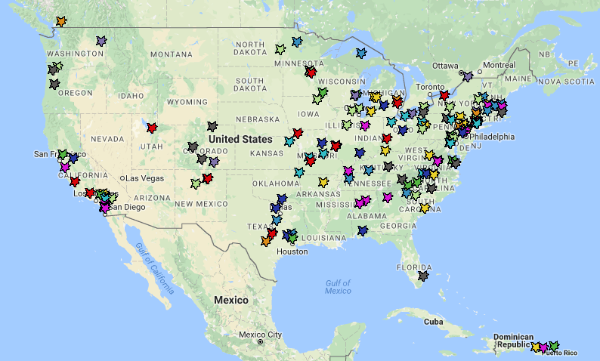

GEP Members 2017
2006
2007
2008
2009
2010
2011
Year joined:
2012
2013
2014
2015
2016

Slide 5
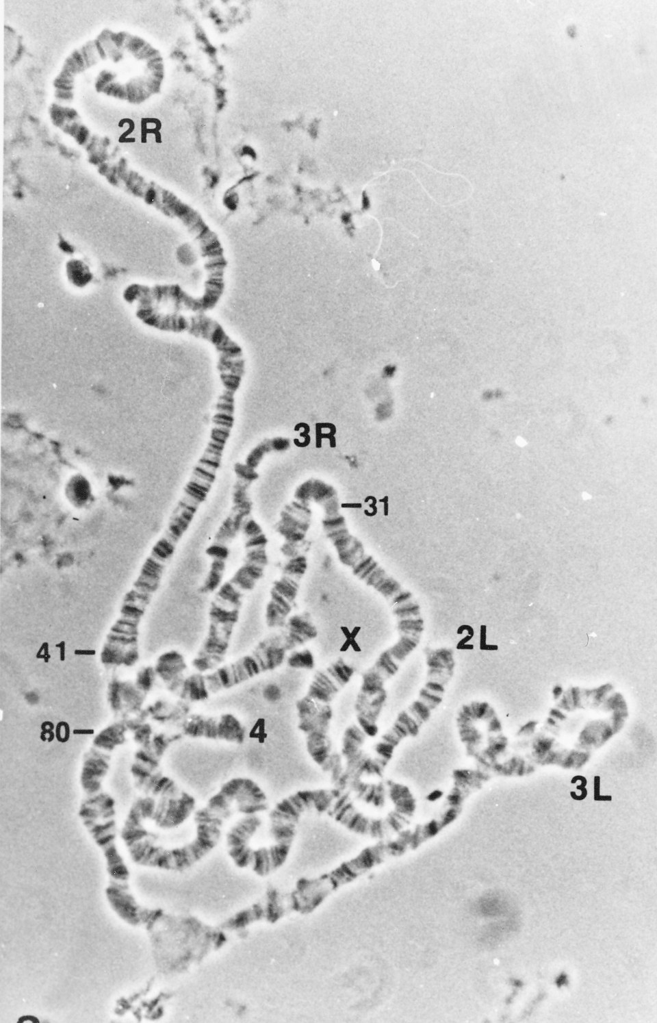
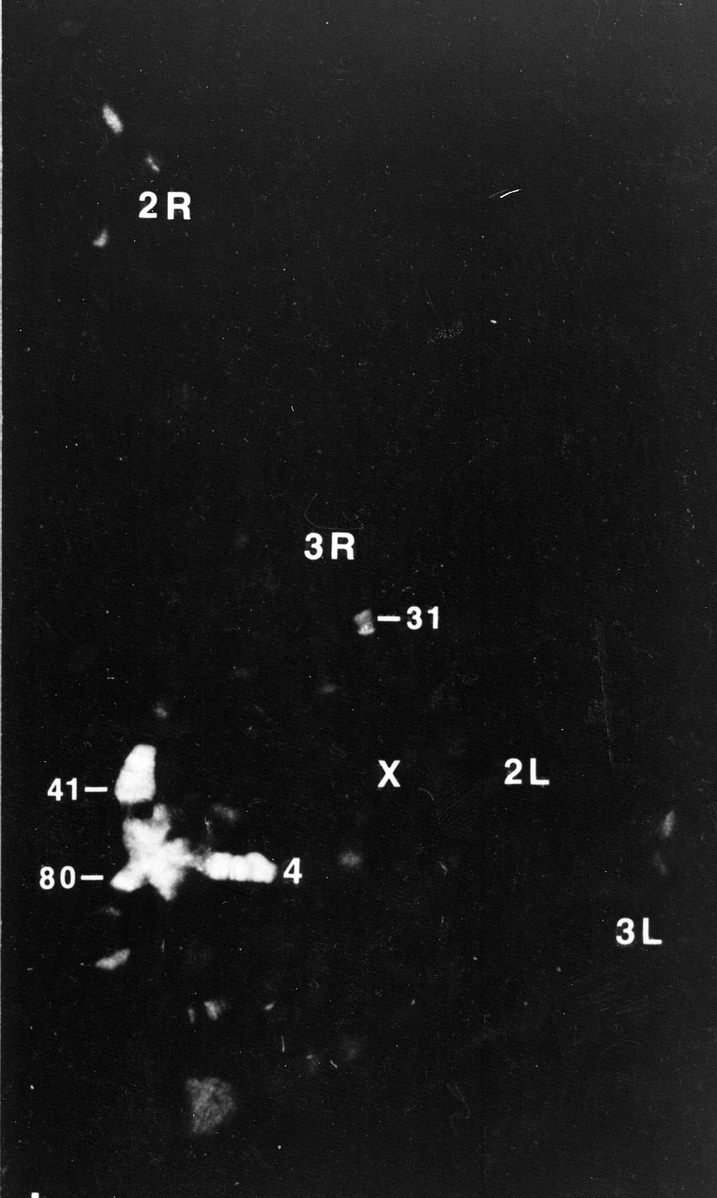
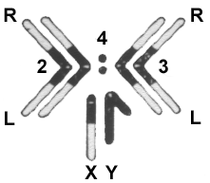
The Drosophila melanogaster fourth chromosome (F element) is largely heterochromatic (packaged with HP1a) but has ~80 genes
F
D
James et al, 1989, Europ J Cell Bio 50: 170
C
C
Phase
HP1
Notes:
To look for proteins preferentially associated with heterochromatin, we prepared monoclonal antibodies against proteins that bind tightly in the nucleus, and screened by using the antibodies for immunofluorescent staining of the polytene chromosomes. Heterochromatin Protein I (HP1) is preferentially associated with the chromocenter, small fourth chromosome, telomeres, and a few sites in the chromosome arms.

Slide 6
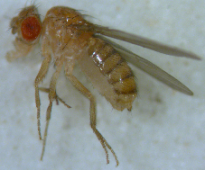
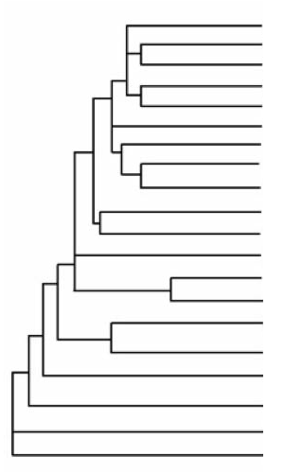
Drosophila comparative genomics: to understand the organization, evolution and gene function on the F element (dot chromosome)
D. melanogaster
D. simulans
D. sechellia
Reference
D. yakuba
D. erecta
D. ficusphila
Prior publication
D. eugracilis
D. biarmipes
Species compared to
analyze 40 MillionYr
evolution
D. takahashii
D. elegans
D. rhopaloa
D. kikkawai
Ongoing annotation –
10-15 MillionYr diverged;
sweet spot for motif finding
D. bipectinata
D. ananassae
D. pseudoobscura
D. persimilis
D. willistoni
New species sequenced by modENCODE
D. mojavensis
D. virilis
D. grimshawi
Phylogenetic tree produced by Thom Kaufman as part of the modENCODE project
Notes:
Anticipate that we will work on the remaining projects from the D. elegans F element and new projects from the D element this Fall.
Plan to have TSS only projects for D. biarmipes

Slide 7
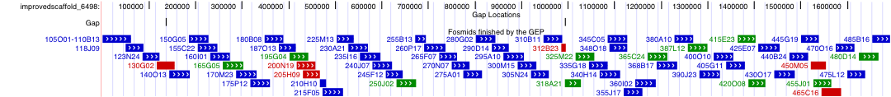
Strategy: divide and conquer!
The D. mojavensis dot chromosome
Students finished 68 projects
covered 1.7 Mb closing 26/28 gaps
added ~15,000 bp and improved ~5000 bp
annotated all potential genes.
Fosmid sequence matches consensus sequence
Putative polymorphisms
Finished sequences are made publicly available;
annotations are linked to FlyBase.

Slide 8
The Genomics Workflow
Public “draft” genomes
http://gep.wustl.edu
Divide into overlapping student projects(~40kb)
Annotation
Sequence and assembly improvement
Evidence-based gene annotation
Collect projects, compare and verify final consensus sequence
Collect projects, compare and confirm annotations
Sequence Improvement
Reassemble into high quality annotated sequence
Students learn to use a UCSC genome
browser, BLAST, FlyBase,Clustal, others.
Students present findings at local meetings;
GEP publishes as group.
Analyze and publish results

Slide 9
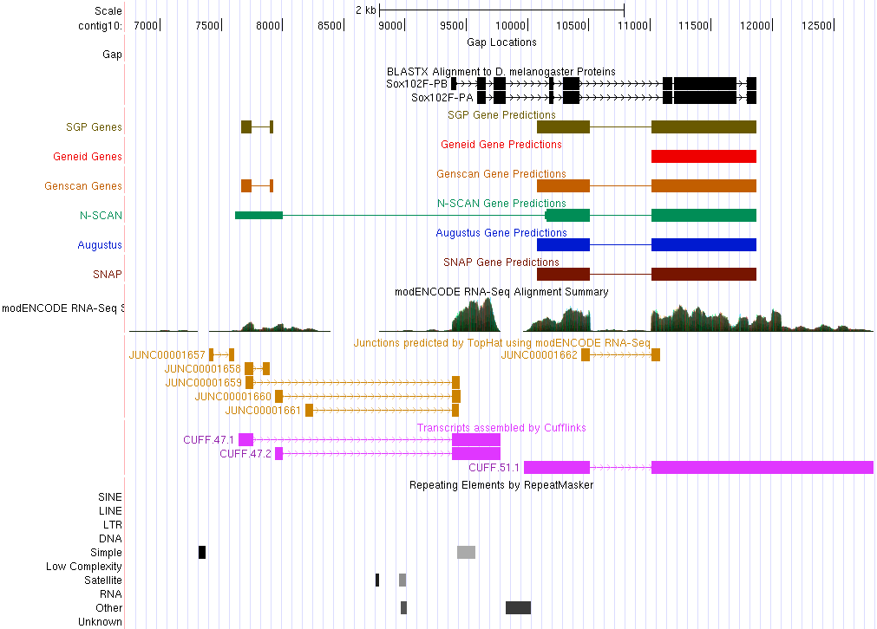
Annotation challenge: Create gene models from evidence: sequence similarity, computational predictions, RNA-Seq, etc.
(local UCSC Browser)
Improved Sequence
Sequence Homology
Gene Predictions
RNA-Seq, TopHat, Cufflinks
Repeats
Notes:
Browser allows us to map various evidence tracks against the improved genome sequence for a given species.

Slide 10
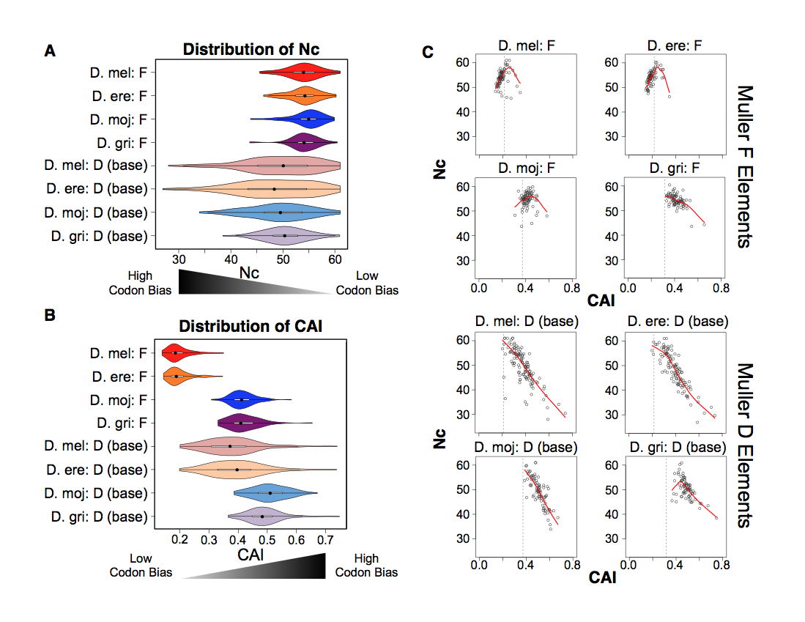
Pooling student data allows us to analyze patterns of evolution of different chromosome domains
Notes:
Simplify? Or figure two from paper? Or the hot spot

Slide 11
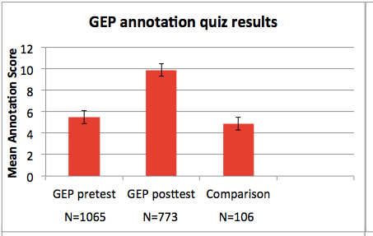
GEP annotation quiz results ’10 – ‘12
Notes:
Metric for measuring how much the students did learn through knowledge quizzes

Slide 12
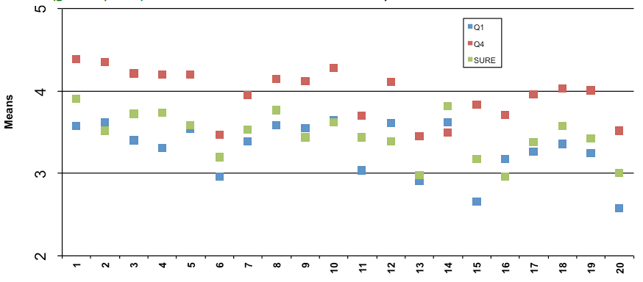
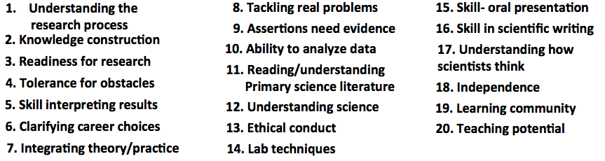
Survey results comparing ~10 hr course (blue) and
~45 hr course (red) with summer-in-the-lab (green)
.
GEP school
SURE 09 Bio
Notes:
Sample size: WU ~45, SURE 09 1200, soph lab 90, all GEP 350. Conclude that 1 semester is enough, 10 hr not enough. Instructors goal – use annotation to teach gene structure, any understanding of research is bonus!

Slide 13
Selected student quotes…..
The class was very intellectually challenging for me. It taught me to think in a way that I had never thought before.
The thing that sparked me the most was the fact that I was able to perform the BLAST searches on my own and was able to explain to my instructor what I had done.
It was a great team-building and learning experience. It was independent work, but you were going through the same things as the other students and built camaraderie.
I seriously think this should be the model for all biology courses.
Notes:
80% of the comments were positive, 20% were not
Initial frustration that were convinced by their own success

Slide 14
And…more comments from GEP students
I learned to fight through the frustration and eventually figure out the problem.
I guess we learned about genomics through doing the tasks…. it was sort of a self-teaching class….
Everything we gained from the class…was either found by desperately messing around on the various websites …or by talking with other students.
I know if I could survive this class then I could survive just about anything.

Slide 15
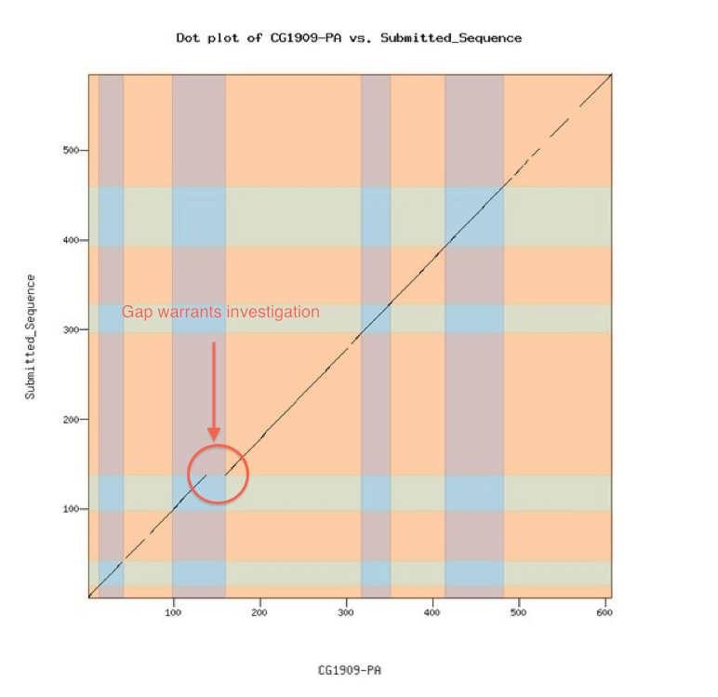
Can we reach more faculty and students?
Biggest need: generate a system making it easier to load a new genome into a browser, adding evidence tracks to facilitate annotation; now funded by NIH to work with Galaxy
Needs to include the ability to check work as you go
Designed to enable faculty to create their own projects, or work in their preferred model organism
Will facilitate “satellite” groups, move move to self-sustaining operation.
Gene Model Checker →

Slide 16
GEP / Galaxy Project: G-OnRamp
Partnership with Jeremy Goecks & Luke Sargent, Oregon Health and Science University; Wash U, Wilson Leung & Yating Liu
Designed to work with eukaryotic genomes
Threes sources of evidence for gene annotation
  Suite of gene predictors
  Homology identification
  Transcriptional evidence from RNA-seq
Galaxy workflows and tools for generating evidence from raw data and visualizing evidence in genome browser (UCSC or JBrowse).

Slide 17
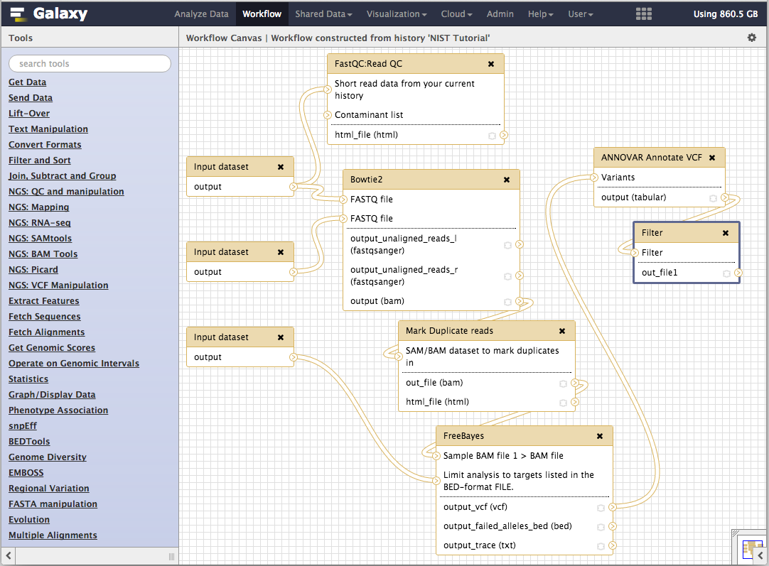
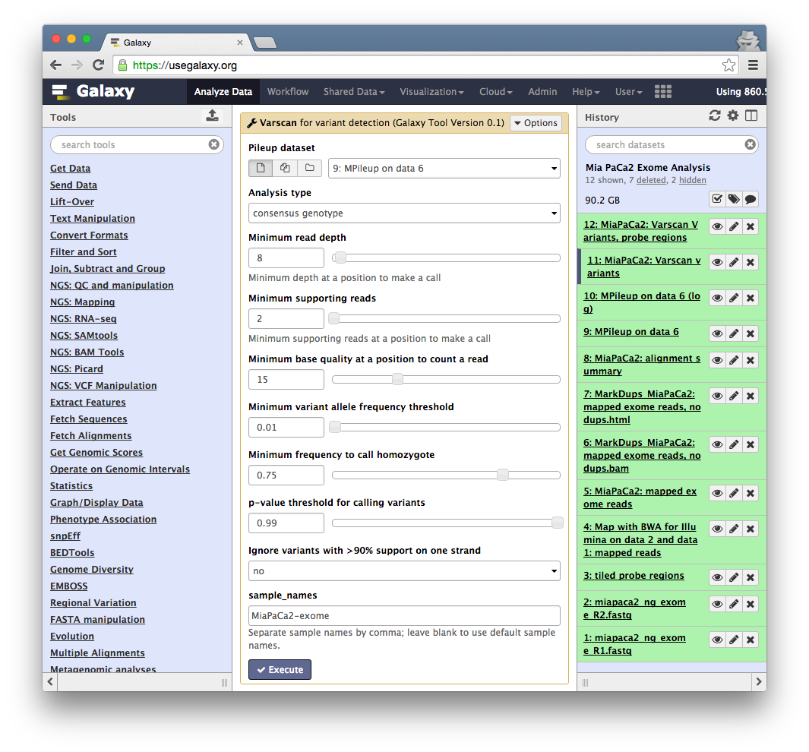
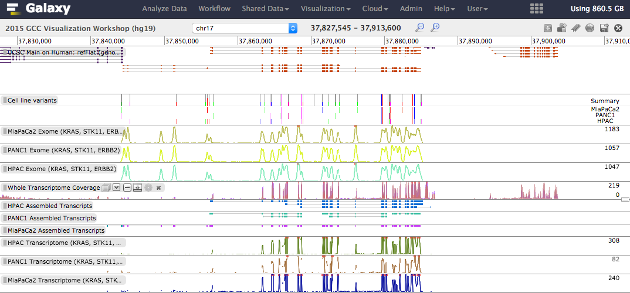
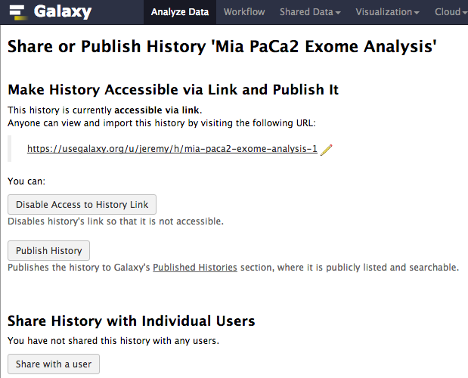
The Galaxy Project http://galaxyproject.org

Slide 18
Galaxy Project:
Fundamental Questions
When genomics (or any biomedical science) becomes dependent on computational methods, how to:
  make tools and workflows accessible to scientists?
  ensure that analyses are reproducible?
  enable transparent communication and reuse of analyses?

Slide 19
A free (for everyone) web service at
http://usegalaxy.org integrating a wealth of tools, compute resources, terabytes of reference data and permanent storage.
Open source software that makes integrating your own tools and data and customizing for your own site simple.
An open extensible platform for sharing tools, datatypes, workflows, ...

Slide 20
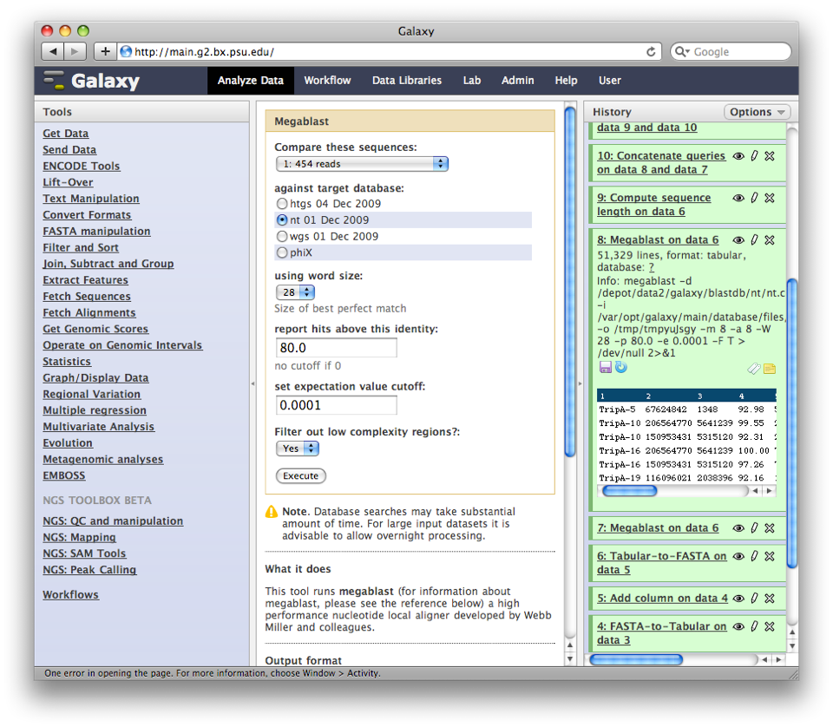
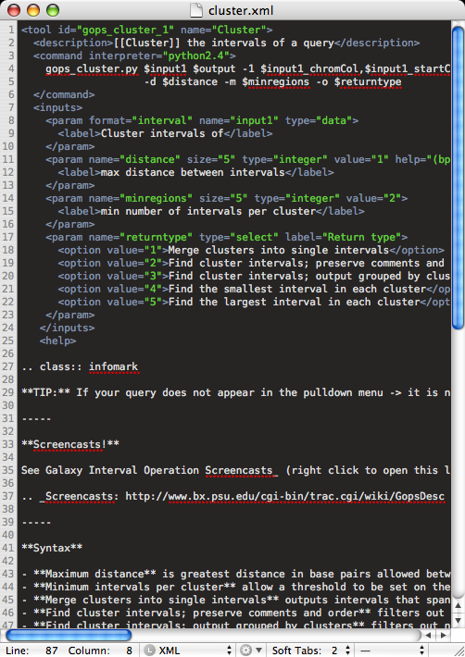
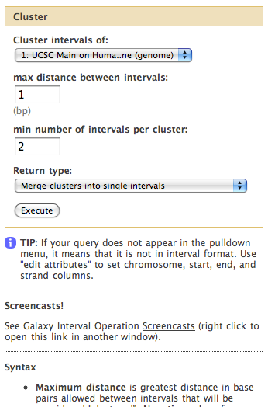
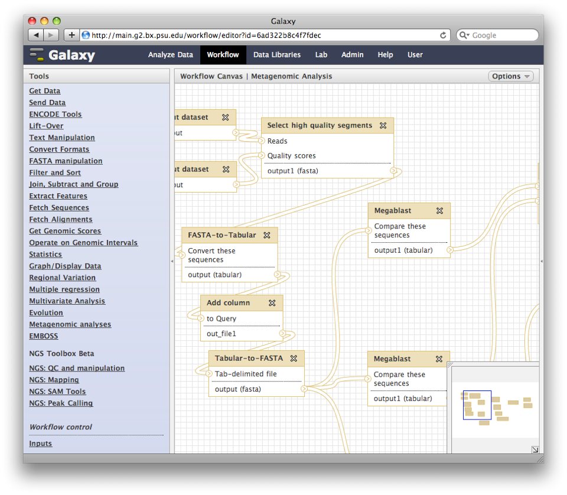
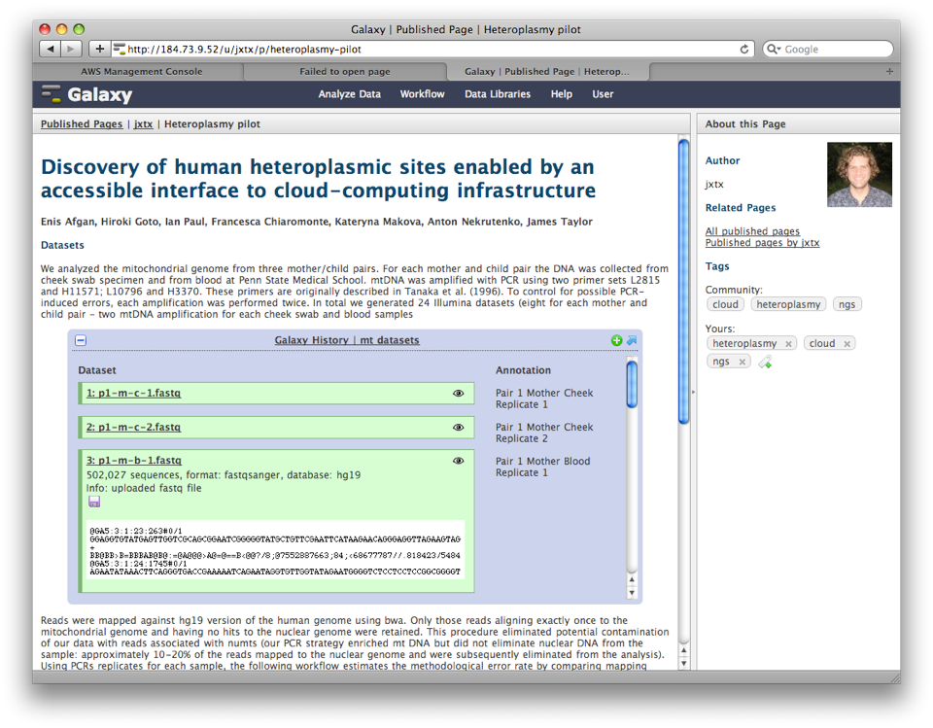
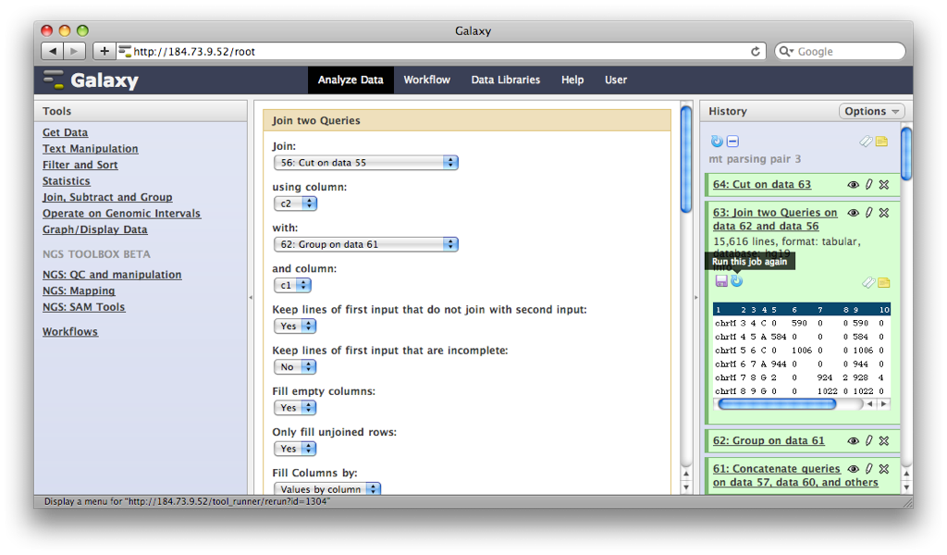
Describe analysis tool
behavior abstractly
Analysis environment automatically and transparently tracks details
Workflow system for complex analysis, constructed explicitly or automatically
Pervasive sharing, and publication
of documents with integrated analysis
Notes:
Bioinformatics research generates lots of useful little tools.
But, no incentive to make them robust, accessible to others, etc.
Can we make this easy enough that the incentive of tools being available in an integrated form outweighs and difficulty

Slide 21
Galaxy Usage
Cited in more than 4,600 publications
Main server at http://usegalaxy.org:
  ~500 new users per month, ~200 TB of user data, ~165,000 analysis jobs per month (http://bit.ly/gxystats)
80 public servers all over the world (http://bit.ly/gxyservers)
  15+ general servers, some supported by institutions
  Many domain-specific servers as well

Slide 22
Galaxy Citations

Slide 23
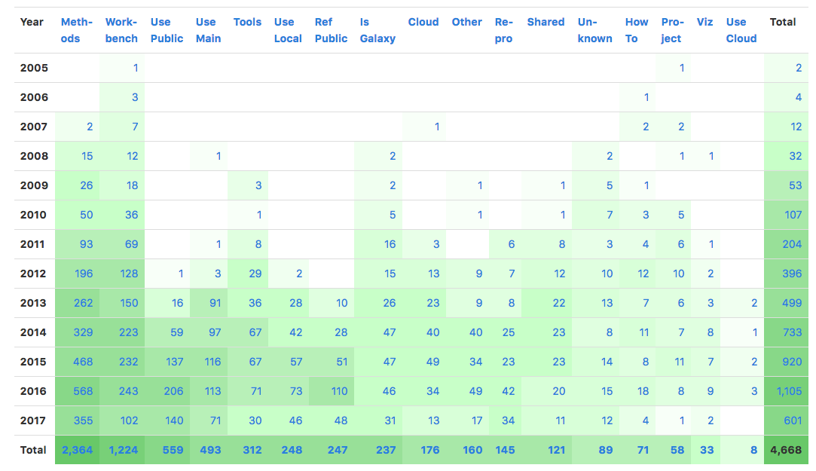
Galaxy Citations

Slide 24
Galaxy Main usage
(https://usegalaxy.org)

Slide 25
Galaxy Main usage
(https://usegalaxy.org)

Slide 26
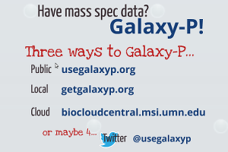
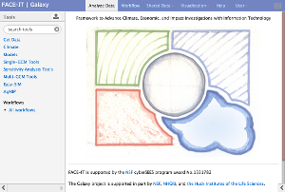
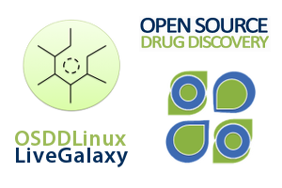
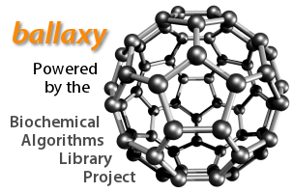
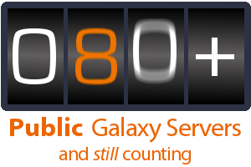

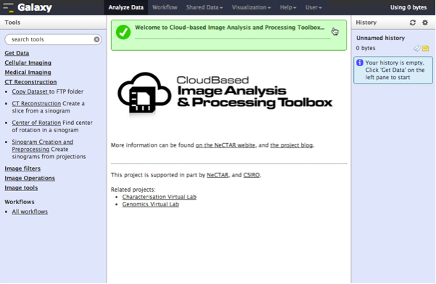
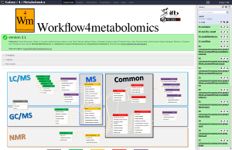
Proteomics
Metabolomics
Drug Discovery
Cosmology
Image Analysis
Climate Change Flow Cytometry Natural Language
Notes:
In fact Galaxy is used in all sorts of domains, some of them having nothing to do with life sciences.

Slide 27
Galaxy as a General Analysis Platform
For large-scale genome analysis, some type of platform is needed
Galaxy is for bioinformaticians too
  API for scripting and automation
  Devops (automated setup and administration) support
  Plug-in architecture: tools, visualizations, data sources, job engines, datatypes, and more…

Slide 28
Galaxy brings together key communities
Scientists
Developers
HPC
Galaxy

Slide 29
Where can you run Galaxy?
Public server: https://usegalaxy.org
On your own computer: https://getgalaxy.org
Cloud: https://launch.usegalaxy.org

Slide 30
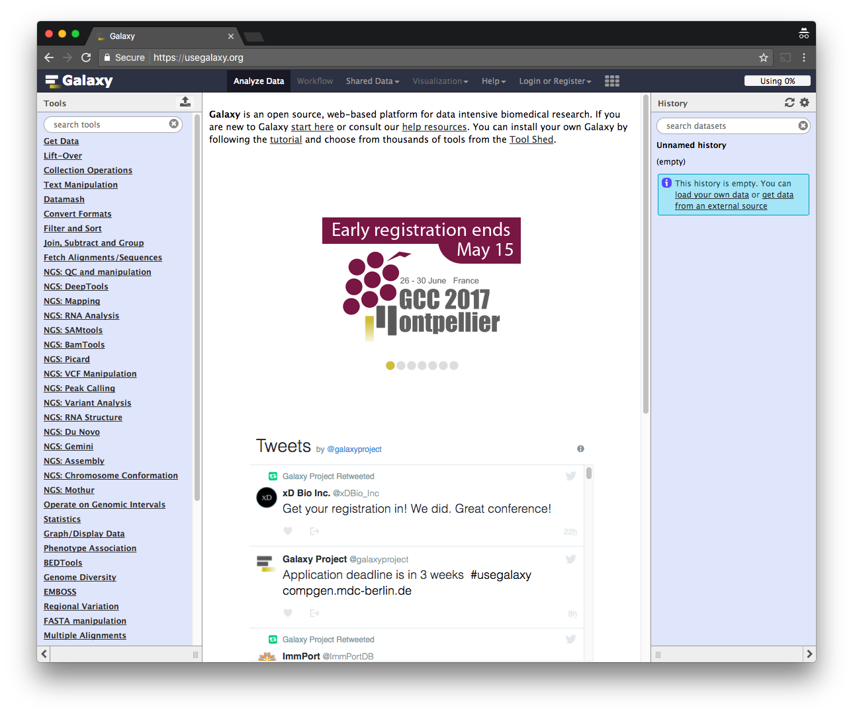
As a free for everyone service on the web: https://usegalaxy.org
Notes:
All of the screen shots we've seen are from usegalaxy.org, the galaxy project's public Galaxy server.

Slide 31


As a free for everyone service on the web: https://usegalaxy.org
A free (for everyone) web server integrating a wealth of tools, compute resources, petabytes of reference data and permanent storage
However, a centralized solution cannot support the different analysis needs of the entire world.

Slide 32

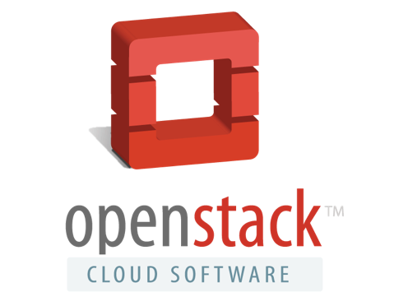


Galaxy is available on the Cloud
We are using this today
http://aws.amazon.com/education
http://wiki.galaxyproject.org/Cloud

Slide 33

Galaxy on the Cloud: Galaxy CloudMan
http://usegalaxy.org/cloud
Start with a fully configured and populated (tools and data) Galaxy instance.
Allows you to scale up and down your compute assets as needed.
Someone else manages the data center

Slide 34
Primary Galaxy Objects
Tools
  Simple (text manipulation) to complex (read alignment, differential expression)
Datasets
  Get from web databases, local computers or produced by tools/workflows
Histories
  Tools used as well as inputs, intermediate, and output datasets
  Parameter settings used in each step
  A complete record of your analysis
Workflows (Pipelines)
  Exported from the Histories
  Tools and parameters selected for an analysis process but not the datasets
  Automated, multi-step analyses using several tools
Visualizations, Data libraries

Slide 35
Each Galaxy Instance/Server is Unique
Tools, datasets, histories, workflows, and user accounts exist on a particular instance/server
Can move many objects between servers, but not always easy (yet)
Not all G-OnRamp tools are available on main server or the cloud (yet)

Slide 36
Important Galaxy links
Everything: https://galaxyproject.org
Public server: http://usegalaxy.org
Tutorials: https://galaxyproject.org/learn/
Run Galaxy on your own computer/cluster: https://getgalaxy.org
Run Galaxy on the AWS or Jetstream cloud: https://launch.usegalaxy.org

Slide 37
Galaxy Glossary (Resources)

Slide 38
Galaxy Resources and Community
Question and Answer boards (very active)
Unified Search
Issues Board
Events Calendar, News Feed
Community Wiki
GalaxyAdmins
Screencasts
Tool Shed
Public Installs
CiteULike group, Mendeley mirror
Annual Community Meeting
http://wiki.galaxyproject.org

Slide 39
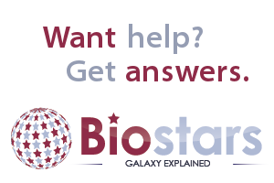
Galaxy Community Resources: Galaxy Biostar
Tens of thousands of users leads to a lot of questions
Absolutely have to encourage community support
Project traditionally used mailing list
Moved the user support list to Galaxy Biostar, an online forum, that uses the Biostar platform
https://biostar.usegalaxy.org/

Slide 40
Galaxy Community Resources: Mailing Lists
Galaxy-Dev
Galaxy-Announce
Low volume (36 posts in 2015, 6500+ members)
Galaxy-UK, -France, -Proteomics, -Training, ...
https://galaxyproject.org/mailing-lists/

Slide 41
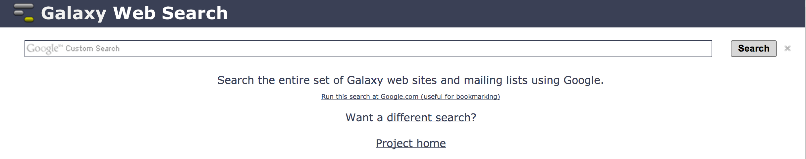
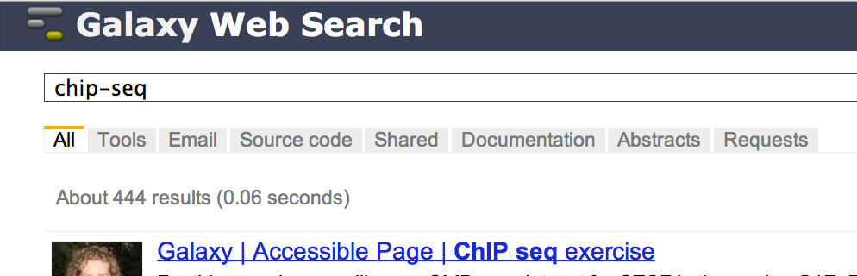
Unified Search:
http://galaxyproject.org/search
Find:
Everything on …
Tools for …
Email about …
Source code for …
Published Histories, Pages, Workflows, about …
Related feature requests
Papers using Galaxy for …
Documentation on …

Slide 42
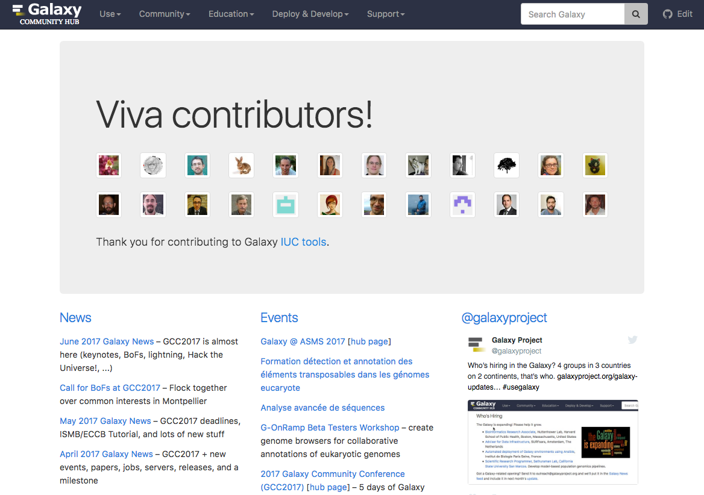
Galaxy Community Hub
https://galaxyproject.org/

Slide 43
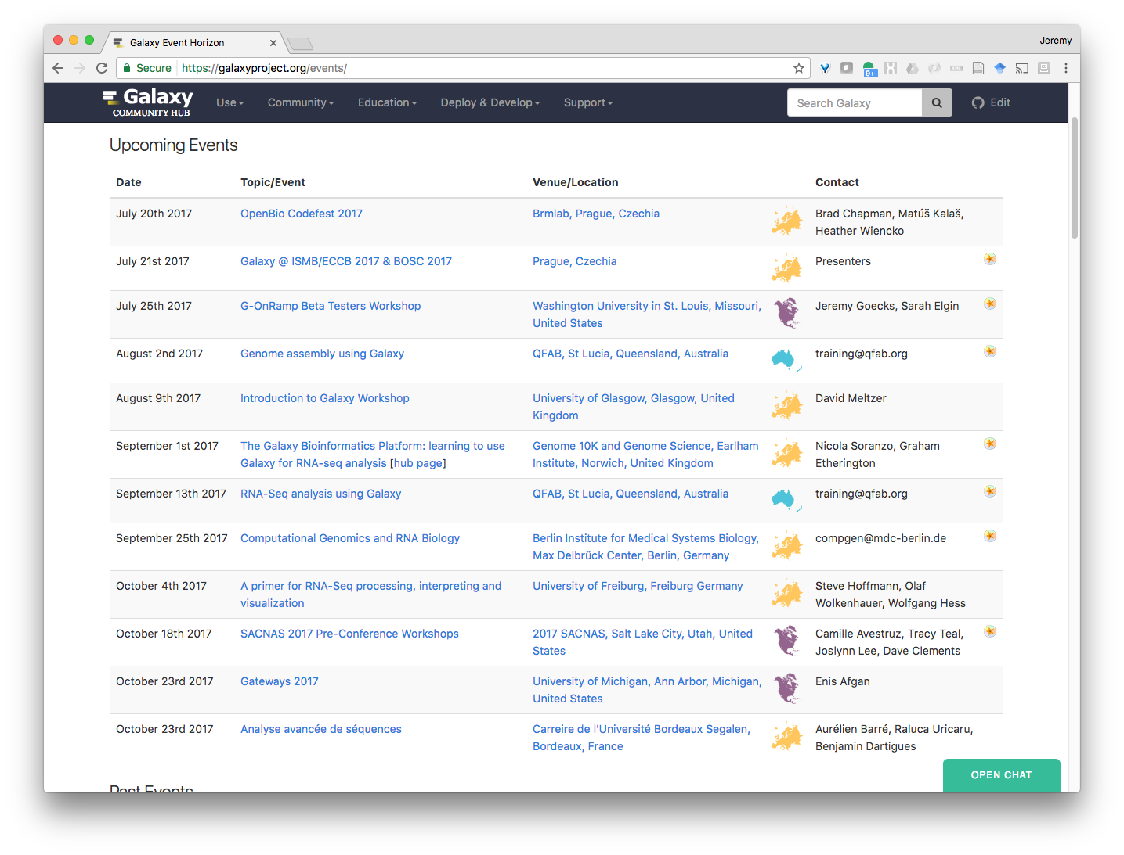
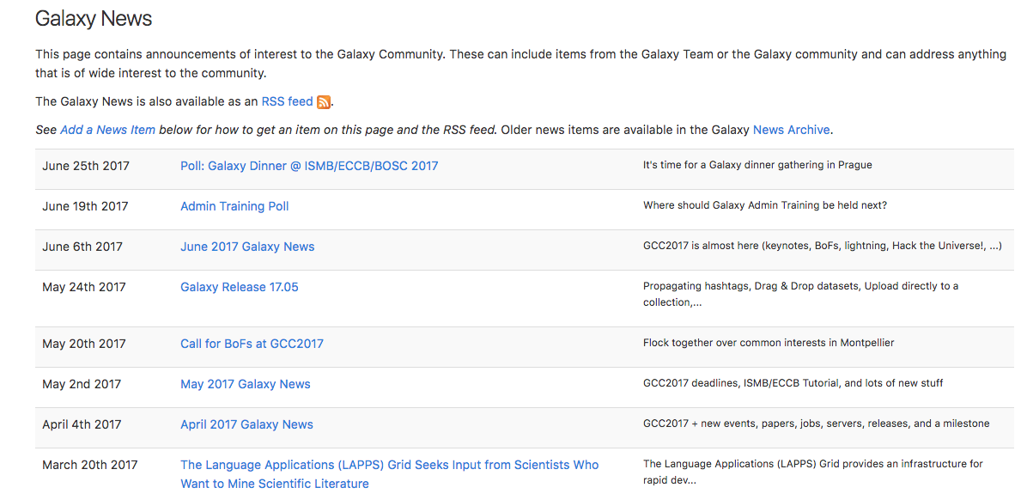
Events
News

Slide 44
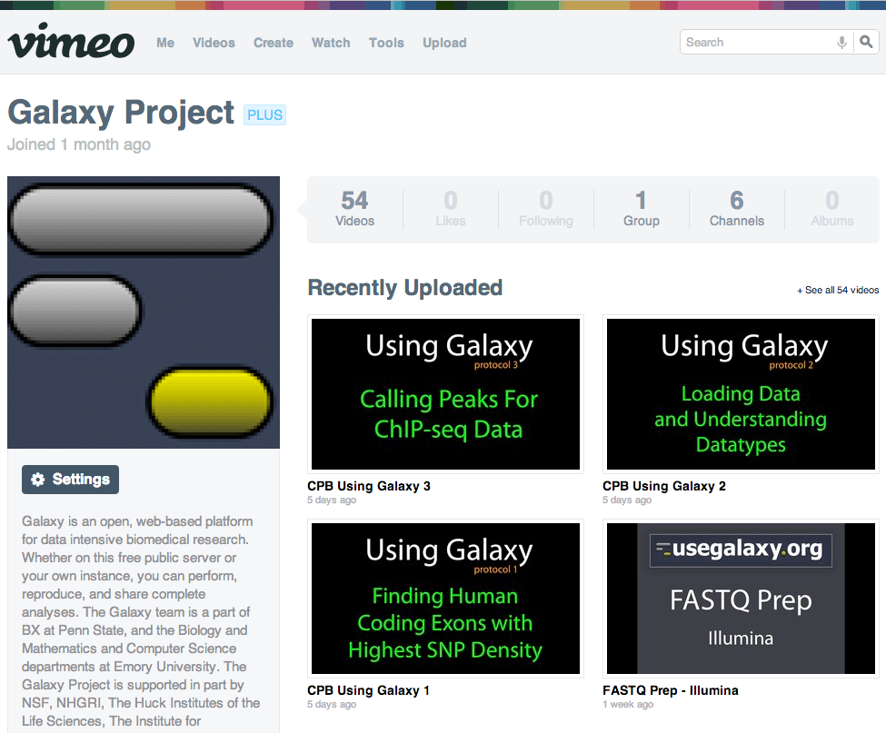
Galaxy Resources & Community:
Videos
“How to” screencasts on using and deploying Galaxy
Talks from previous meetings.
https://vimeo.com/galaxyproject

Slide 45
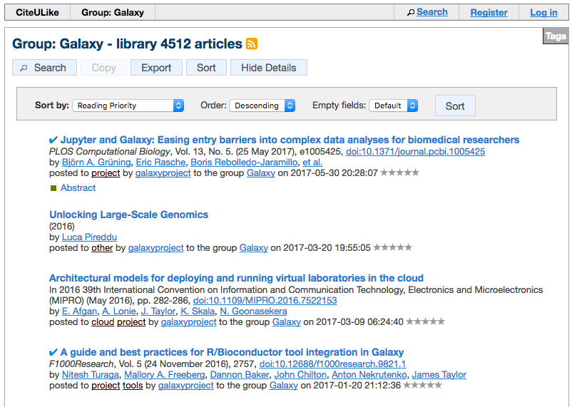
Galaxy Resources & Community: CiteULike Group
http://bit.ly/gxycul

Slide 46
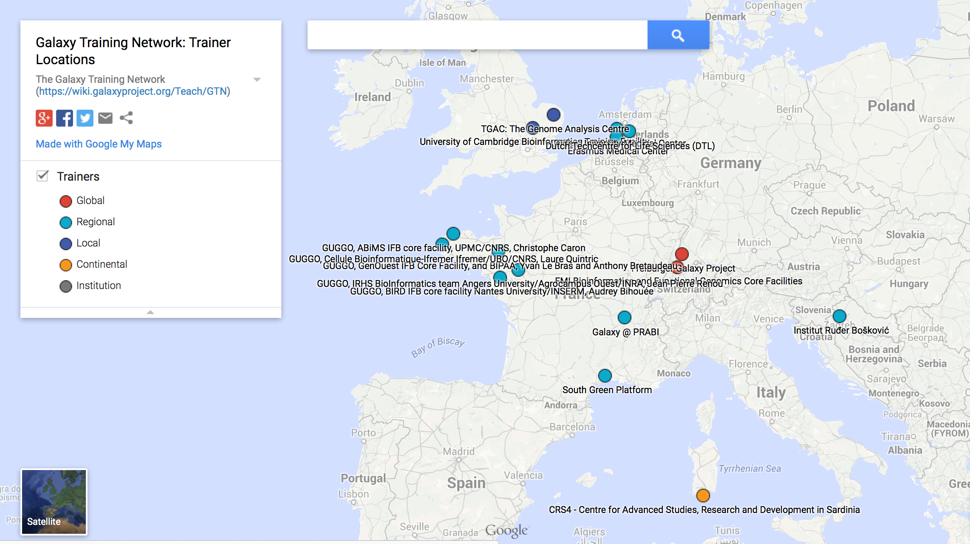
Galaxy Training Network
Galaxy Training Network launched In October 2014.
bit.ly/gxygtn
https://galaxyproject.org/teach/gtn/
Notes:
TODO

Slide 47
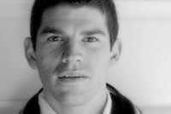
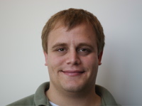
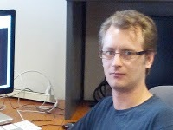
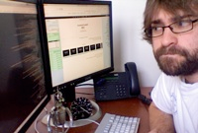
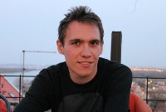
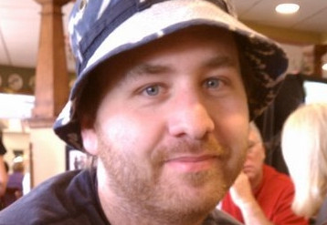
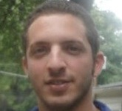





The “Core” Galaxy Team
Engineering
Enis Afgan
Dannon Baker
Dan Blankenberg
Dave Bouvier
Nate Coraor
Martin Čech
John Chilton
Sam Guerler
Nick Stoler
Vahid Jalili
Support and outreach
Leadership
Communications
Leadership
Dave Clements
Jennifer Jackson
James Taylor
Anton Nekrutenko
Jeremy Goecks
Supported by the NHGRI (HG005542, HG004909, HG005133, HG006620), NSF (DBI-0850103), Penn State University, Johns Hopkins University, Oregon Health and Science University, and the Pennsylvania Department of Public Health

Slide 48








Extended team and other contributors…
Björn Grüning
Uni Freiburg
Peter Cock
TJHI
Kyle Ellrott
OSHU
Eric Rasche
CPT
Nicola Soranzo
TGAC
Brad Chapman
HSPH
Nuwan Goonasekera
VeRSI
Yousef Kowsar
VLSCI
And many others who have contributed to the main Galaxy code and to tools for the ToolShed, participated in discussions, attended the Galaxy conferences, …

Slide 49

G-OnRamp Galaxy Workflow

Slide 50

Executing the Workflow creates the browser

Slide 51


Executing the Workflow creates the browser

