Slide 1
Introduction to
G-OnRamp
From Galaxy to Genome Annotation
Jeremy Goecks and Luke Sargent

Slide 2
G-OnRamp Motivations
GEP has shown great success but there are several challenges:
  Limited to the analysis of different Drosophila species
  Limited flexibility to incorporate other analyses and data into the curriculum
  Collaboration is restricted to a central organization

Slide 3
GEP + Galaxy = G-OnRamp
G-OnRamp strengths:
  Works with any eukaryotic genomes
  Customizable workflows and analyses
  Automated installation and configuration of computational tools
  Web-based framework with built-in shared objects for collaboration

Slide 4
Fully customizable workflow

Slide 5
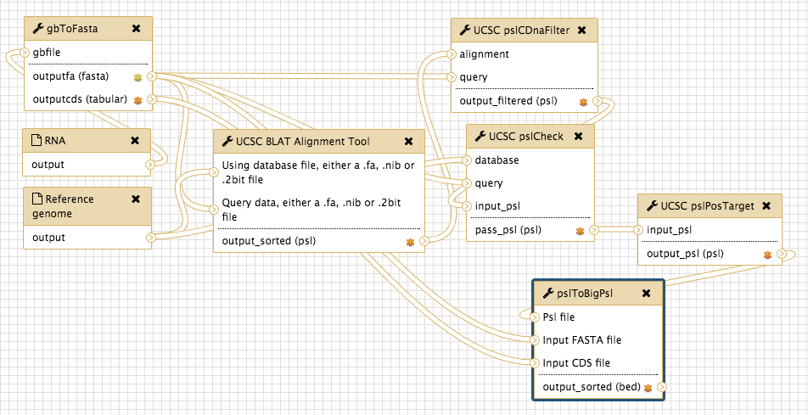
Sub-workflow: BLAT Alignment
Produces translated BLAT alignments to GenBank mRNA sequences

Slide 6
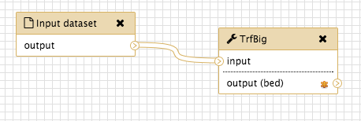
Sub-workflow: Simple Repeats
Identifies tandem repeats using TrfBig

Slide 7
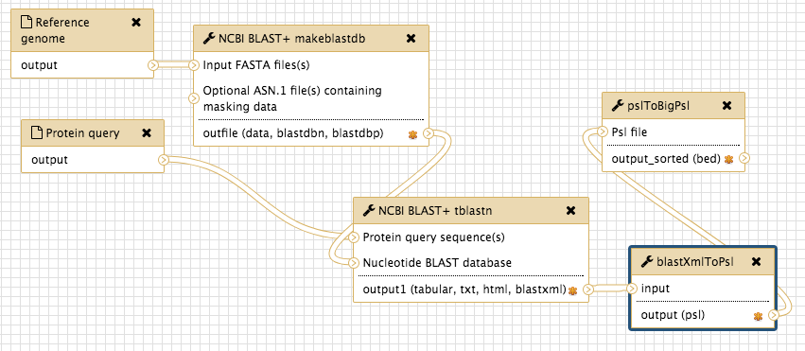
Sub-workflows: Homology
tblastn
sub-workflow
BLAT
sub-workflow

Slide 8
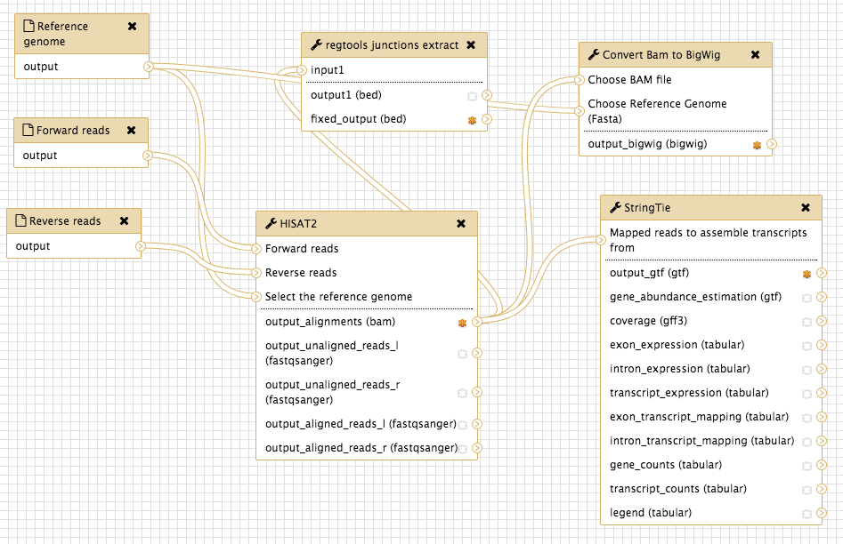
Sub-workflow: RNA-Seq
RNA-Seq read mapping with HISAT and assembly with StringTie

Slide 9
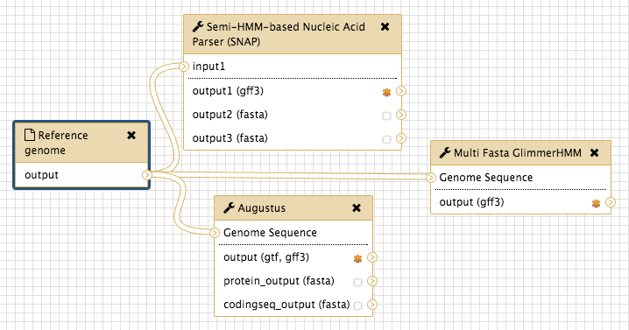
Sub-workflow: Gene Predictions
Gene predictions with Augustus, GlimmerHMM, and SNAP

Slide 10
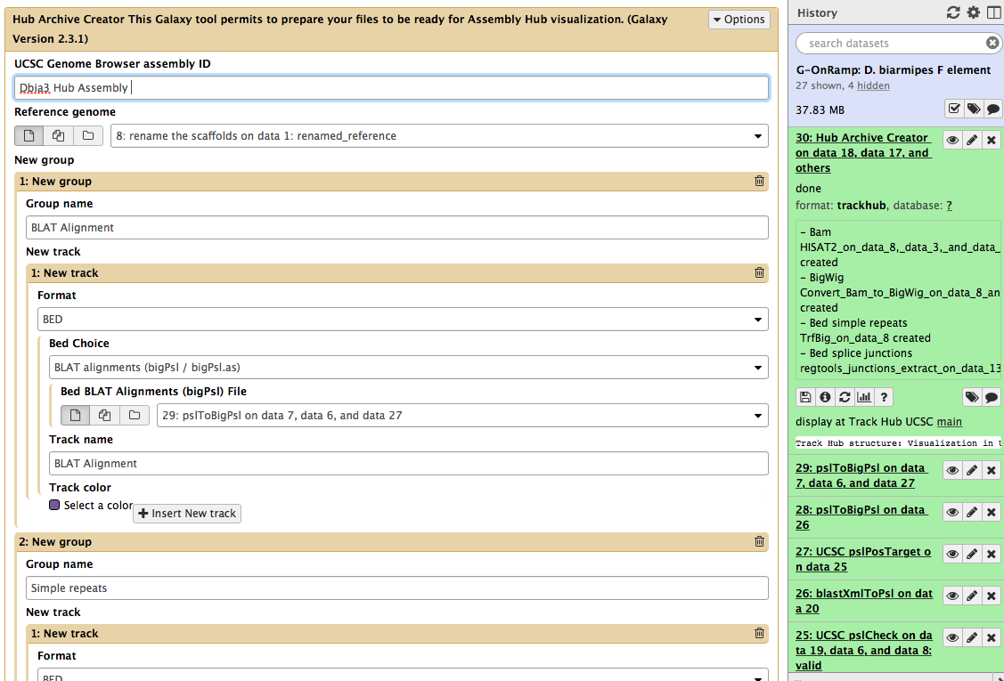
Tune parameters and Run!

Slide 11
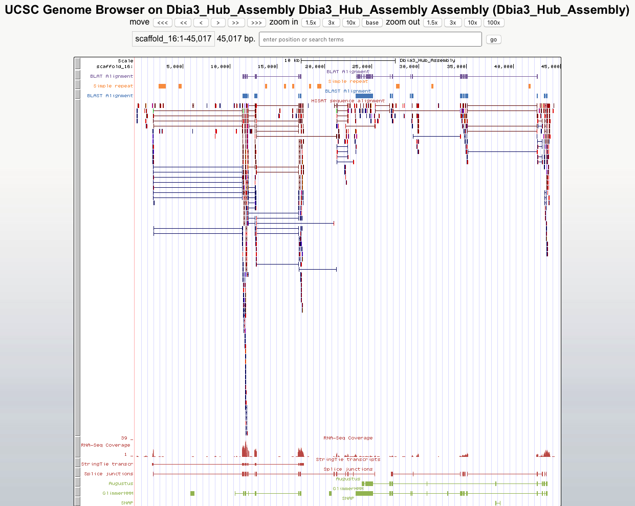
G-OnRamp to the UCSC Assembly Hub (and JBrowse!)

Slide 12
G-OnRamp future
Extend workflow with new annotation sources:
  ChIP-seq
  DNase-seq/ATAC-seq
  DNA methylation (bisulfite sequencing)
Fully-automated deployment
More supporting tools similar to GEP
Data storage and backup through CyVerse

Slide 13
Questions?
Up Next: Walkthrough
  Import sample data
  Import G-OnRamp workflow
  Run workflow to generate results
  Visualize results in the UCSC genome browser

