Slide 1
Welcome to the
G-OnRamp Workshop
July 16 – 19, 2018 SCR Elgin, J Goecks
Funded by the NIH BD2K Program,
with continuing GEP support from NSF and Washington University in St Louis,
and Galaxy support from NHGRI, NCI, NSF, and Oregon Health and Science University.
Copyright 2018 Washington University

Slide 2
Workshop Participants
J. Antonio Baeza-Migueles Clemson University
John Bermingham Washington University in St. Louis
Indrani Bose Western Carolina University
Lijing Bu University of New Mexico
Pradheep Chhalliyil Genetic ID
Olivier Fedrigo Rockefeller University
Cristina Fernandez-Marco Cold Spring Harbor Laboratory
Vanessa Gonzalez Smithsonian Institution
Pingheng Hsieh Institute of Information Science, AS, Taiwan
Amanda Hulse-Kemp USDA - ARS
Katherine Jensen UNCC & Smithsonian Institute
Rick Meyer Donald Danforth Plant Science Center
Antonette Todd Delaware State University
Mirian Tsuchiya Smithsonian Institute
James Wachira Morgan State University
Brian Wey City College of City University of New York
Sally Elgin, Wilson Leung,
Chris Shaffer, Yating Liu Washington University in St Louis, MO
Jeremy Goecks, Luke Sargent Oregon Health Sciences University
Fusion of Galaxy and the Genomics Education Partnership
Notes:
Instructor: Professor Sarah CR Elgin
Slide:
Sources:
Notes:

Slide 3

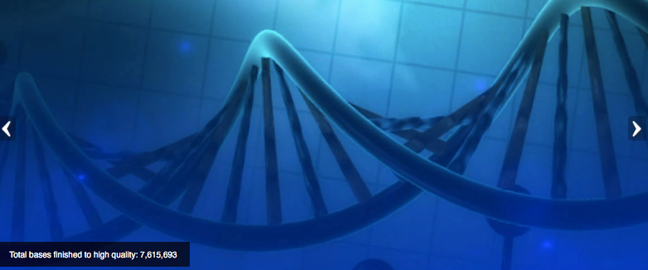
Goals:
Integration of genomics into the undergraduate biology curriculum
Integration of research thinking into the academic year curriculum
Creation of dynamic student-scientist partnerships
Publication of research in genomics & in science education
Advantages of bioinformatics for course-based research:
  Low laboratory costs (computers, internet connection)
  Web based tools (IT support, installation)
  No lab safety issues; open access 24/7
  Lends itself to peer instruction
  Allows low-cost failure
  Large pool of publically accessible raw data
Currently 126 faculty from >100 colleges & universities; last year 74 schools claimed projects, >1500 students involved.
Notes:
Started over 10 years ago, We realized from teaching a genoimcs researched based course some of the benefits of a research experience of this type
1. cost; 2. Safety; 3. data availabitly; 4. Acsessibilty (many web based tools)
Instructor: Professor Sarah CR Elgin
Slide: Faculty join by coming to a 1-week workshop at Wash U to learn software tools and approach.
Sources:
Talk specifically about each advantage and each goal –in particular the “no lab safety so lends peer instructio”
Notes:

Slide 4
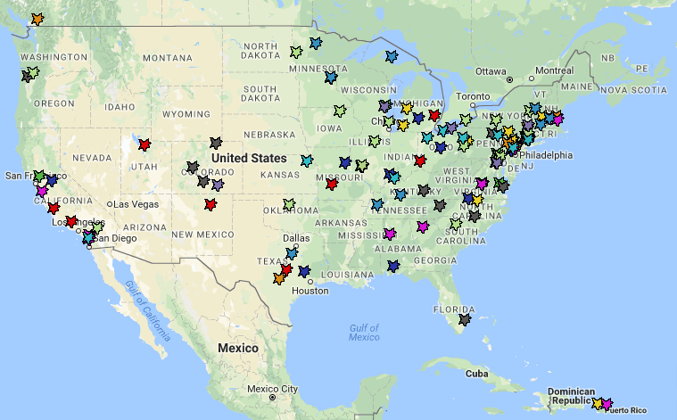

Current GEP Membership
Mostly
PUIs &
community
colleges
2006
2007
2008
2009
2010
2011
Year joined:
2012
2013
2014
2015
2016 & 2017

Slide 5
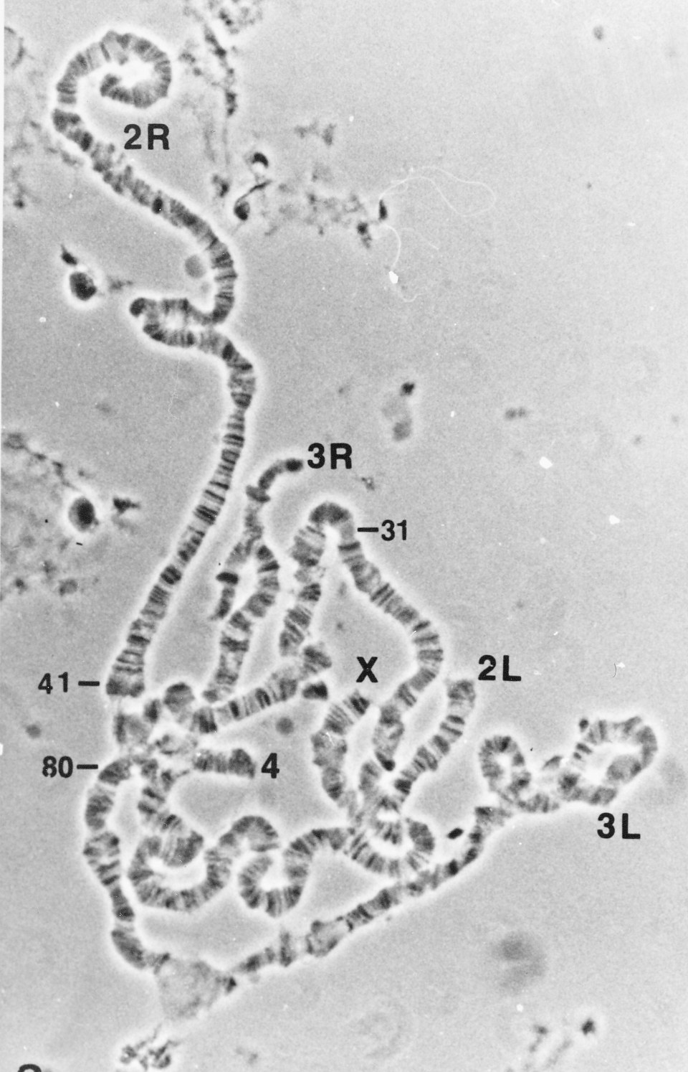
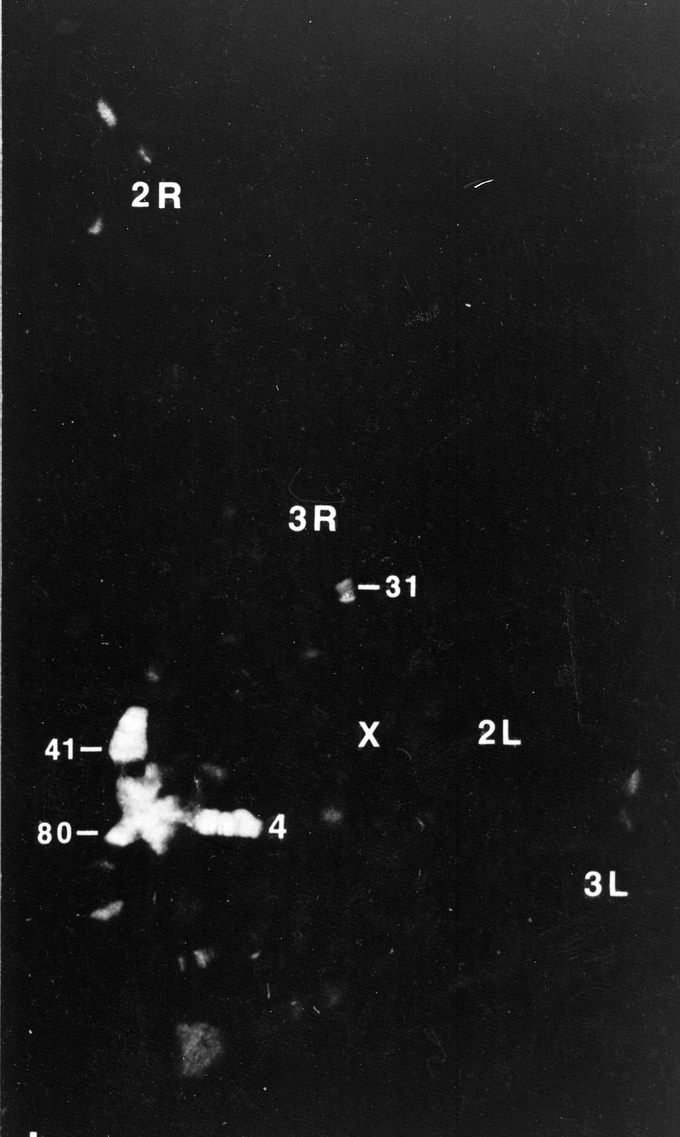
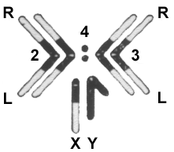
The Drosophila melanogaster fourth chromosome (F element) is largely heterochromatic (packaged with HP1a) but has ~80 genes
F
D
James et al, 1989, Europ J Cell Bio 50: 170
C
C
Phase
HP1
Notes:
To look for proteins preferentially associated with heterochromatin, we prepared monoclonal antibodies against proteins that bind tightly in the nucleus, and screened by using the antibodies for immunofluorescent staining of the polytene chromosomes. Heterochromatin Protein I (HP1) is preferentially associated with the chromocenter, small fourth chromosome, telomeres, and a few sites in the chromosome arms.

Slide 6
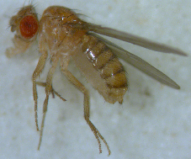
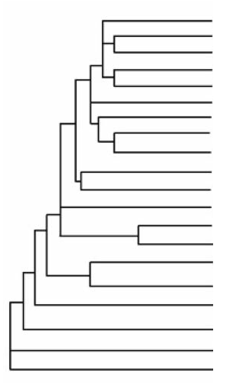
Drosophila comparative genomics: to understand the organization, evolution and gene function on the 4th (dot) chromosome
D. melanogaster
D. simulans
D. sechellia
D. yakuba
D. erecta
D. ficusphila
New species sequenced by modENCODE
D. eugracilis
D. biarmipes
D. takahashii
D. elegans
Reference
D. rhopaloa
2010 Genetics publication
D. kikkawai
D. bipectinata
2015 G3 publication
D. ananassae
D. pseudoobscura
2017 G3 publication
D. persimilis
D. willistoni
Ongoing annotation
D. mojavensis
D. virilis
D. grimshawi
Phylogenetic tree produced by Thom Kaufman as part of the modENCODE project
Notes:
Anticipate that we will work on the remaining projects from the D. elegans F element and new projects from the D element this Fall.
Plan to have TSS only projects for D. biarmipes

Slide 7
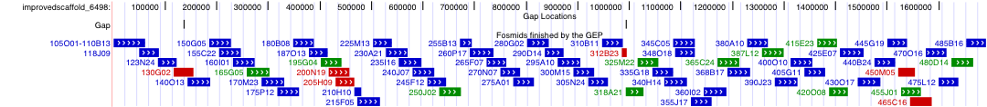
Strategy: divide and conquer!
Students improve the sequence & carefully annotate the genes
Use publically available genome sequences from the web
Divide into 40 - 100 kb projects, which different schools claim & then submit
Each project done at least twice independently; checked by advanced student, results reconciled
For D. mojavensis, students covered 1.7 Mb, closed 26 of 28 gaps,
added/improved 20 Kb, and annotated all potential genes.
Fosmid sequence matches consensus sequence
Putative polymorphisms
Finished sequences are made publicly available;
annotations are linked to FlyBase.
This could not be accomplished without the efforts of hundreds of students!

Slide 8
The Genomics Workflow
Public “draft” genomes
http://gep.wustl.edu
Divide into overlapping student projects(~40kb)
Annotation
Sequence and assembly improvement
Evidence-based gene annotation
Collect projects, compare and verify final consensus sequence
Collect projects, compare and confirm annotations
Sequence Improvement
Reassemble into high quality annotated sequence
Students learn to use a UCSC genome
browser, BLAST, FlyBase, Clustal, others.
Students present findings at local meetings;
GEP publishes as group.
Analyze and publish results

Slide 9
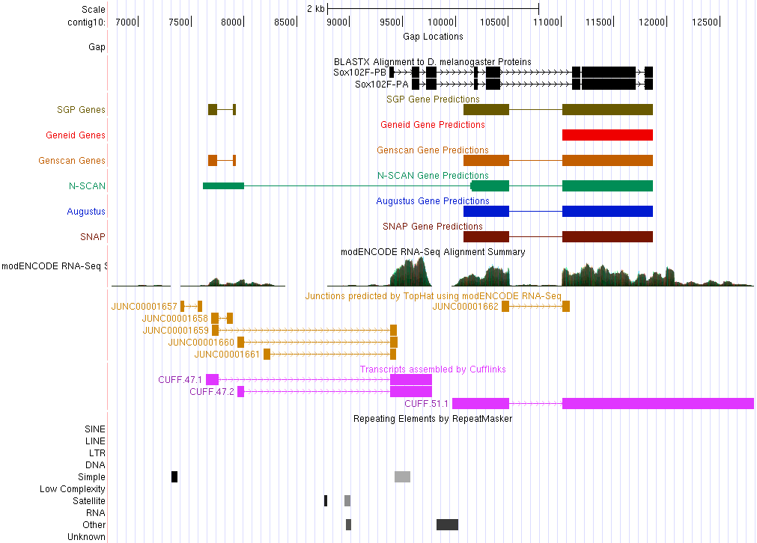
Annotation challenge: Create gene models from evidence: sequence similarity, computational predictions, RNA-Seq, etc.
(local UCSC Browser)
Improved Sequence
Sequence Homology
Gene Predictions
RNA-Seq, TopHat, Cufflinks
Repeats
Notes:
Browser allows us to map various evidence tracks against the improved genome sequence for a given species.

Slide 10
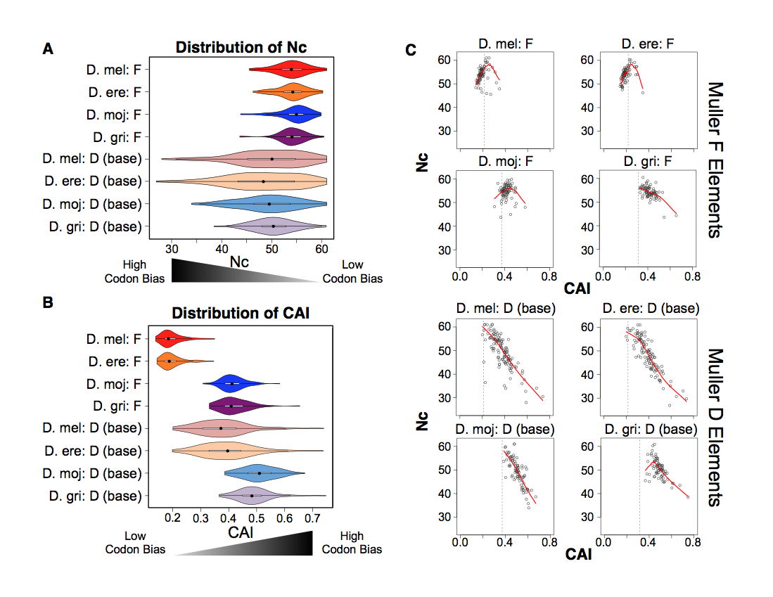
Pooling student data allows us to analyze patterns of evolution of different chromosome domains
Notes:
Simplify? Or figure two from paper? Or the hot spot

Slide 11
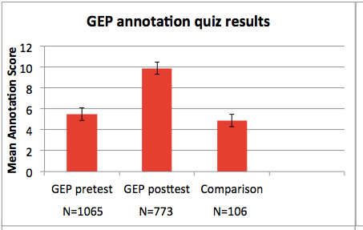
GEP annotation quiz results ’10 – ’12;
similar results obtained for ‘15 – ’17.
Notes:
Metric for measuring how much the students did learn through knowledge quizzes

Slide 12
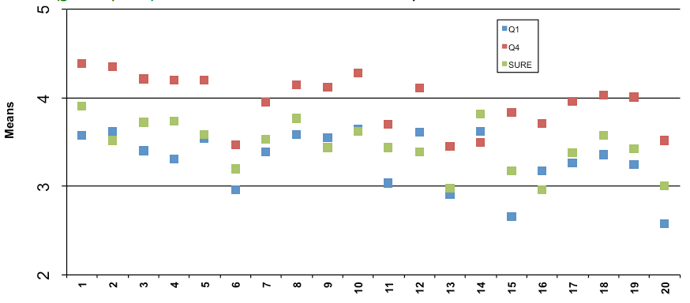
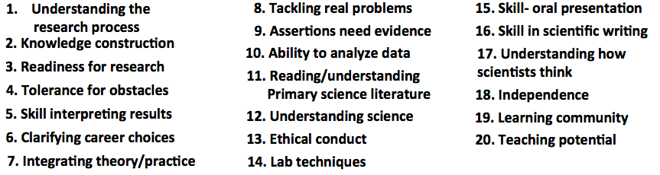
Survey results comparing ~10 hr course (blue) and
~45 hr course (red) with summer-in-the-lab (green)
.
GEP school
SURE 09 Bio
Notes:
Sample size: WU ~45, SURE 09 1200, soph lab 90, all GEP 350. Conclude that 1 semester is enough, 10 hr not enough. Instructors goal – use annotation to teach gene structure, any understanding of research is bonus!

Slide 13
Selected student quotes…..
The class was very intellectually challenging for me. It taught me to think in a way that I had never thought before.
It was a great team-building and learning experience. It was independent work, but you were going through the same things as the other students and built camaraderie.
Everything we gained from the class…was either found by desperately messing around on the various websites …or by talking with other students.
I know if I could survive this class then I could survive just about anything.
Notes:
80% of the comments were positive, 20% were not
Initial frustration that were convinced by their own success

Slide 14
Recent hypothesis:
“formative frustration” (struggle) is important!
Reports from GEP Faculty
Blue = positive impact
Red = negative impact
Green = no impact
D. Lopatto;
J. Brennan
How likely are you to let your students take risks/fail….
In wet lab work… 32% 50% 10%
In GEP research... 67% 27% 1%
Very likely Moderately Not at all
Notes:
Scaling is one of the big issues;
Ongoing debate if we can some yes some no
Could use online
Ways that could help include

Slide 15
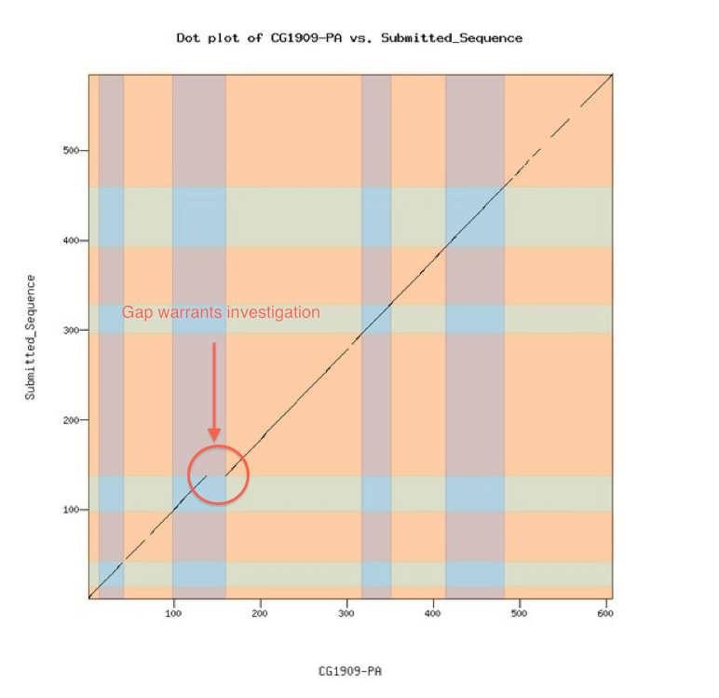
Can we reach more faculty and students?
Biggest need: generate a system making it easier to load a new genome into a browser, adding evidence tracks to facilitate annotation; funded by NIH to work with Galaxy to achieve this.
Needs to include the ability to check work as you go: use Gene Model Checker
Designed to enable faculty to create create their own projects, or work work in their preferred model
organism
The GEP is actively looking for
new projects for students.
Gene Model Checker →

Slide 16
GEP / Galaxy Project: G-OnRamp
Partnership with Jeremy Goecks & Luke Sargent, Oregon Health and Science University; Wash U, Wilson Leung & Yating Liu
Goal: custom annotation workflow
Designed to work with eukaryotic genomes
Threes sources of evidence for gene annotation
  Suite of gene predictors
  Homology identification (given reference species)
  Transcriptional evidence from RNA-seq
Galaxy workflows and tools for generating evidence from raw data and visualizing evidence in a genome browser (UCSC or JBrowse).

Slide 17
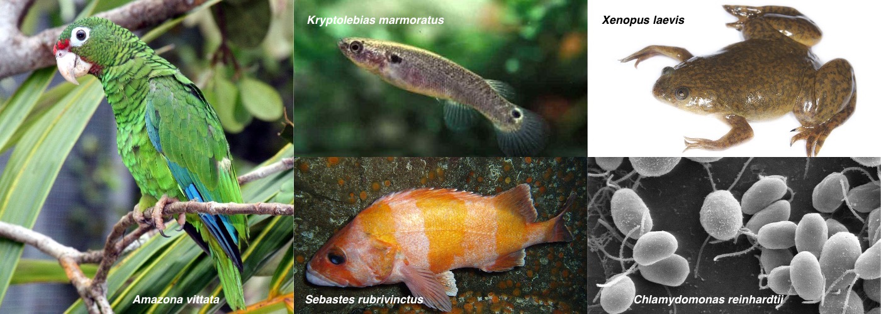
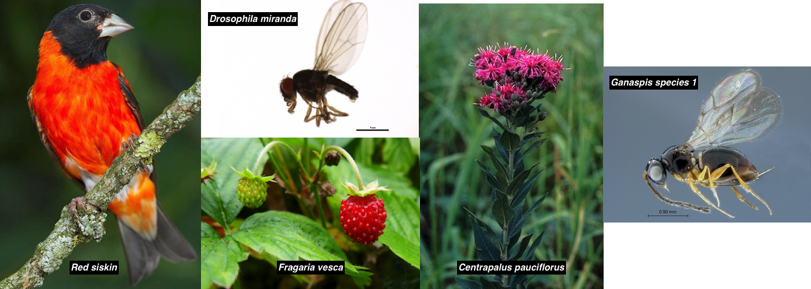
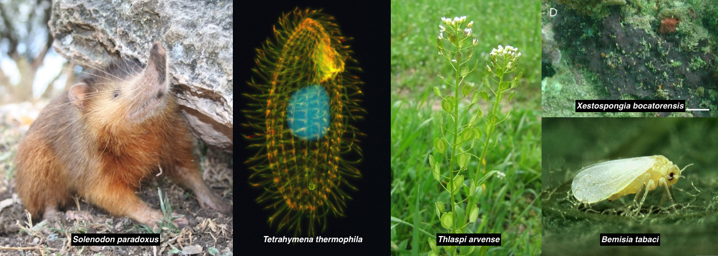
2017 G-OnRamp Workshops
15 genome browsers created:
      Assembly sizes: 70Mb - 2.8Gb
      Number of scaffolds: 54 - 402,501
Data hosted on the CyVerse Data Store
    http://gonramp.org ➜ “View Assembly”
June 2018 G-OnRamp Workshop
Solenodon paradoxus | Haitian solenodon or agouta
Schrenkiella parvula | Brassicaceae
Chlamydomonas reinhardtii | Unicellular green algae
Aiptasia pallida | Sea anemone
Avena atlantica | Oats
Potamopyrgus antipodarum | The New Zealand mud snail
Taeniopygia guttata | Zebra Finch

Slide 18
Conclusions:
Genomics is an excellent topic for CUREs (course-based undergraduate research experiences)
Evidence points to
  knowledge gains
  gains in understanding of science
Massively parallel undergraduates can accomplish research that could not be done in any other way!
How to create varied opportunities? G-OnRamp should make it easy to create good genome browsers for annotating new genomes to answer novel research questions. Consider partnering with students!
Notes:
Scaling is one of the big issues;
Ongoing debate if we can some yes some no
Could use online
Ways that could help include

Slide 19




G-OnRamp http://gonramp.org
Ready to use Galaxy server and workflows for genome annotation
  for any eukaryotic genome, can adapt as needed
  generates genome browser for doing manual annotation
  integrates into ecosystem of bioinformatics tools such as UCSC Genome Browser, JBrowse/Apollo, and CyVerse
  applicable to both research and education, such as GEP
Reference genome
assembly
Sequence similarity
Hub Archive Creator
Transcripts / proteins from informant genome
Gene predictions
RNA-Seq analysis
JBrowse
Archive Creator
RNA-Seq
reads
Repeats

Slide 20
Galaxy features complement GEP challenges
GEP challenges | Galaxy features
Requires expertise (e.g., familiarity with Linux) to configure and run bioinformatics tools | Provides a web-based user interface to configure and run tools
Difficult to share workflows and results | Can make Histories, Datasets, and Workflows publicly available or share with individual Galaxy users
Difficult to incorporate additional analyses and tools | Can use the Workflow Canvas to modify existing workflows and add new tools from the Galaxy Tool Shed
GEP projects are currently limited to the analysis of different Drosophila species | Can extract a Workflow from History and run the Workflow on other genome assemblies

Slide 21
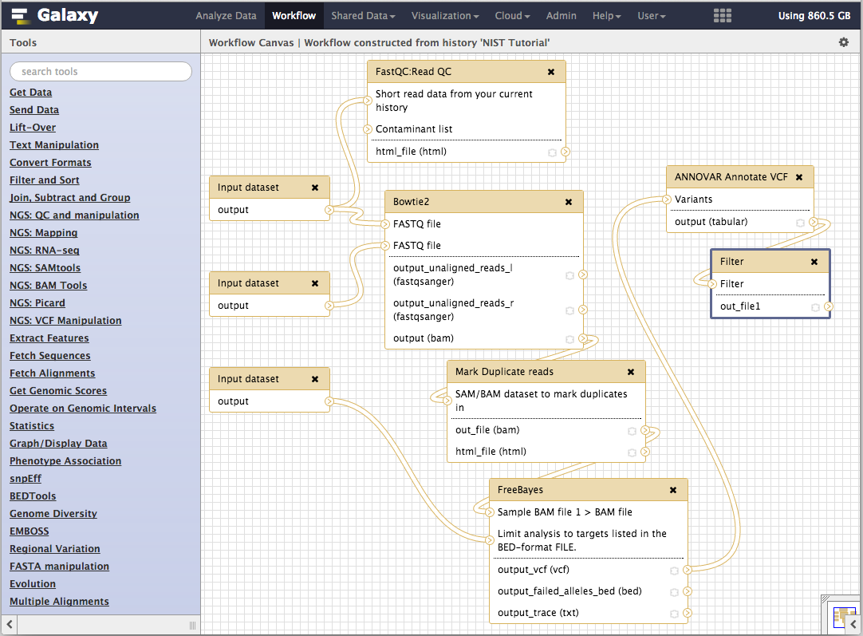
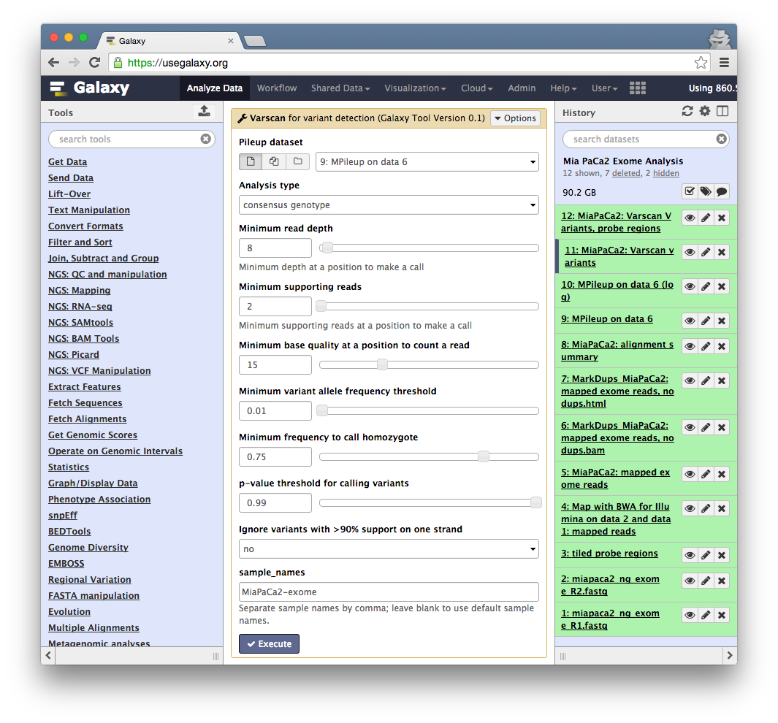
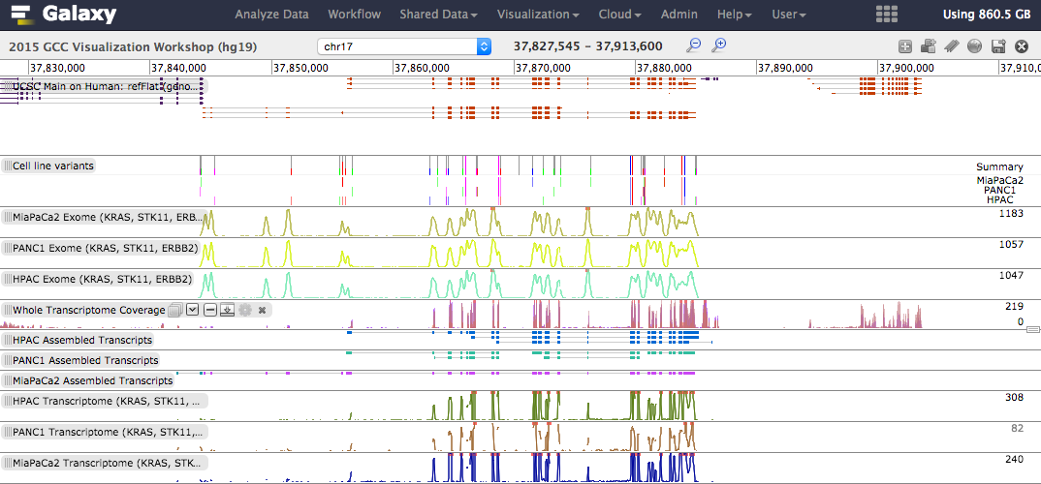
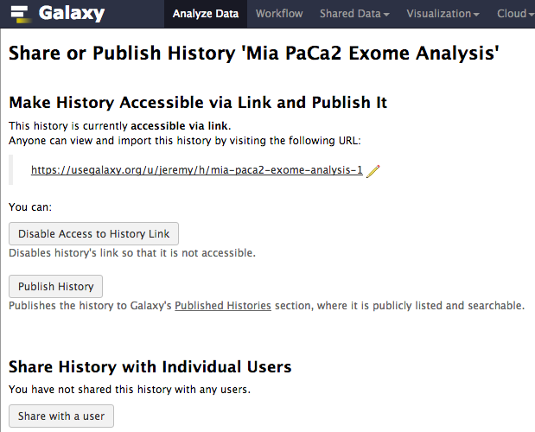
The Galaxy Project http://galaxyproject.org

Slide 22
Galaxy Project:
Fundamental Questions
When genomics (or any biomedical science) becomes dependent on computational methods, how to:
  make tools and workflows accessible to scientists?
  ensure that analyses are reproducible?
  enable transparent communication and reuse of analyses?

Slide 23
A free (for everyone) web service at
http://usegalaxy.org integrating a wealth of tools, compute resources, terabytes of reference data and permanent storage
Open source software that makes integrating your own tools and data and customizing for your own site simple
An open extensible platform for sharing tools, datatypes, workflows, ...

Slide 24
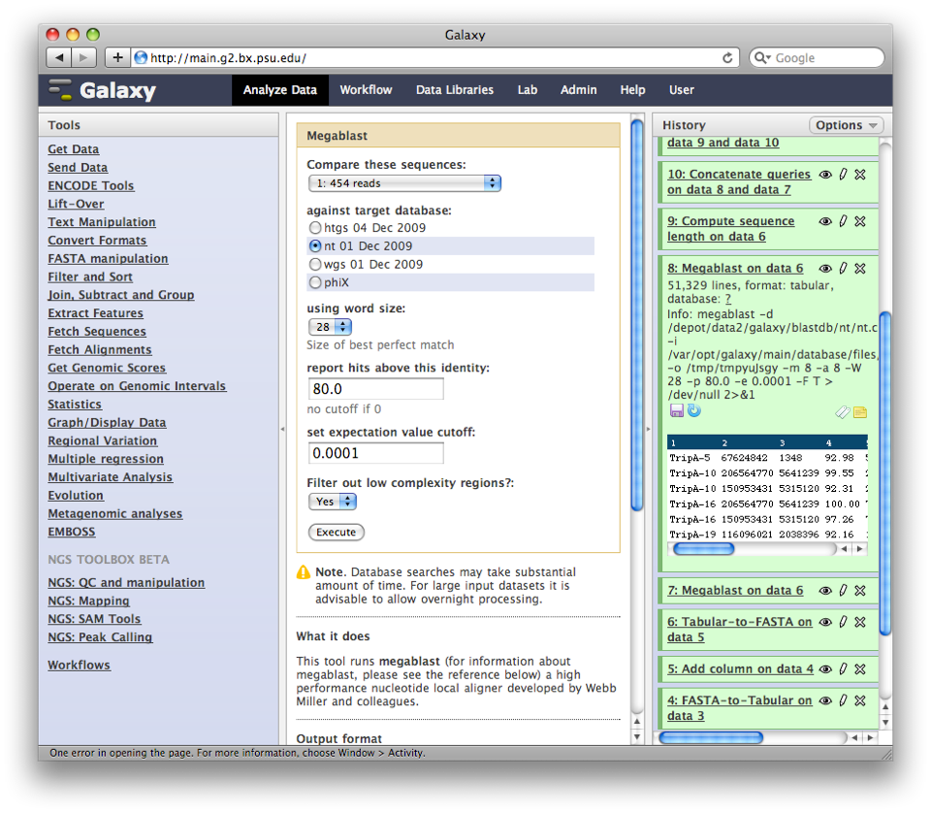
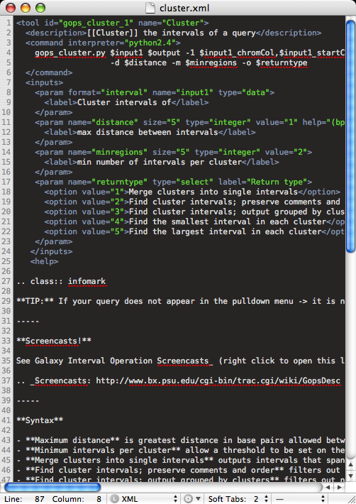
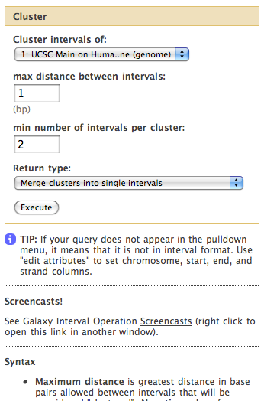
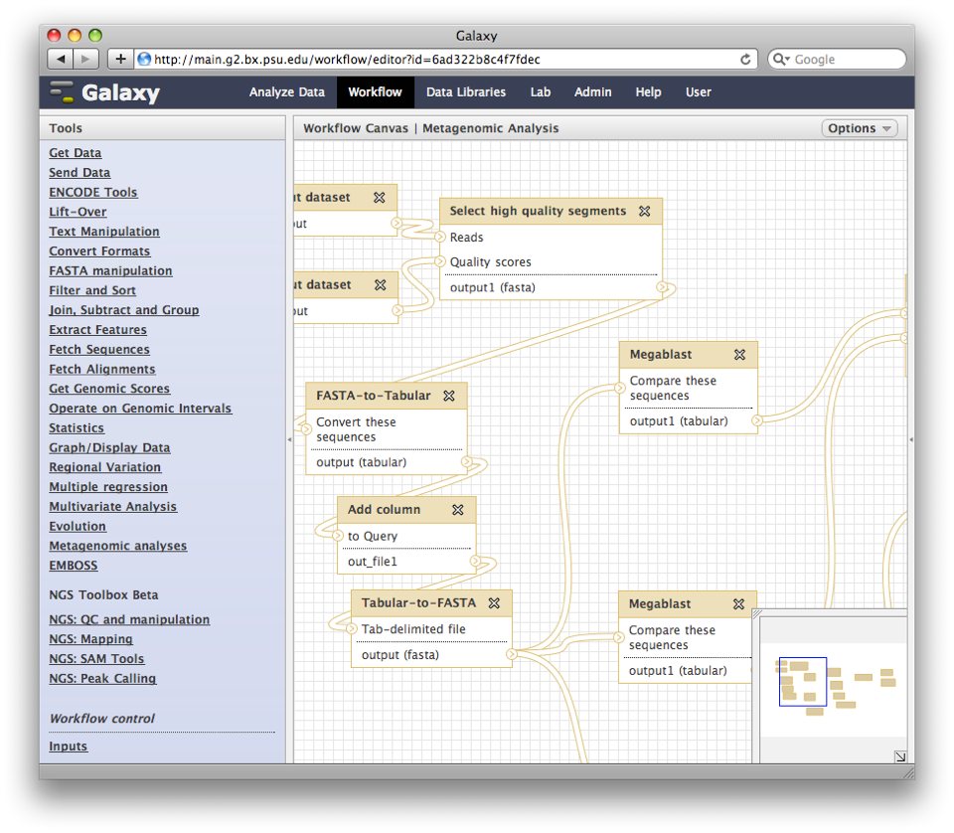
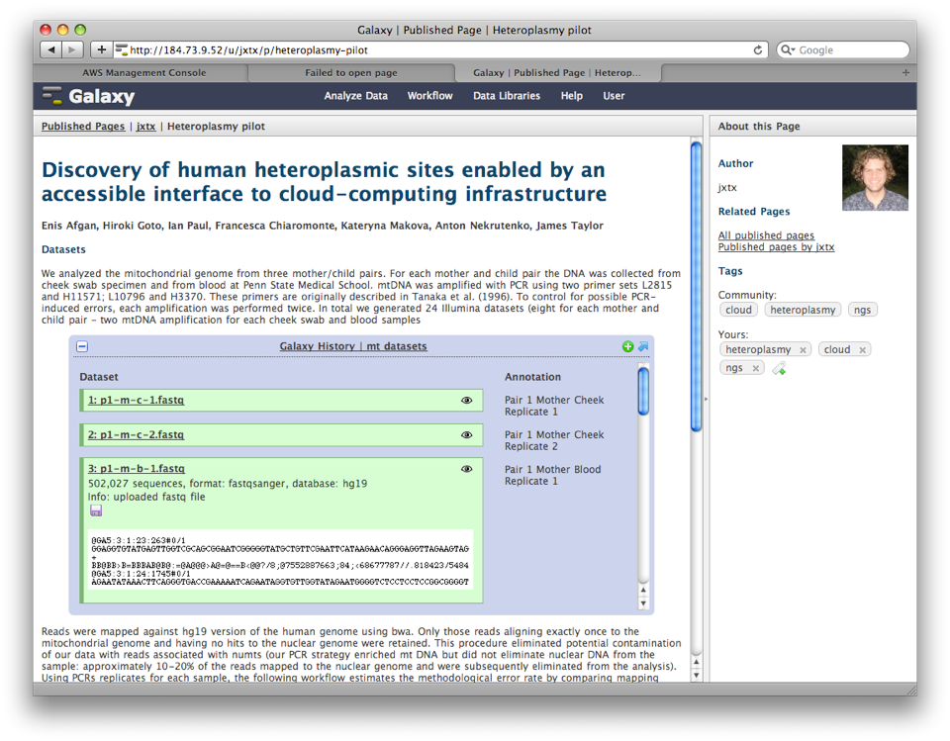
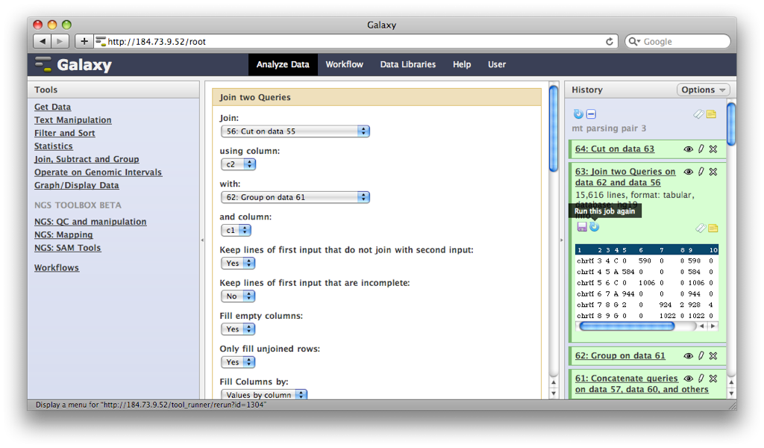
Describe analysis tool
behavior abstractly
Analysis environment automatically and transparently tracks details
Workflow system for complex analysis, constructed explicitly or automatically
Pervasive sharing, and publication
of documents with integrated analysis
Notes:
Bioinformatics research generates lots of useful little tools.
But, no incentive to make them robust, accessible to others, etc.
Can we make this easy enough that the incentive of tools being available in an integrated form outweighs and difficulty

Slide 25






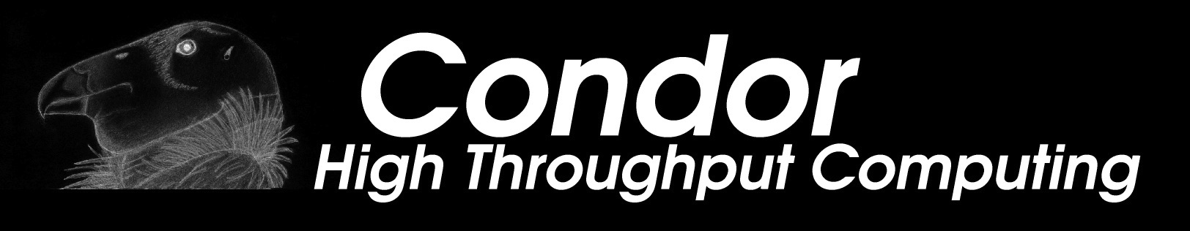





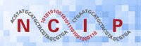
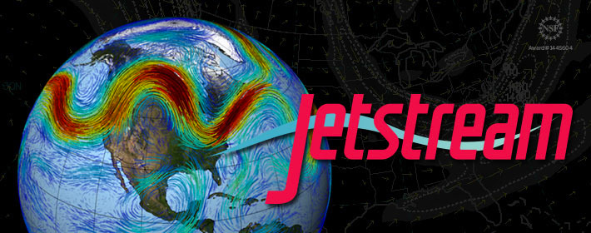

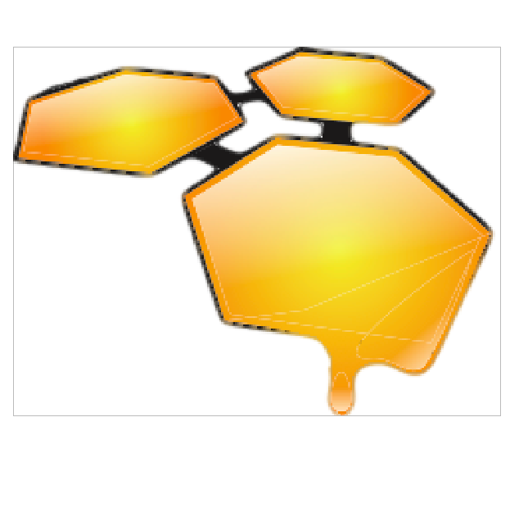

Three ways to use Galaxy
1. The public web service at http://usegalaxy.org
2. Run locally with many compute environments
3. Deploy on a cloud

Slide 26
Public Servers
Main server at http://usegalaxy.org:
  >100k registered users, ~1500 new users per month, ~200 TB of user data, ~300k analysis jobs per month (http://bit.ly/gxystats)
100 public servers all over the world (http://bit.ly/gxyservers)
  20+ general servers, some supported by institutions
  Many domain-specific servers as well

Slide 27
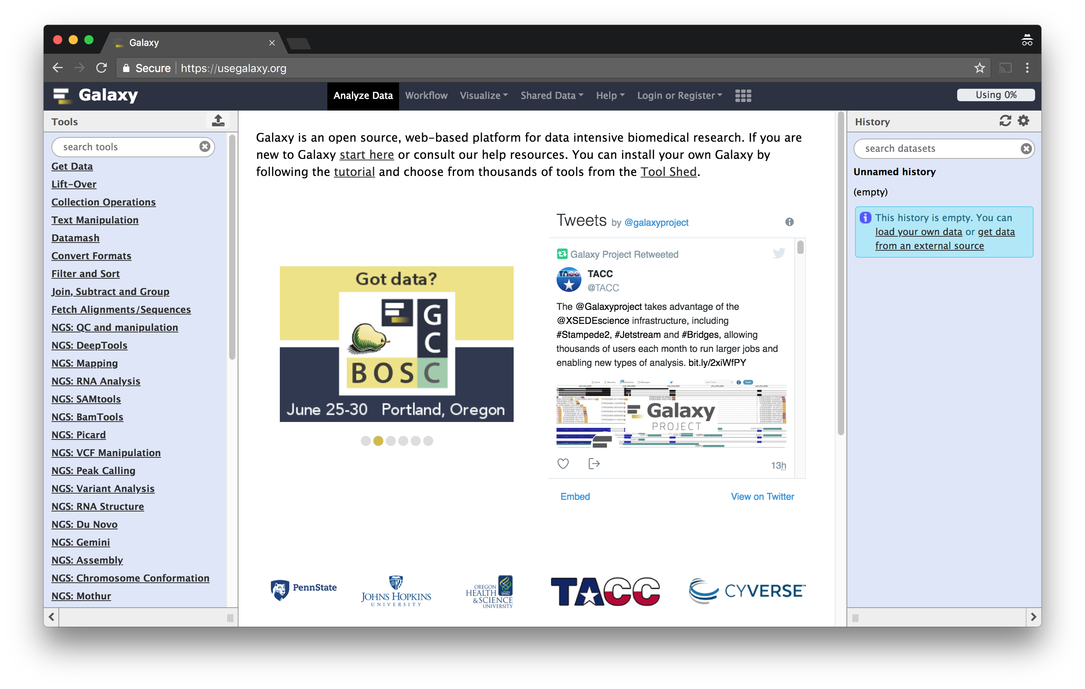
As a free for everyone service on the web: https://usegalaxy.org
Notes:
All of the screen shots we've seen are from usegalaxy.org, the galaxy project's public Galaxy server.

Slide 28


As a free for everyone service on the web: https://usegalaxy.org
A free (for everyone) web server integrating a wealth of tools, compute resources, petabytes of reference data and permanent storage
However, a centralized solution cannot support the different analysis needs of the entire world

Slide 29
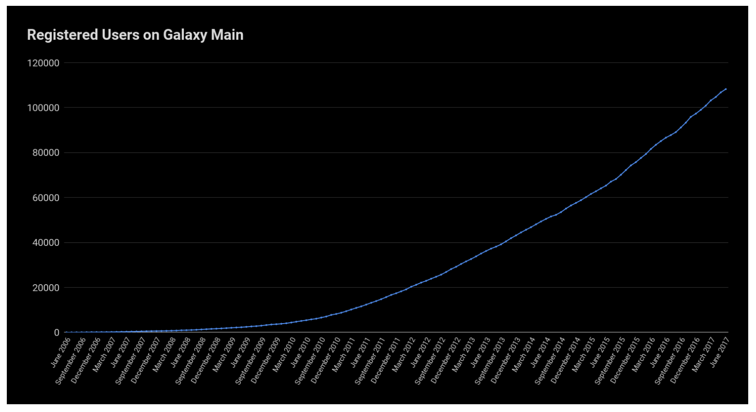
Galaxy Main usage
(https://usegalaxy.org)

Slide 30
Galaxy Main usage
(https://usegalaxy.org)

Slide 31
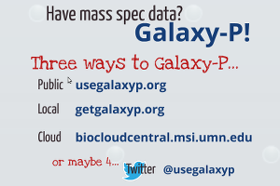
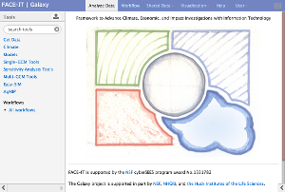
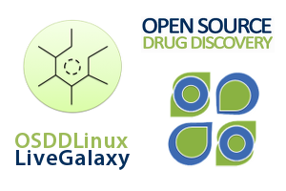
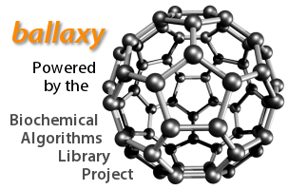


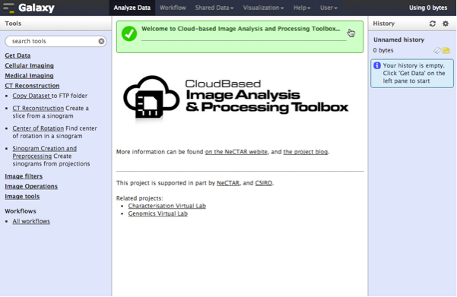
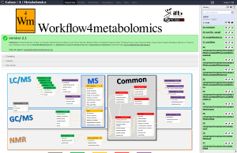
Proteomics
Metabolomics
Drug Discovery
Cosmology
Image Analysis
Climate Change Flow Cytometry Natural Language
Notes:
In fact Galaxy is used in all sorts of domains, some of them having nothing to do with life sciences.

Slide 32
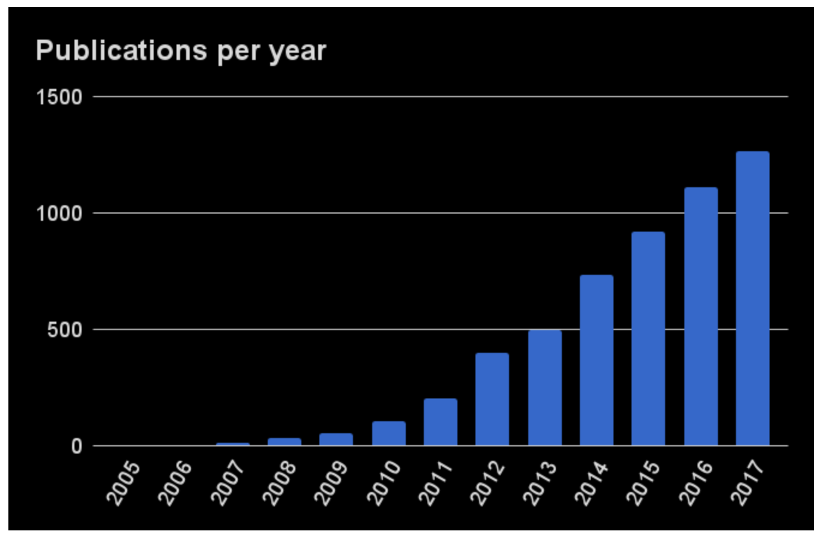
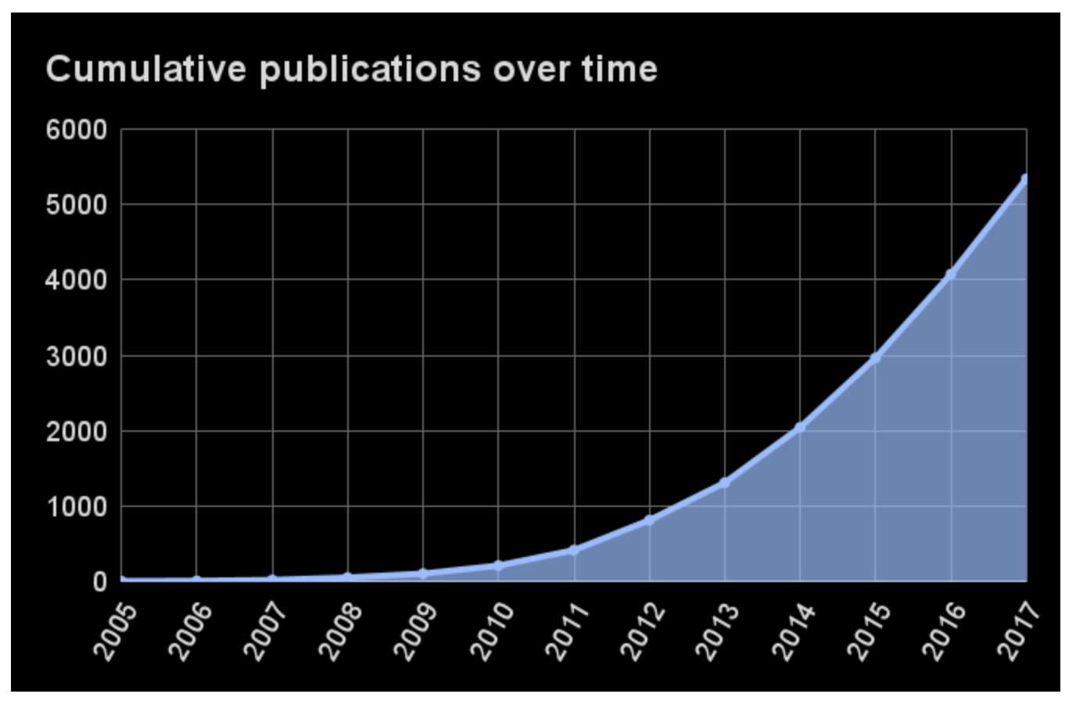
Galaxy Citations

Slide 33
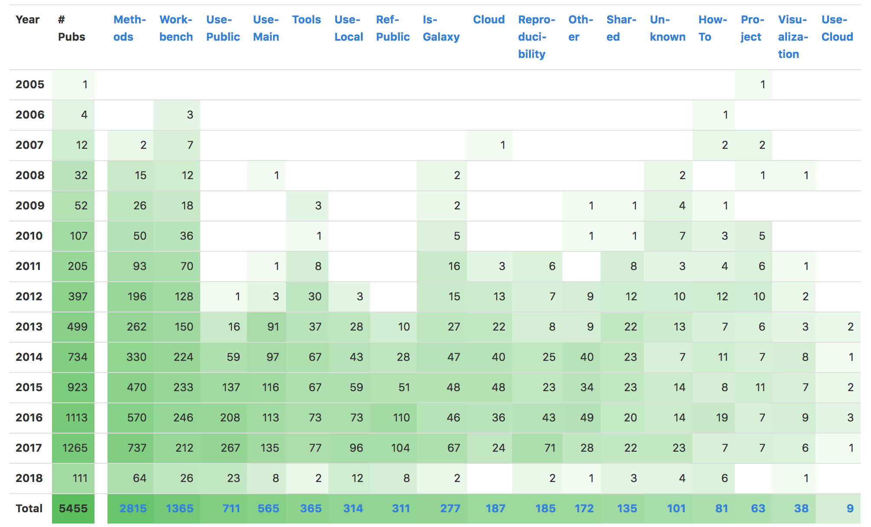
Galaxy Citations

Slide 34
Galaxy brings together key communities
High Performance Computing
Scientists
Developers
Galaxy

Slide 35
Galaxy as a General Analysis Platform
Large-scale genome analysis requires a platform for workflows (modularity), scalability, and reproducibility
Galaxy is for bioinformaticians too
  API for scripting and automation
  Devops (automated setup and administration) support
  Plug-in architecture: tools, visualizations, data sources, job engines, datatypes, and more…

Slide 36

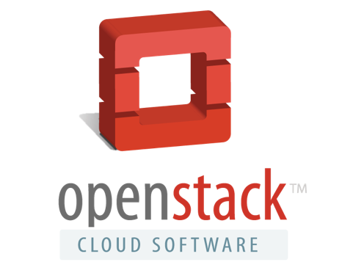


Galaxy is available on the Cloud
We are using this for the workshop
http://aws.amazon.com/education
http://wiki.galaxyproject.org/Cloud

Slide 37

Galaxy on the Cloud: https://launch.usegalaxy.org/
Start with a fully configured and populated (tools and data) Galaxy instance
Allows you to scale up and down your compute assets as needed
Someone else manages the data center
http://usegalaxy.org/cloud

Slide 38
Galaxy on Public/Scientific Clouds
NSF JetStream
  Runs on XSEDE, credit freely available
NHGRI Data Commons and NCI Cloud Pilots
  Just starting this work, credits will also be widely available
  Bringing Galaxy together with existing public datasets and cloud computing resources

Slide 39
Galaxy Glossary (Resources)

Slide 40
Primary Galaxy Objects
Tools
  Simple (text manipulation) to complex (HTS read alignment, differential expression)
Datasets
  Get from web databases, upload your own, or produced by tools/workflows
Histories
  A complete record of your analysis
  Output datasets + tools/parameters/inputs used in each step
Workflows (Pipelines)
  Abstract automated, multi-step analyses using several tools
  Exported from the Histories
  Tools and parameters selected for an analysis process but not the datasets
Visualizations, Data libraries
Notes:
Duplicate from Overview of Galaxy presentation

Slide 41
Each Galaxy Instance (Server) is Unique
Tools, datasets, histories, workflows, and user accounts exist on a particular instance/server
Can move many objects between servers, but not always easy (yet)
Not all G-OnRamp tools are available on main server or the cloud (yet)

Slide 42
Important Galaxy links
Everything: https://galaxyproject.org
Public server: http://usegalaxy.org
Tutorials: https://galaxyproject.org/learn/
Run Galaxy on your own computer/cluster: https://getgalaxy.org
Run Galaxy on the AWS or Jetstream cloud: https://launch.usegalaxy.org

Slide 43
Galaxy Resources and Community
Biostars Question & Answer forum (very active)
Unified Search
Github issues
Events Calendar, News Feed
Community Wiki
GalaxyAdmins
Screencasts
Tool Shed
Public Installs
CiteULike group, Mendeley mirror
Galaxy Community Conference
http://wiki.galaxyproject.org

Slide 44
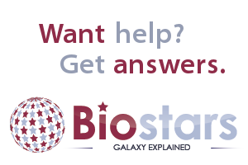
Galaxy Community Resources: Galaxy Biostars
Tens of thousands of users leads to a lot of questions
Absolutely have to encourage community support
Project traditionally used mailing list
Moved the user support list to Galaxy Biostar, an online forum, that uses the Biostar platform
https://biostar.usegalaxy.org/

Slide 45
Galaxy Community Resources: Mailing Lists
Galaxy-Dev
Galaxy-Announce
Low volume (36 posts in 2015, 6500+ members)
Galaxy-UK, -France, -Proteomics, -Training, ...
https://galaxyproject.org/mailing-lists/

Slide 46
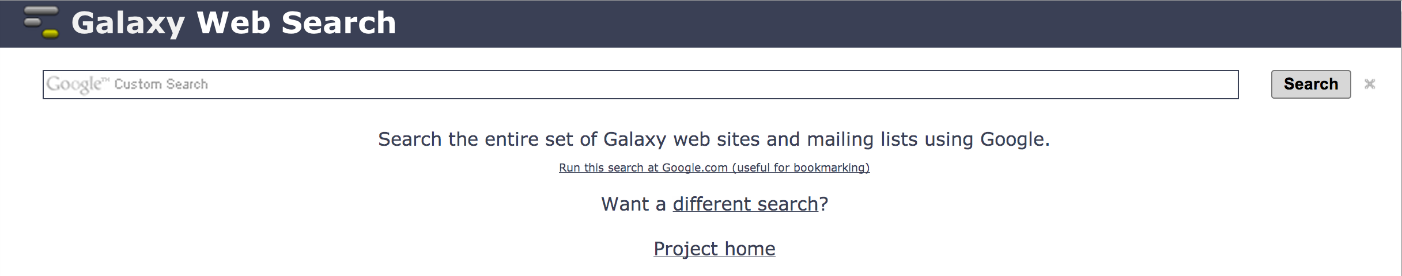
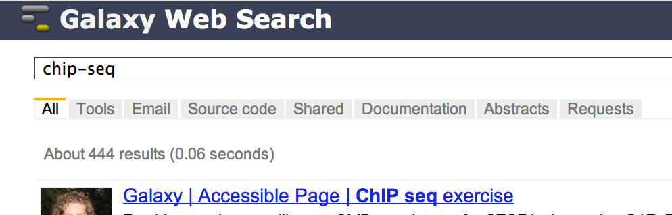
Unified Search:
http://galaxyproject.org/search
Find:
Everything on …
Tools for …
Email about …
Source code for …
Published Histories, Pages, Workflows, about …
Related feature requests
Papers using Galaxy for …
Documentation on …

Slide 47
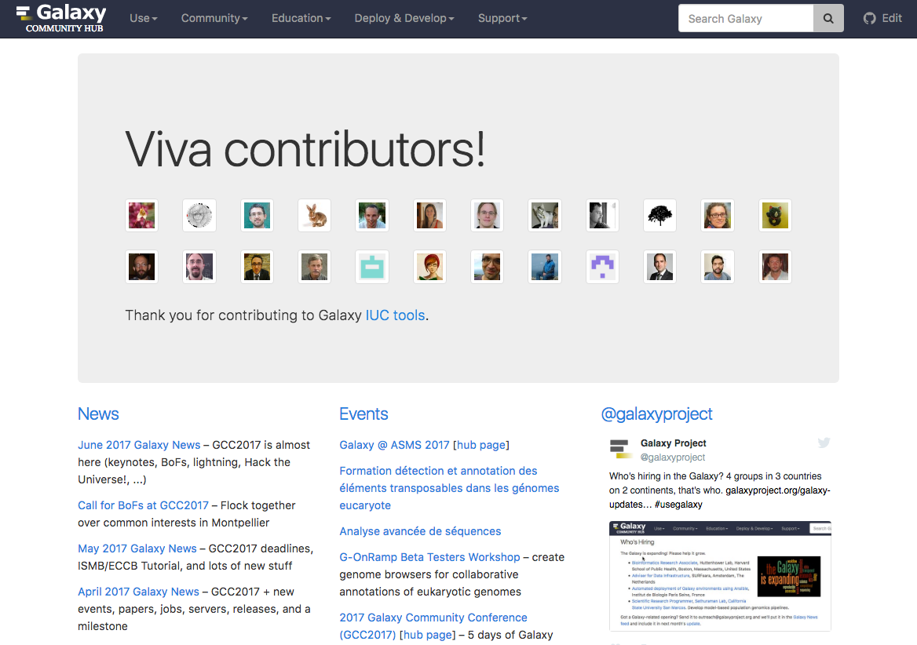
Galaxy Community Hub
https://galaxyproject.org/

Slide 48
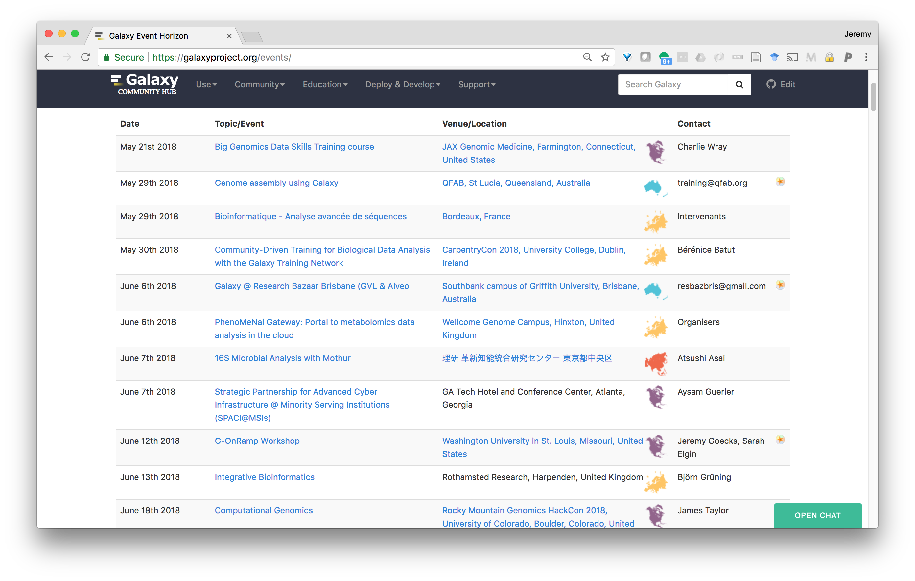
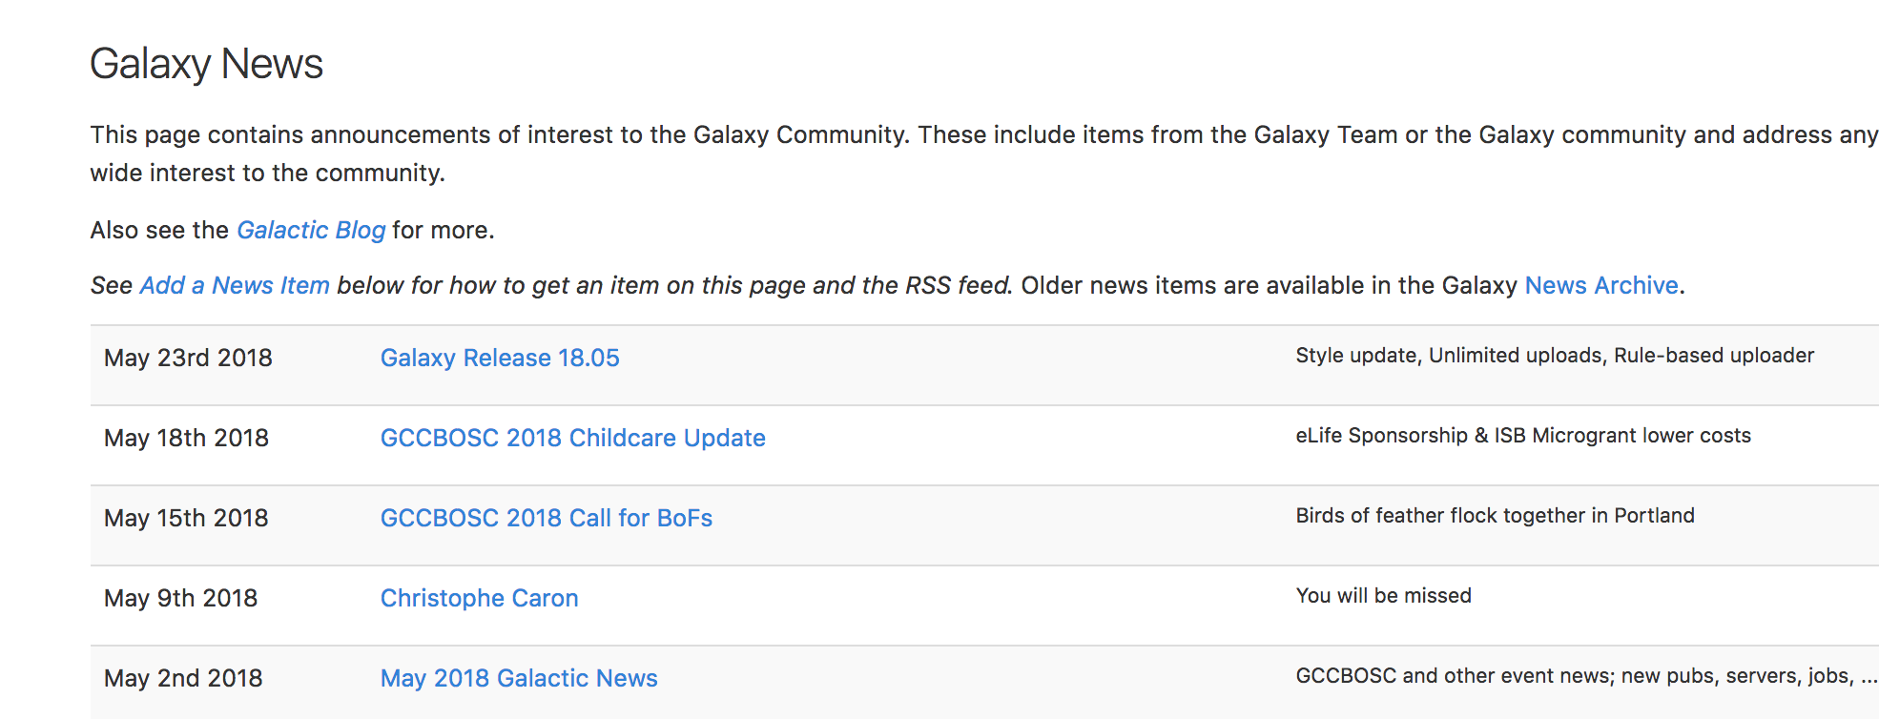
Events
News

Slide 49
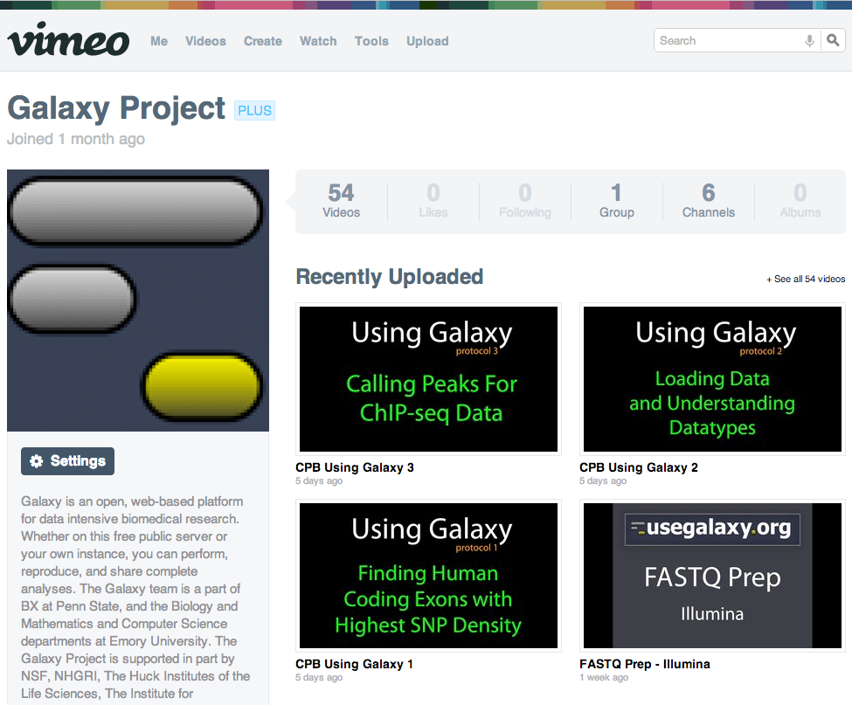
Galaxy Resources & Community:
Videos
“How to” screencasts on using and deploying Galaxy
Talks from previous meetings.
https://vimeo.com/galaxyproject

Slide 50

Galaxy Resources & Community: Zotero
https://www.zotero.org/groups/1732893/galaxy

Slide 51


Galaxy Training Network
October 2014.
bit.ly/gxygtn
Notes:
TODO

Slide 52












The “Core” Galaxy Team
Engineering
Enis Afgan
Dannon Baker
Dan Blankenberg
Dave Bouvier
Nate Coraor
Martin Čech
John Chilton
Sam Guerler
Nick Stoler
Vahid Jalili
Support and outreach
Leadership
Communications
Leadership
Dave Clements
Jennifer Jackson
James Taylor
Anton Nekrutenko
Jeremy Goecks
Supported by the NHGRI (HG005542, HG004909, HG005133, HG006620), NSF (DBI-0850103), Penn State University, Johns Hopkins University, Oregon Health and Science University, and the Pennsylvania Department of Public Health

Slide 53









Extended team and other contributors…
Luke Sargent
OHSU
Björn Grüning
Uni Freiburg
Peter Cock
TJHI
Kyle Ellrott
OSHU
Helena Rasche
Uni Freiburg
Nicola Soranzo
TGAC
Brad Chapman
HSPH
Nuwan Goonasekera
VeRSI
Yousef Kowsar
VLSCI
And many others who have contributed to the main Galaxy code and to tools for the ToolShed, participated in discussions, attended the Galaxy conferences, …

Slide 54
G-OnRamp http://gonramp.org
Ready to use Galaxy server and workflows for genome annotation
  for any eukaryotic genome, can adapt as needed
  generates genome browser for doing manual annotation
  integrates into ecosystem of bioinformatics tools such as UCSC Genome Browser, JBrowse/Apollo, and CyVerse
  applicable to both research and education, such as GEP
Reference genome
assembly
Sequence similarity
Hub Archive Creator
Transcripts / proteins from informant genome
Gene predictions
RNA-Seq analysis
JBrowse
Archive Creator
RNA-Seq
reads
Repeats

Slide 55

Sequence Similarity
Input Data
JBrowse Archive Creator
Ab initio Gene Predictions
RNA-Seq
Repeats
JBrowse Archive to Apollo
Notes:
Some animation to overlay the sub workflows?

Slide 56

Use the UCSC genome browser to visualize multiple genomic datasets
D. miranda
Sequence similarity
NCBI BLAST+
UCSC BLAT
Augustus
GlimmerHMM
SNAP
Gene predictions
HISAT
StringTie
regtools
RNA-Seq analysis
Repeats
TRF
WindowMasker

Slide 57

Apollo: The Annotation Platform
An instantaneous, collaborative, genome annotation editor
Programmatic interaction between Galaxy and Apollo, from organism population to user administration

Slide 58

Use the JBrowse/Apollo browser to visualize multiple genomic datasets
D. miranda
Sequence similarity
UCSC BLAT
Gene predictions
Augustus
GlimmerHMM
SNAP
RNA-Seq analysis
HISAT
StringTie
regtools
TRF
WindowMasker
Repeats

