Slide 1
Overview of Galaxy
Yating Liu, Luke Sargent, and Jeremy Goecks
July 2018 G-OnRamp Workshop

Slide 2
Outline
Galaxy usage and terminology
Galaxy 101 review
Using Galaxy to analyze RNA-Seq data

Slide 3
Galaxy usage and terminology

Slide 4
Using Galaxy for this workshop
Recall that you use Galaxy three ways
  via existing public servers
  download and run on local computer or cluster
  on the cloud
Today is on the cloud: http://cloud5.galaxyproject.org
Future cloud se on your own: https://launch.usegalaxy.org

Slide 5
Primary Galaxy Objects
Tools
  Simple (text manipulation) to complex (read alignment, differential expression)
Datasets
  Get from web databases, local computers or produce by tools/workflows
Histories
  Tools used as well as inputs, intermediates, and output datasets
  Parameter settings used in each step
  Are complete records of your analysis
Workflows (Pipelines)
  Exported from the Histories
  Tools and parameters selected for an analysis process but not the datasets
  Automated, multi-step analyses using several tools
Visualizations, Data libraries

Slide 6
The Goals of Galaxy 101
Get data from external databases such as the UCSC Table Browser
Understand Galaxy Histories
Use Galaxy tools to do simple data conversions and analyses
Create and run a workflow

Slide 7
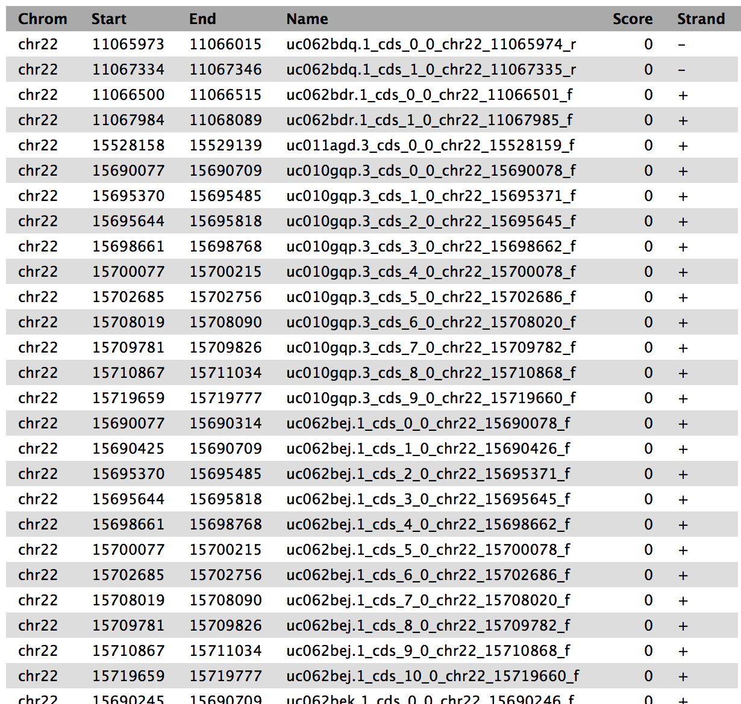
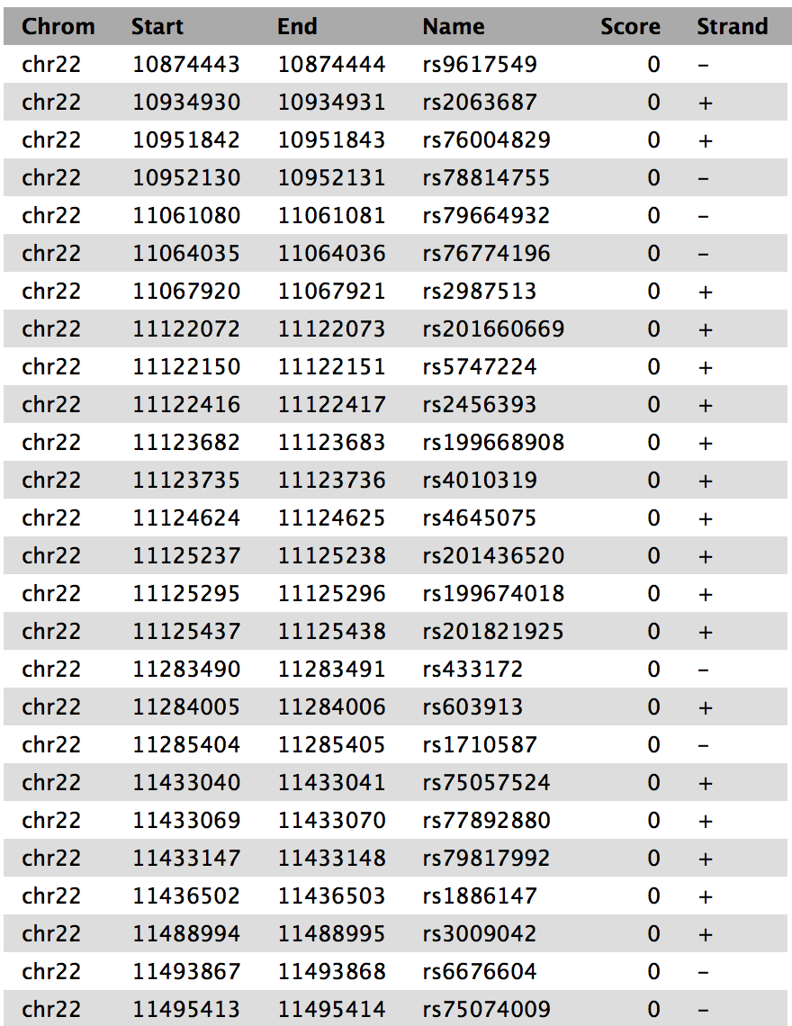
Galaxy 101: Find the top 5 exons with the highest number of SNPs on chromosome 22
"Of all human coding exons, which has the highest number of single nucleotide polymorphisms (SNPs)?"
Exons: 14,875 regions
SNPs: ~190,000 regions
https://galaxyproject.org/tutorials/g101/

Slide 8
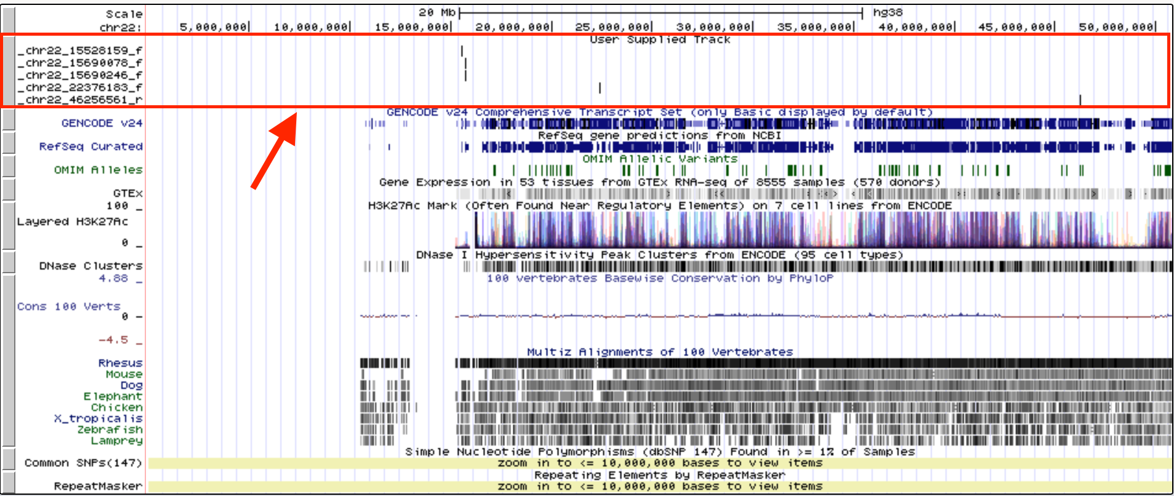
Solution from Galaxy
Exons
Join exons with SNPs
Group by exons
Sort exons by SNP count
Select top five exons
Recover exon info
SNPs
Rearrange columns

Slide 9
Get Data
Galaxy can import data from external databases:
  UCSC Table Browser
  EBI SRA
    High-throughput sequencing data (fastq files)
Users can upload files
  Upload modal (small files, < 100 MB)
    Uploading small files from disk or fetching data from other servers
  Choose FTP file (large files)

Slide 10
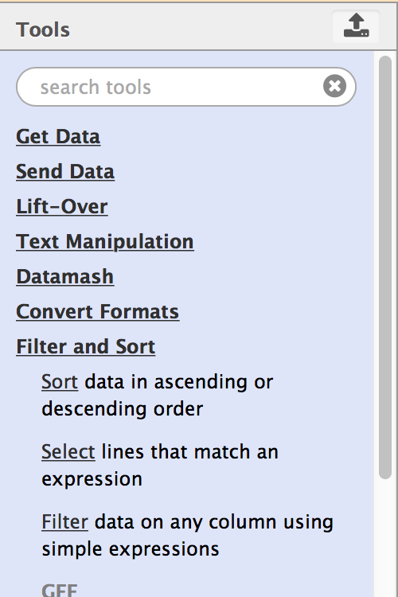
Search Tools
Enter the name of a tool or a search term
Click on the group header to expand each section

Slide 11
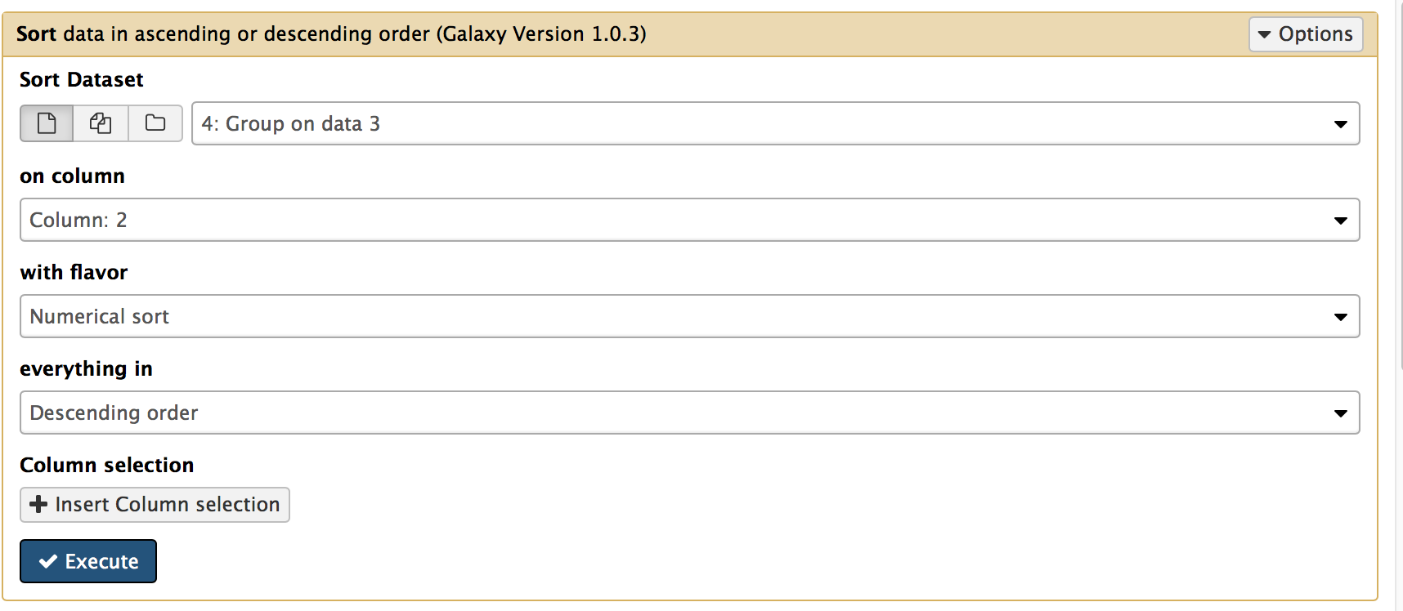
Tool Configuration and Execute
Select dataset
Set parameters
Run the tool
Each tool has a different set of parameters

Slide 12
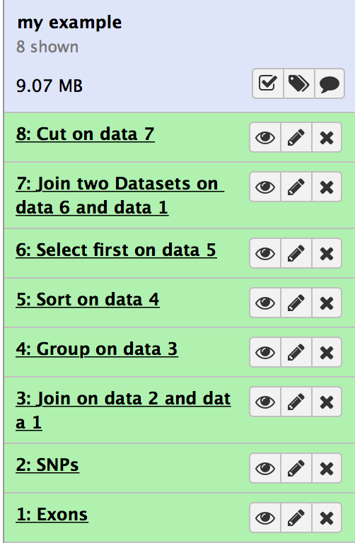
History of Galaxy 101
A complete record of our analysis
  Input datasets: Exons and SNPs
  Output datasets from each step
  Tools and parameter settings for each step

Slide 13
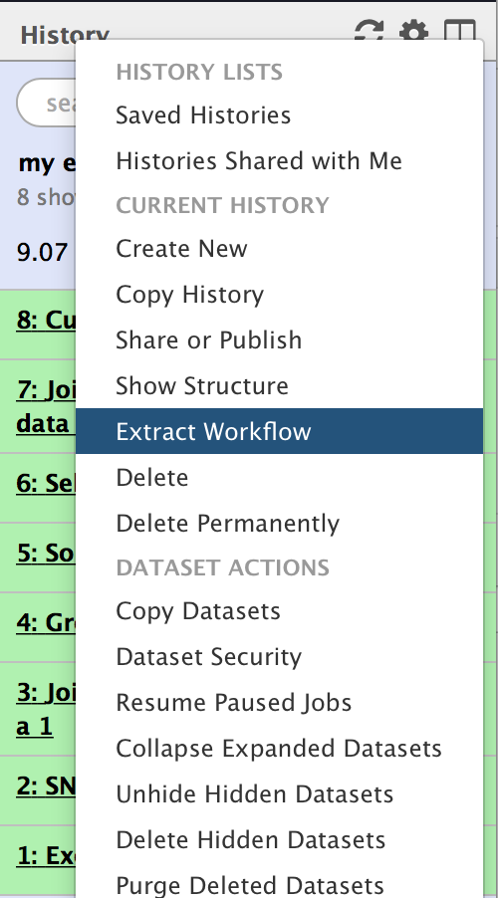
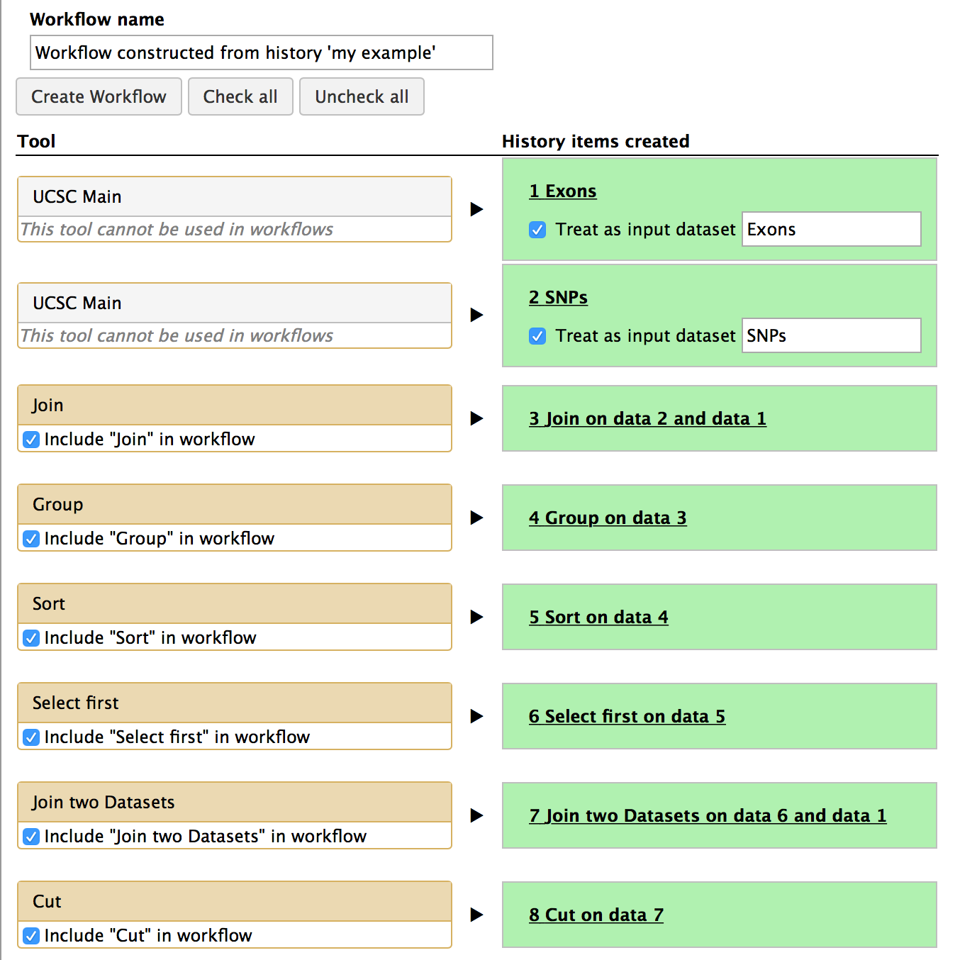
Extract Workflow
Edit workflow name
Create the workflow
Record all steps of the analysis
Parameter settings used in each step
Extract Workflow from History to run the analysis on a new dataset

Slide 14
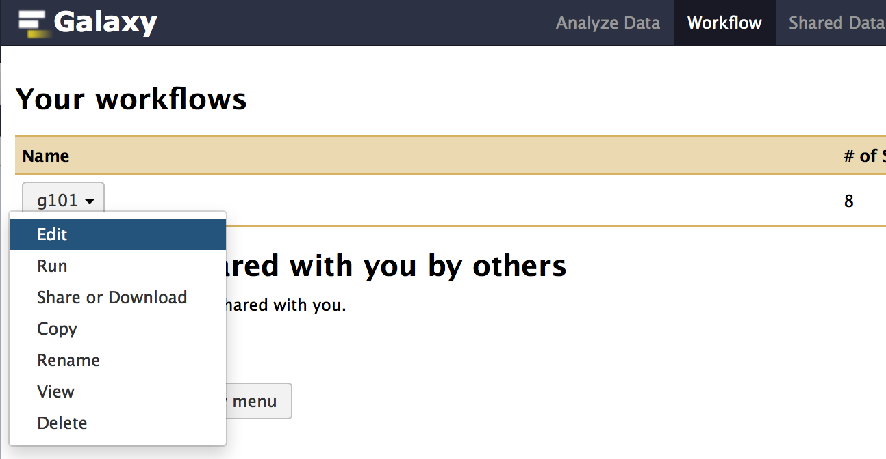
Edit Workflow
Access workflows from the menu bar
Edit the workflow using the workflow canvas
Run the workflow
Rename the workflow

Slide 15
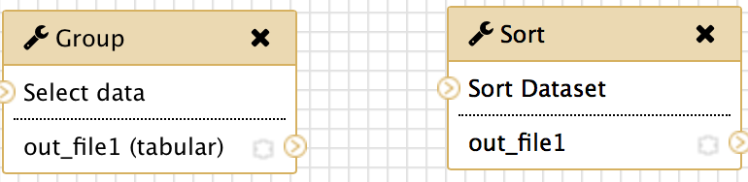
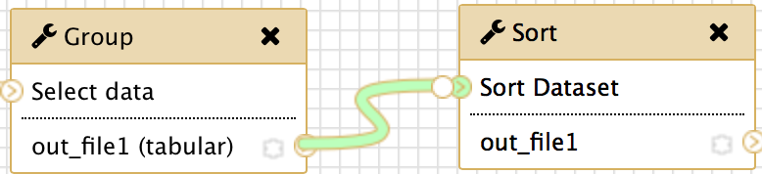
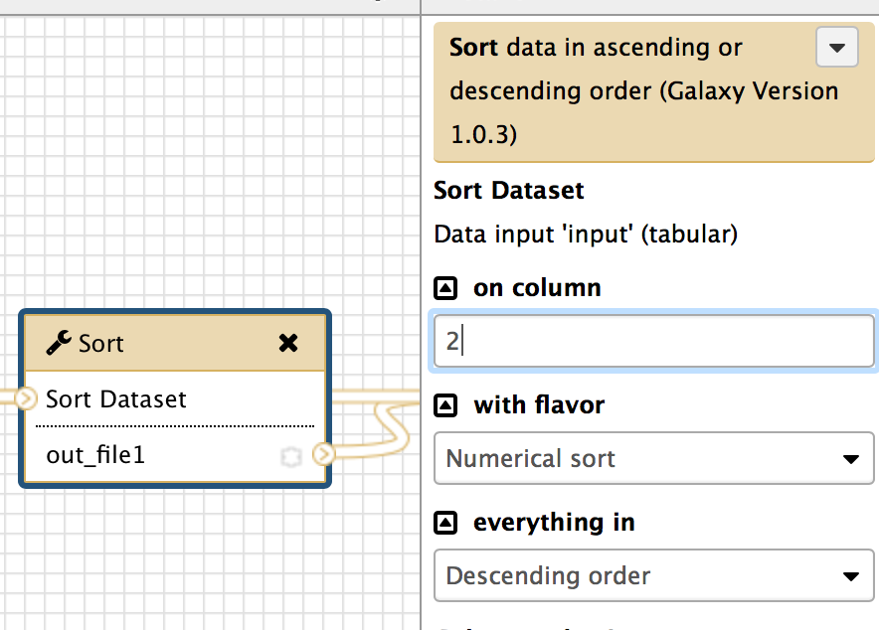
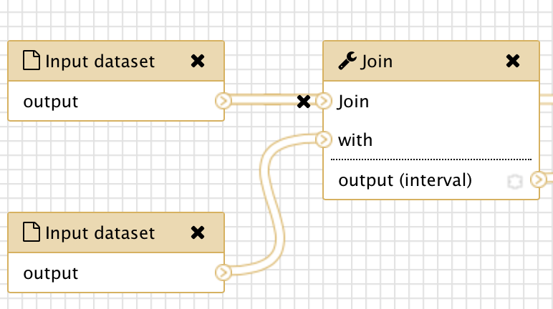
Edit the Workflow
Create a new connection by dragging from the output connection of one tool to the input connection of another tool
Delete a connection by clicking on the ‘x’ icon
Click on the tool to edit parameters

Slide 16
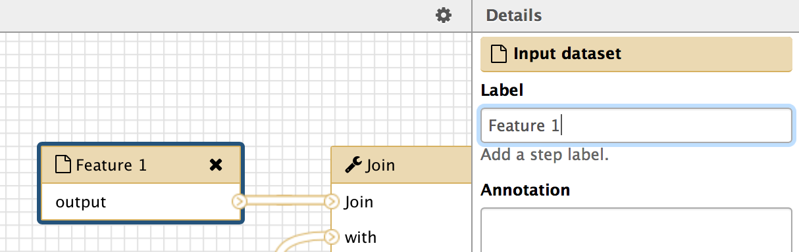
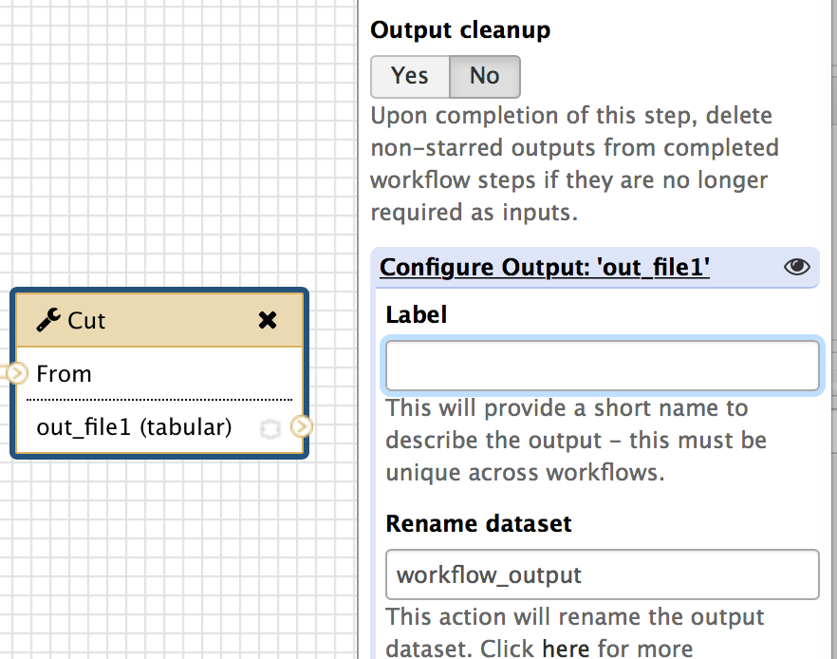
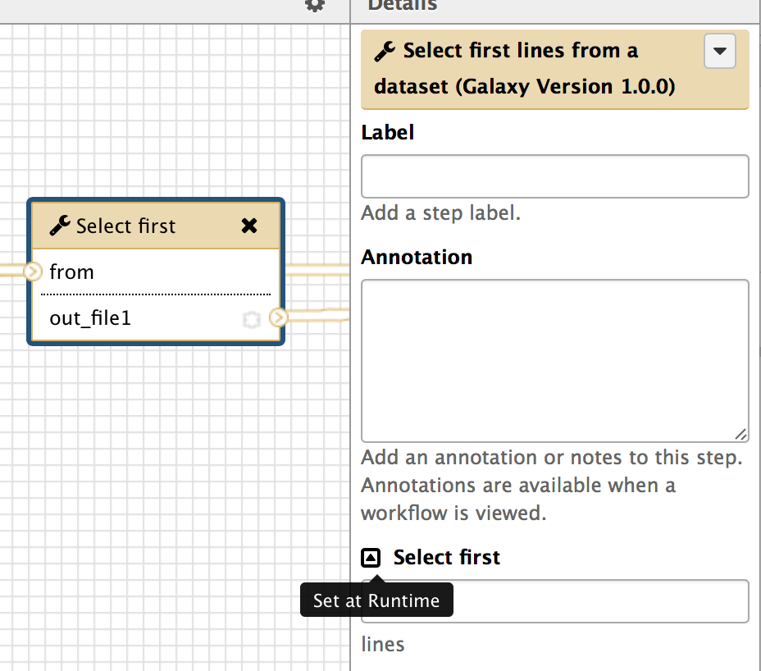
Edit the Workflow
Rename an input dataset
Rename an output
Click on the up arrow to set this parameter at runtime

Slide 17
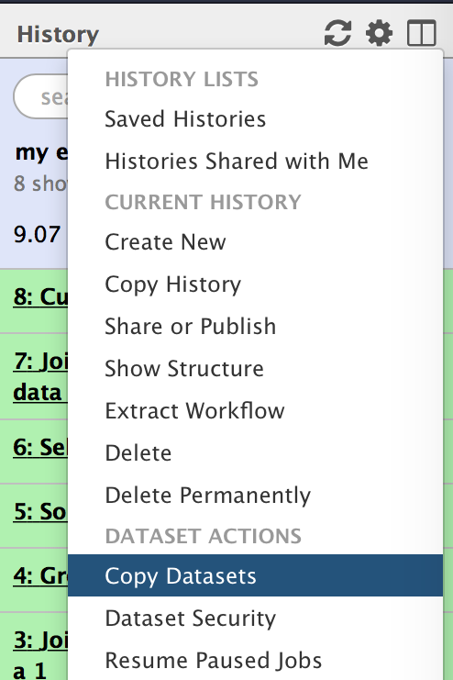
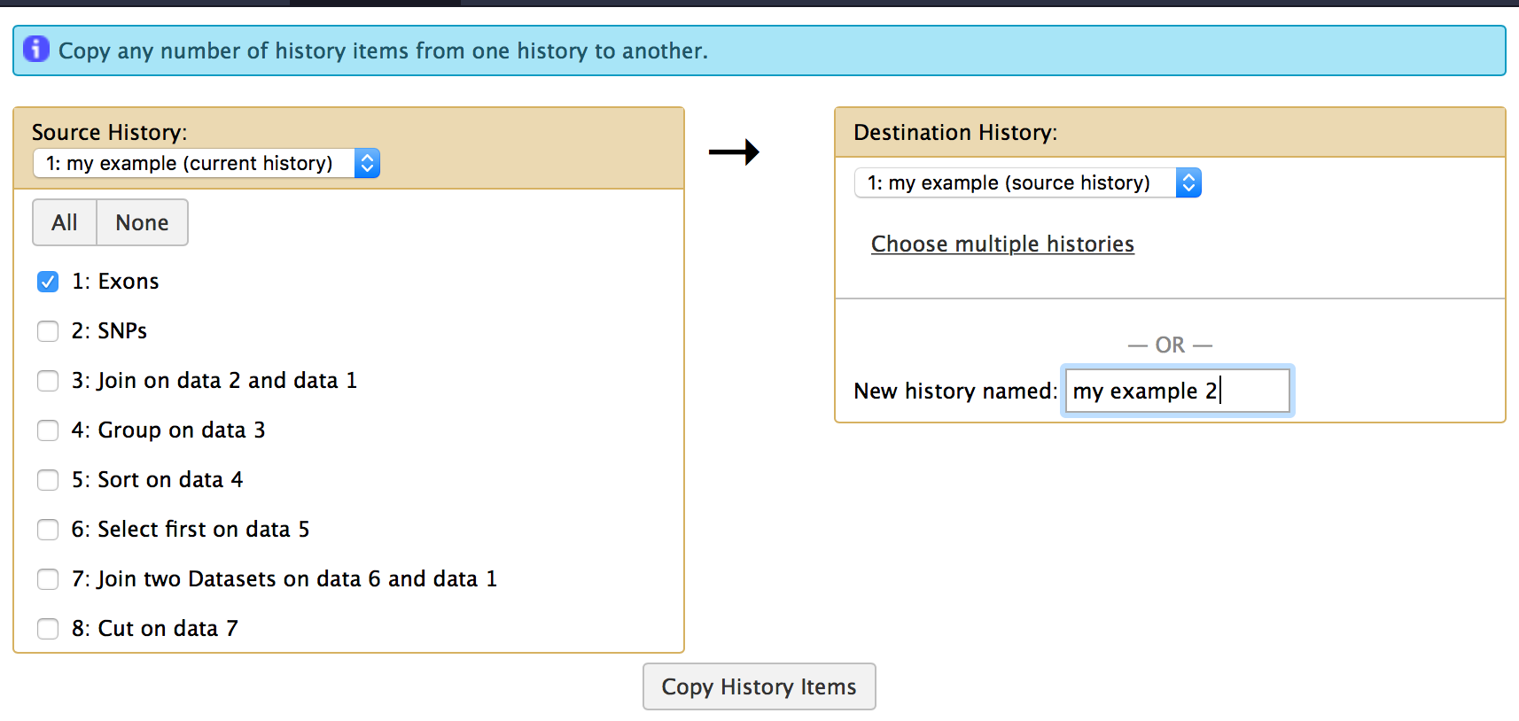
Copy datasets from current History

Slide 18
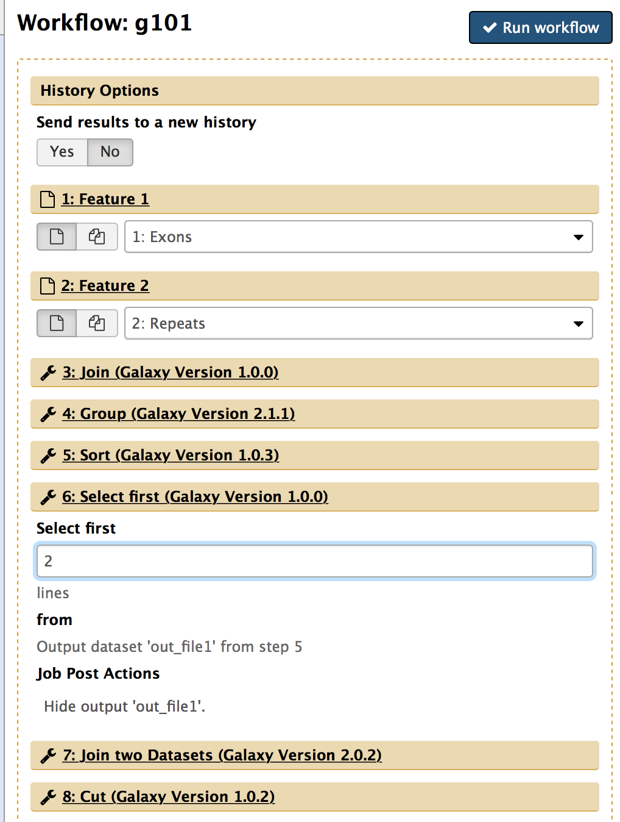
Run an existing workflow
Specify input datasets
Click on the header to expand each step
Set the parameters

Slide 19
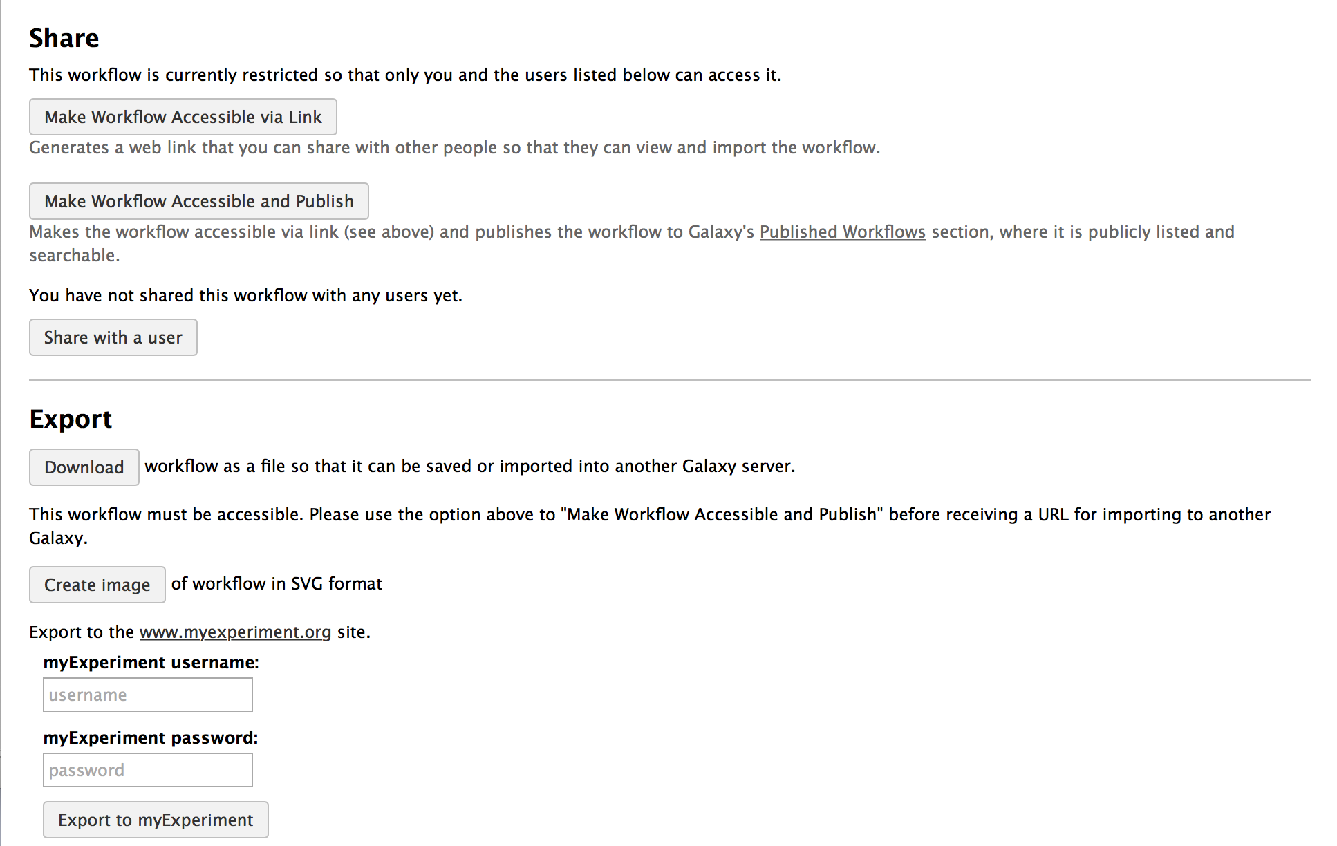
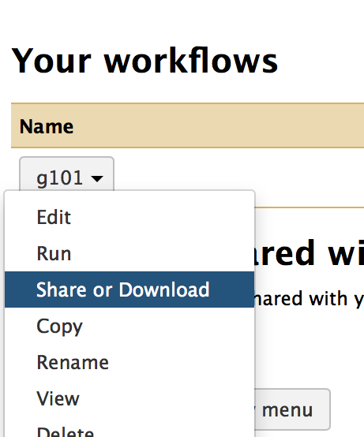
Share a workflow with others
Share workflow publicly or with another user
Publish a workflow
Export to another Galaxy server or to myExperiment

Slide 20
Galaxy 101 Summary
Get data
  UCSC Table Browser
  Previous Histories
View and edit dataset attributes (e.g. Name)
Run Galaxy tools to do analyses
Extract a workflow from the current History
Customize the workflow
  Rename input and output datasets
  Set parameters
  Create or delete connections between tools
Run an existing workflow to analyze other samples
Share the workflow

Slide 21
Using Galaxy to analyze RNA-Seq data

Slide 22
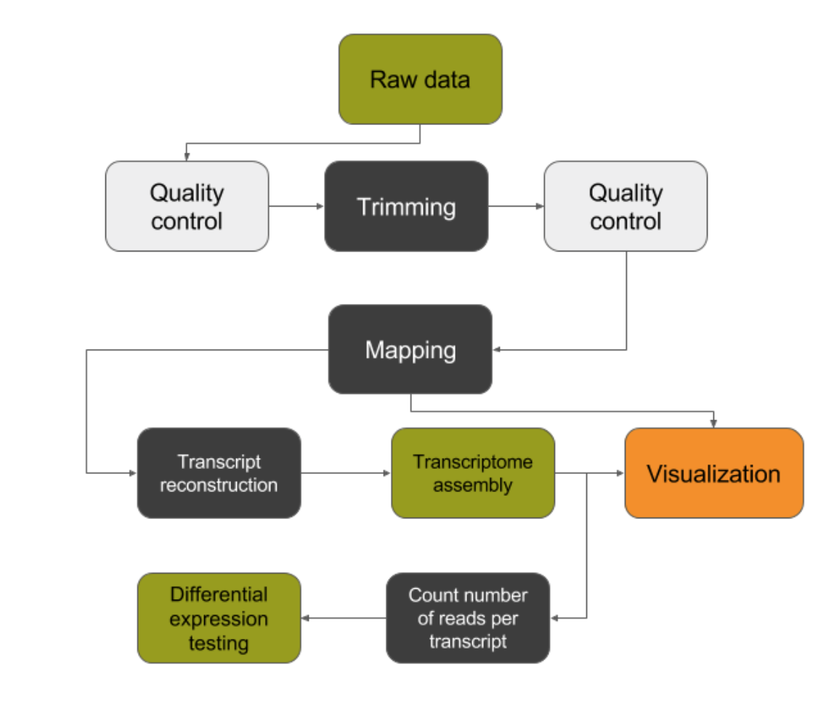
Using Galaxy to perform RNA-Seq analysis
Objective: to get more familiar with Galaxy and introduce tools for QC, pre-processing, read mapping and post-processing
RNA-Seq walkthrough for the workshop
Subset of Galaxy walkthrough: https://galaxyproject.org/tutorials/nt_rnaseq/
Get mapped data ready for the differential expression analysis
Optional session: Differential expression analysis with RNA-Seq
  https://galaxyproject.org/tutorials/nt_rnaseq/

Slide 23
RNA-Seq walkthrough: details
Preparing dataset collections
  Get data through the “Data Libraries”
  Create two dataset collections
Explore the data
  Assess data quality using FastQC
Pre-processing, mapping, and post-processing
  Pre-processing: Trimming off the low quality bases from the ends of the reads using Trimmomatic
  Read mapping with HISAT
  Post-processing: cleaning the BAM with SAMtools -> Filter SAM or BAM tool
Extract workflow and run the workflow with different samples
De novo transcript reconstruction
Analysis of the differential gene expression
Not included in the walkthrough. Refer to https://galaxyproject.org/tutorials/nt_rnaseq/

Slide 24
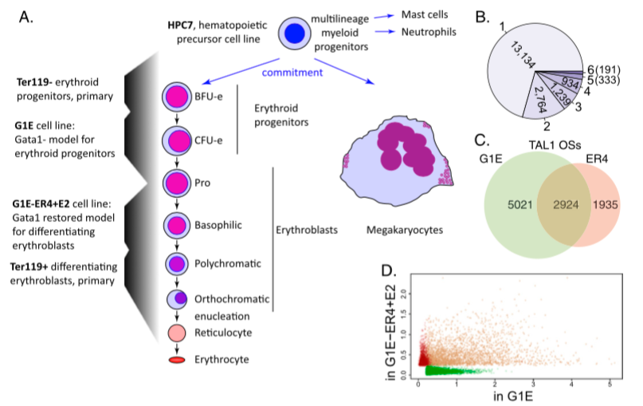
RNA-Seq data used in the walkthrough
G1E mouse cell line (G1E)
  a GATA-null immortalized cell line
Megakaryocytes (Mk)
  Large bone marrow cell
  Produces platelets for blood clotting
Two biological replicates per sample (R1 and R2)
Each replicate has forward and reverse reads (f and r)
G1E
Mk
Wu W et al. Genome Res. 2014 Dec; 24(12):1945-62.
Notes:
The diagram shows differentiation from hematopoietic precursors to erythroblasts and megakaryocytes, including the corresponding cell types or lines used in this study.
By contrasting RNA from GATA-null G1E cells with that of megakaryocytes we can identify transcripts regulated by GATA-1.
G1E cells were derived from mouse ES cells hemizygous for a Gata1 knockout;
Differentiation to erythrocytes (red blood cells) or myeloid (bone marrow)
Gata1 is a transcription factor
Part of a larger study that also examined the ChIP-Seq data for multiple transcription factors

Slide 25
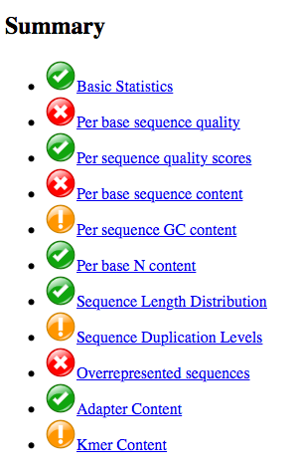
Quality control with FastQC
Quality control checks on raw sequences coming from high throughput sequencing (NGS)
Generate quality control report
  Summary table provides an overview of potential issues with sequencing results

Slide 26
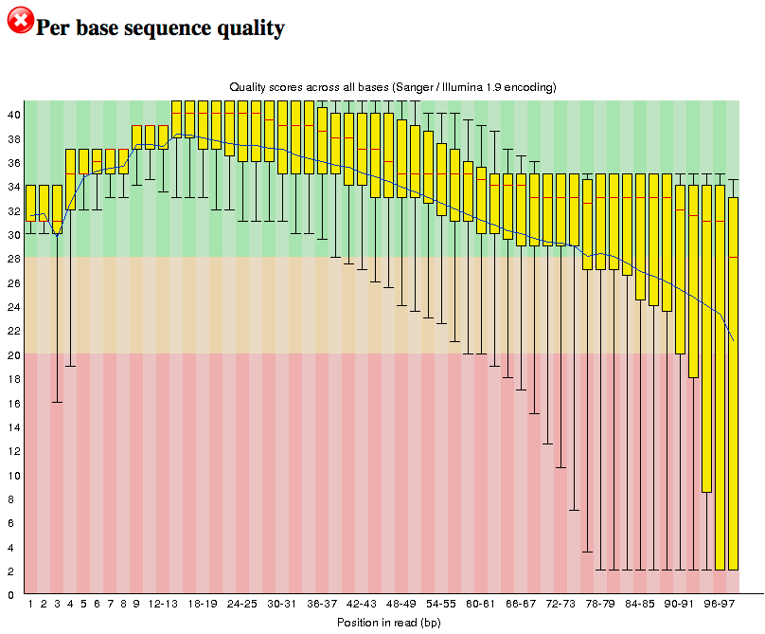
FastQC: Per base sequence quality
(G1E_R1_f_ds_SRR549355)
The y-axis on the graph shows the quality scores (phred scores)
  Phred 30 = 1 error per 1000 base calls
The central red line: median quality
The lower and upper whiskers: 10% and 90% points
The yellow box: inter-quartile range (25-75%)
The blue line: mean quality
The background color
  Green: very good quality (phred scores > 28)
  Orange: reasonable quality (phred scores between 20 and 28)
  Red: poor quality (phred scores < 20)
http://www.bioinformatics.babraham.ac.uk/projects/fastqc/
Notes:
Base calling is the process of assigning bases (nucleobases) to chromatogram peaks
The yellow box represents the inter-quartile range (25-75%)
The upper and lower whiskers represent the 10% and 90% point
The central red line is the median value
The blue line represents the mean quality
The y-axis on the graph shows the quality scores.
The background of the graph divides the y axis into very good quality calls (green), calls of reasonable quality (orange), and calls of poor quality (red).
The quality of calls on most platforms will degrade as the run progresses, so it is common to see base calls falling into the orange area towards the end of a read.

Slide 27
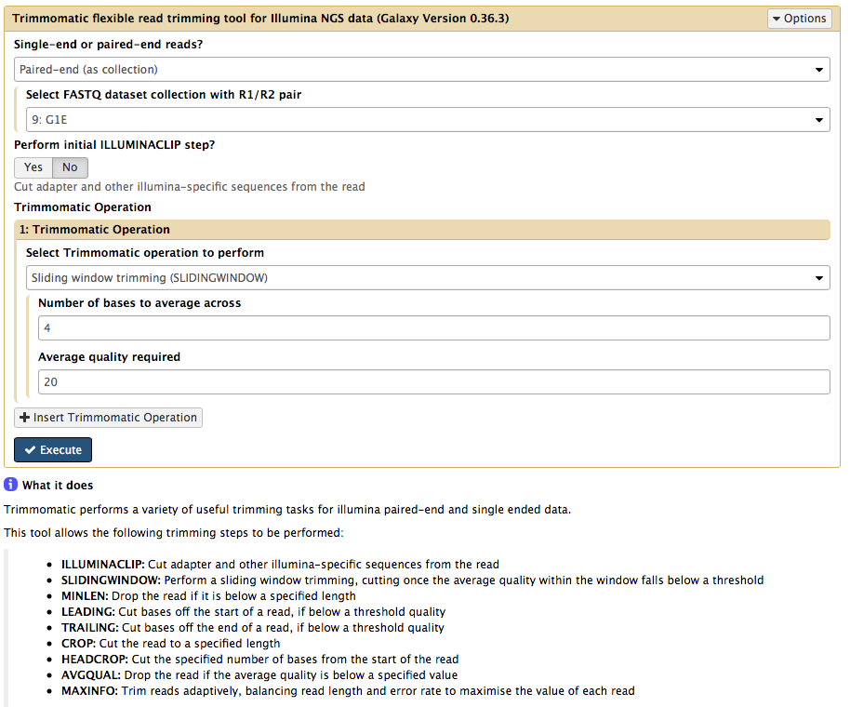
Trim low quality bases with Trimmomatic
A flexible read trimming tool for Illumina NGS data
  This tool can perform nine trimming steps
SLIDINGWINDOW: Trim the rest of the read starting from the first sliding window where the average quality score falls below the user-defined quality threshold
http://www.usadellab.org/cms/?page=trimmomatic

Slide 28
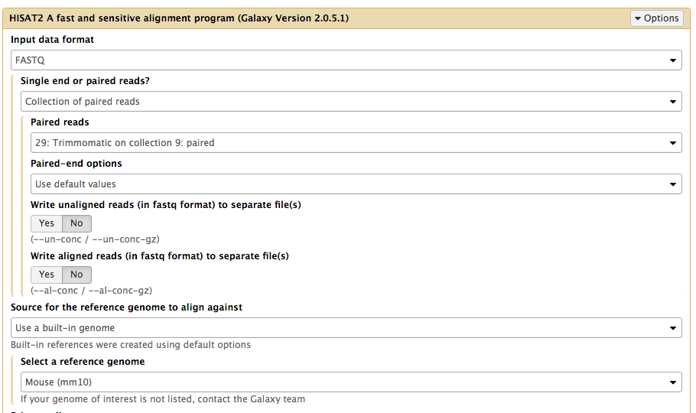
Read mapping with HISAT2
A fast and sensitive alignment program for mapping RNA-Seq reads against a reference genome

Slide 29
Filter BAM data with Filter SAM or BAM
This tool uses the view command in SAMtools (http://www.htslib.org) to filter a SAM or BAM file based on mapping quality (MAPQ), FLAG bits, Read Group, Library, or region.
We will filter the BAM files using the following criteria:
  Minimum MAPQ quality score is 20
  Read is paired
  Read is mapped in a proper pair

Slide 30
RNA-Seq walkthrough summary
RNA-Seq data
Tools
  Quality control
  Pre-processing
  Read mapping
  Post-processing
Galaxy familiarity

