Slide 1
Storing and Accessing G-OnRamp’s Assembly Hubs outside of Galaxy
Using the CyVerse Data Store for Backup and Visualization

Slide 2
G-OnRamp: Visualization Creation
Definitions
Genome assemblies are genome sequences that have been assembled from processed chromosomal fragments
  These assemblies can be visualized in a Genome Browser
    UCSC Genome Browser, JBrowse, IGV, Apollo (via JBrowse) and more
Assembly Hubs combine a genome assembly with relevant evidence tracks for visualization
Hub Archive is the collection of data files needed to create and view an assembly hub

Slide 3
G-OnRamp: Visualization Creation
The Rationale
Hub Archives:
Are created by G-OnRamp workflows
Must be served by a dynamic service
  UCSC: http://genome.ucsc.edu/
  JBrowse: any webserver configured to serve data files
  Apollo: a dedicated Apollo server (bundled with G-OnRamp)
Can be hosted on any service that supports byte-range requests: requesting a specific range data from a file
…So, where can we host hubs freely and easily?

Slide 4
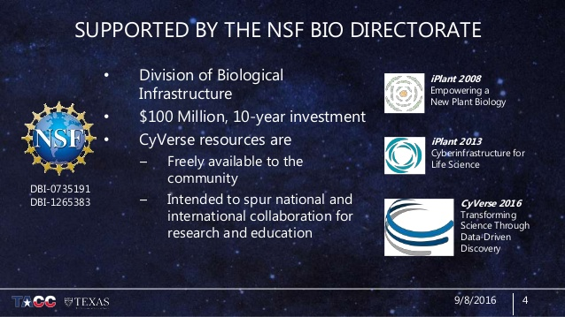
CyVerse: A Little History
An Overview
https://www.slideshare.net/mattdotvaughn/cyverse-transforming-life-science-research-via-cyberinfrastructure
Notes:
See slide deck here for some potential images: https://www.slideshare.net/mattdotvaughn/cyverse-transforming-life-science-research-via-cyberinfrastructure Feel free to use with attribution via URL.

Slide 5
CyVerse: A Little History
U.S. Cyberinfrastructure for plant sciences levels up
Created in 2008 by the NSF as ‘iPlantCollaborative’
Originally intended to serve the U.S. plant science Community
  However, resources were applicable across the life sciences
Service accessibility expanded to international users
Expanded mission in 2015 to serve all life sciences
Renamed to CyVerse to reflect newly broadened scope
Unique in its focus on supporting computational science
  anyone can get an account and data storage
Notes:
See slide deck here for some potential images: https://www.slideshare.net/mattdotvaughn/cyverse-transforming-life-science-research-via-cyberinfrastructure Feel free to use with attribution via URL.

Slide 6
CyVerse: A Little History
Service usage statistics
Since 2008:
> 47,000 Active users
> 5,600 Participating Academic Institutions
> 2,400 Participating Non-Academic Institutions

Slide 7
CyVerse: The Platform
“Solutions to the challenges of large-scale computational science”
CyVerse CyberInfrastructure includes:
A data storage facility
An interactive, web-based, analytical platform
Cloud infrastructure to use remote servers for computation, analysis, and storage
Web authentication and security services
Support for scaling computational algorithms to run on large, high-speed computers
Education and training in how to use cyberinfrastructure
People with expertise in all of the above

Slide 8
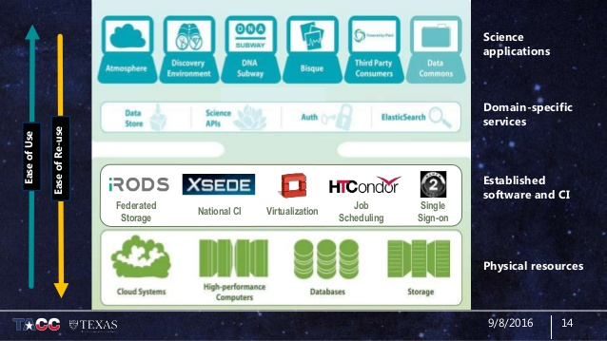
CyVerse: The Platform
The Whole Cyber Enchilada
https://www.slideshare.net/mattdotvaughn/cyverse-transforming-life-science-research-via-cyberinfrastructure

Slide 9
CyVerse: The Platform
Which services do we need?
CyVerse CyberInfrastructure includes:
A data storage facility <- Where your data lives
An interactive, web-based, analytical platform
Cloud infrastructure to use remote servers for computation, analysis, and storage <- How your data gets there and back
Web authentication and security services
Support for scaling computational algorithms to run on large, high-speed computers
Education and training in how to use cyberinfrastructure
People with expertise in all of the above

Slide 10
G-OnRamp: Assembly Hub Storage
Why use external storage?
Advantages of External storage:
No Cost: CyVerse offers 100GB free storage space and a means to expand allocation upon request
  Other Cloud Storage services (e.g., Amazon) can incur charges
Flexibility: Accessible from anywhere, by anyone
Simple: No need to run Galaxy to use hubs
Disadvantages of External storage:
Privacy: Accessible from anywhere, by anyone
Completeness: No input datasets or workflow intermediates, only hub that contains data needed for visualization
No Analytics: Cannot run analysis tools or workflows

Slide 11
G-OnRamp: Assembly Hub Storage
How does it work?
For UCSC Hub Archives:
link to remote data can be included in UCSC URL
  e.g., http://genome.ucsc.edu/HubConnect? hub=https://de.cyverse.org/anon-files/iplant/home/shared/G-OnRamp_hubs/Sample/hub.txt
use UCSC servers
For Jbrowse Hub Archives:
can be hosted entirely on CyVerse
  e.g., https://de.cyverse.org/G-OnRamp_hubs/JBrowse/index.html?data=https://de.cyverse.org/G-OnRamp_hubs/JBrowse_hubs/Sample/json
use CyVerse servers + JBrowse files in public G-OnRamp servers
*note: URLs simplified to illustrate server host vs. data host; not resolvable links

Slide 12
CyVerse: G-OnRamp Integration
Methods of Storing Genome Hub Archives
Means of Accessibility:
The Integrated Rule-Oriented Data System (iRODS)
  Open-source data management
Filesystem in Userspace (FUSE)
  Mount your Data Store directory to a local directory
  view and navigate directories and directory contents, using the command line.
Agave Application Programming Interface (API)
  Programmatic interaction via HTTP requests

Slide 13
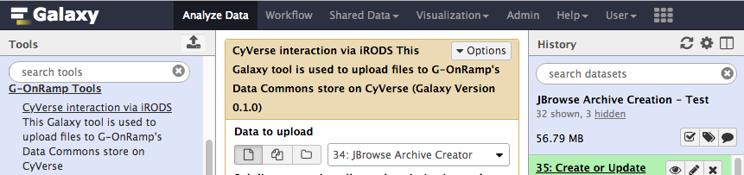
CyVerse: G-OnRamp Integration
G-OnRamp -> CyVerse via iRODS
G-OnRamp uses:
The Integrated Rule-Oriented Data System (iRODS)
  Open-source data management
…by way of a Galaxy tool using a python iRODS client library
Create a hub, apply the tool, fill in parameters, and upload

Slide 14
CyVerse: Sign up!
Get a free account
Signup link:
https://user.cyverse.org/
Note: signing up with an institutional email (*.edu) grants access to Atmosphere, CyVerse’s compute system, but is not necessary to use the Data Store
Discovery Environment (Web-based UI):
https://de.cyverse.org/
Log in with your newly-created credentials to browse your (empty) account and view data shared with the community

