Slide 1
Follow-up from last night: XSEDE credits
https://portal.xsede.org/allocations/startup

Slide 2
Introduction to G-OnRamp
Collaborative Eukaryotic Genome Annotations with Galaxy

Slide 3
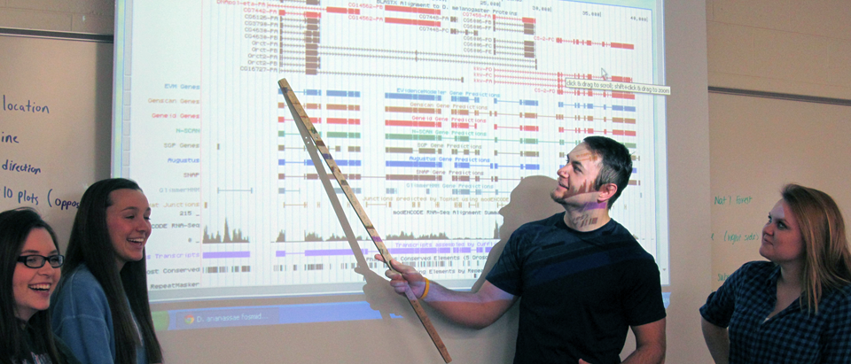
G-OnRamp: Motivations
GEP has shown great success but there are several challenges:
Limited to the analysis of different Drosophila species
Limited flexibility to incorporate other analyses and data into the curriculum
Collaboration is restricted to a central organization

Slide 4
G-OnRamp: GEP + Galaxy
G-OnRamp strengths:
Works with any eukaryotic genomes
Customizable workflows and analyses
Automated installation and configuration of computational tools
Web-based framework with built-in shared objects for collaborative generation, visualization and annotation of data
Reference genome
assembly
Sequence similarity
JBrowse
Archive Creator
Gene prediction
Transcripts / proteins from informant genome
RNA-Seq analysis
Hub Archive Creator
RNA-Seq
reads
Repeats

Slide 5
G-OnRamp: Tools
Sequence similarity
Gene predictions
Create Genome Browser Assembly Hubs
RNA-Seq
Repeats
HISAT
Augustus
Hub Archive Creator
NCBI BLAST+
Tandem Repeats Finder
StringTie
GlimmerHMM
JBrowse Archive Creator
UCSC BLAT
regtools
SNAP

Slide 6
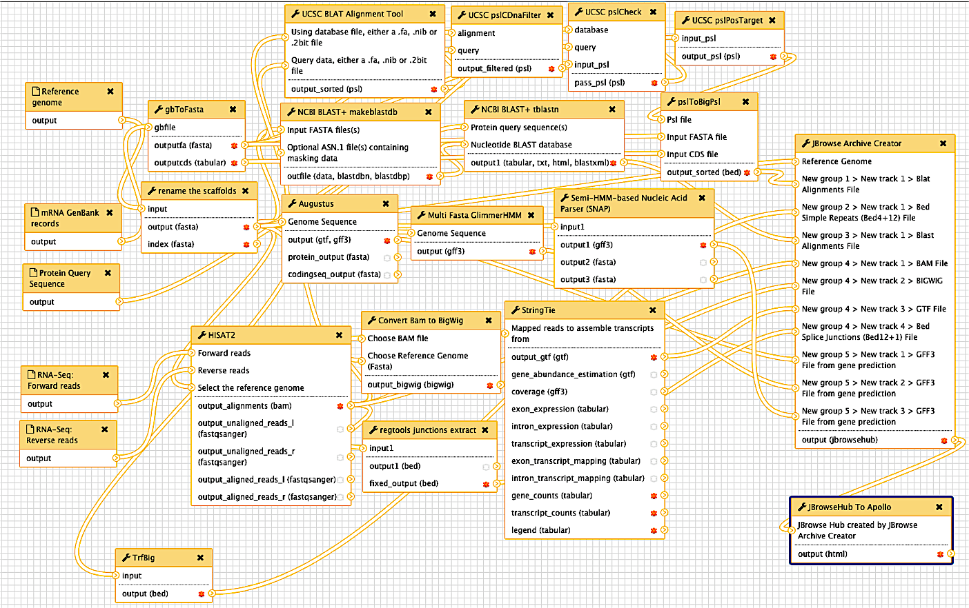
G-OnRamp: Fully Customizable Workflow

Slide 7
G-OnRamp: Sub-Workflows
Sequence Similarity
Input Data
JBrowse Archive Creator
Ab initio Gene Predictions
RNA-Seq
Repeats
JBrowse Archive to Apollo

Slide 8
G-OnRamp: Sub-Workflows
Sequence Similarity
Homologous transcript alignments to reference species mRNA sequences (from GenBank)
Homologous sequence alignment to reference species protein sequences (from UniProt)

Slide 9
G-OnRamp: Sub-Workflows
Repeats
Identifies regions with tandem repeats

Slide 10
G-OnRamp: Sub-Workflows
Align RNA-seq reads, find splice junctions, create coverage plots, and assemble transcripts
RNA-Seq

Slide 11
G-OnRamp: Sub-Workflows
Ab initio Gene Predictions
Gene predictions with Augustus, GlimmerHMM, and SNAP

Slide 12
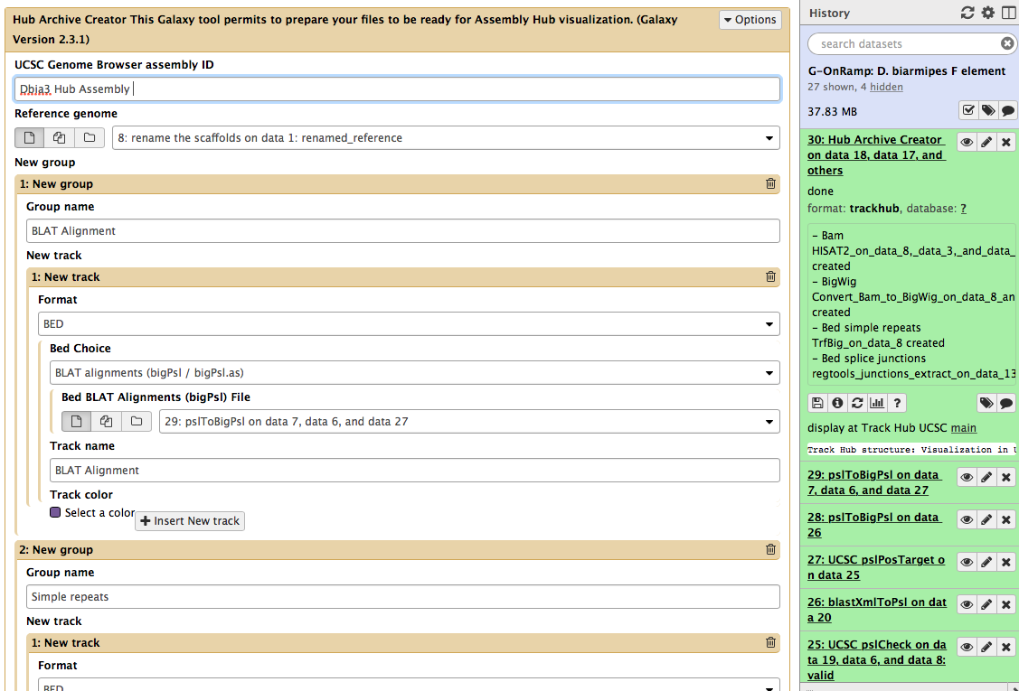
G-OnRamp: Executing Workflows
Specify inputs, tune parameters, and run!

Slide 13
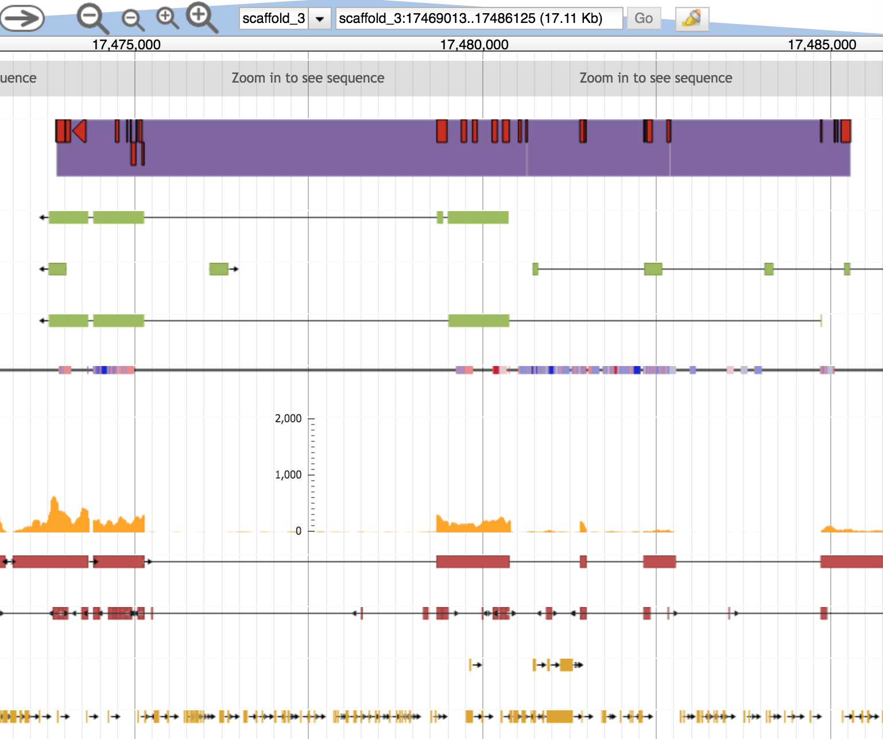
G-OnRamp: Browsing Visualizations
Sequence similarity
• UCSC BLAT
Gene predictions
• Augustus
• GlimmerHMM
• SNAP
RNA-Seq analysis
• HISAT
• StringTie
• regtools
Repeats
• TRF
• WindowMasker
Pictured: evidence tracks on JBrowse

Slide 14
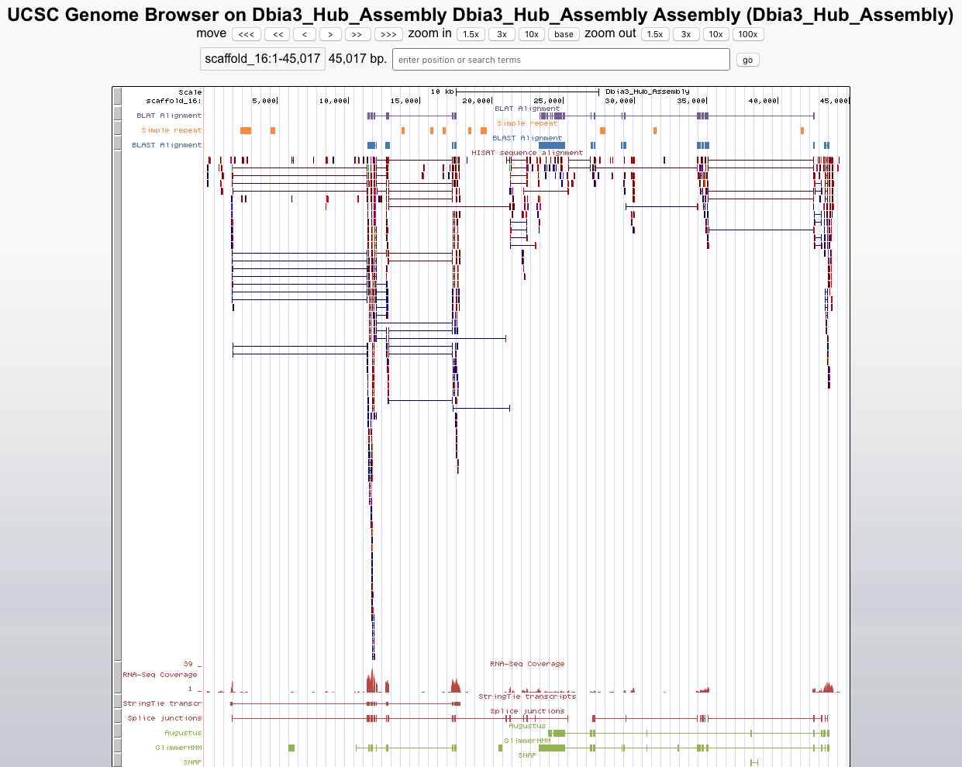
G-OnRamp: Browsing Visualizations
Sequence similarity
Repeats
RNA-Seq analsis
Gene predictions
Pictured: evidence tracks on UCSC Assembly Hub

Slide 15
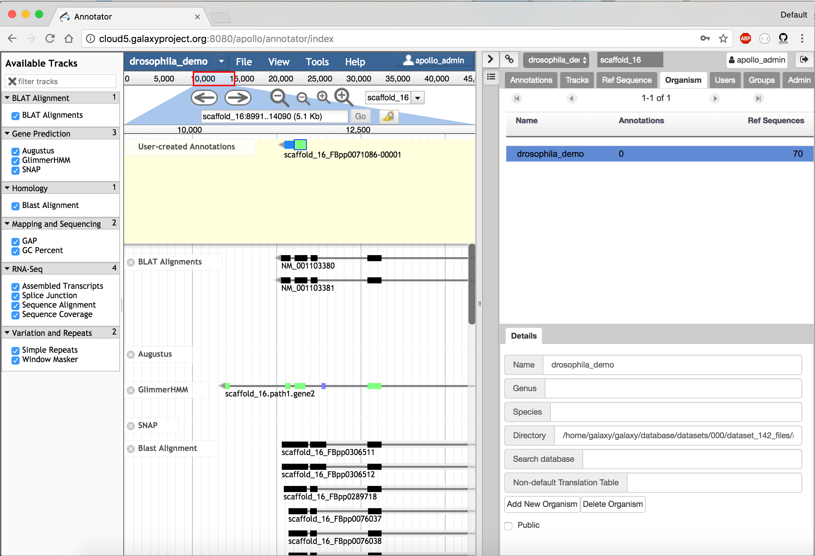
G-OnRamp: Annotations with Apollo

Slide 16
G-OnRamp: Toward Completion
Final round of development and polishing based on workshop feedback
Automated CyVerse interaction for browser data storage and access without the need for Galaxy
Publication of workshop genome browser via CyVerse
Official releases of VM, AMI for everyday use on local computer, cloud
Make complete documentation available online

Slide 17
Up Next:
Introduction to G-OnRamp Walkthrough
Import sample data
Import G-OnRamp workflow
Run workflow to generate results
Visualize results in genome browser(s)

